Slide 1
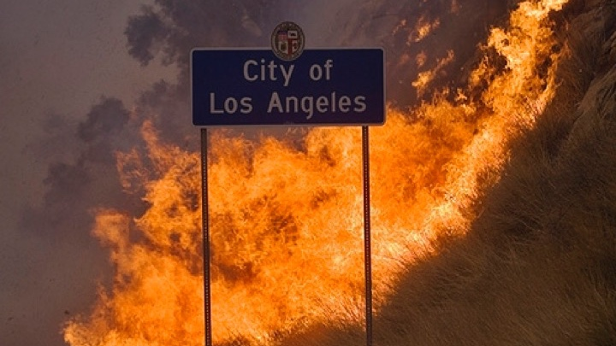
Wildland fire
Santa Monica Mountains National Recreation Area
A Physical Process
Notes:
“The Santa Monica Mountains have one of the most extreme fire climates in the world and periodically burn in large, dramatic wildfires (NPS 2005). Approximately 13% of this fire-prone area is developed, with communities that are among the wealthiest in Los Angeles County and the state of California. Fires in this region are often extremely damaging and costly because of both wildfire suppression costs and property losses, and are usually considered to be major social disasters.
In contrast, biologists have considered fire in the Santa Monica Mountains to be a normal event that maintains the vigor and diversity of its shrubland plant communities. Chaparral is the classic example of an auto-successional cycle where wildfire burns all of the aboveground vegetation and at the same time stimulates the regeneration of the same species that grew there previously from both the soil seed bank and resprouting shoots (Hanes 1971). The observed resilience of chaparral to fire has led to the sometimes uncritical acceptance of the idea that any fire, any time, and any where is good for chaparral. Plants are not adapted to fire per se, but to a specific fire regime defined by the range of variability in fire type, season, size, frequency, and intensity. When the parameters of the fire regime exceed their normal range species can be extirpated, causing shifts in community composition and structure to occur” (Witter, Taylor, & Davis, 2007, p. 173).

Slide 2
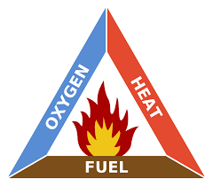
What is fire ?
What is a flame?
An animated video by Ben Ames
https://vimeo.com/40271657
What are the ingredients of a fire?
(Ames, 2012, NPS, n.d.d)
Notes:
Click the link above to watch a 7 minute animated video explaining the science of fire.
This link explains why the video was made: http://www.openculture.com/2012/06/iwhat_is_a_flamei_the_first_prize-winner_at_alan_aldas_science_video_competition.html
“A ‘wildland fire’ is defined as any non-structure fire that occurs in the wildland. This term encompasses fires previously called wildfires, prescribed fires and prescribed natural fires” (NPS, 2006, p. 16).
Fire Triangle: Oxygen, Fuel, and Heat
These three elements make up the fire triangle. Remove any one of them and the fire will not burn.
Heat first comes from the ignition source that in nature is lightning or lava.
Fuel is any material that will burn. Some fuels are more likely to burn than others. For instance, dead trees, leaves, needles and grasses have far less water in them than living ones. Dead plants usually burn sooner and hotter than live ones.
At least 16 percent oxygen must be in the air for a fire to start. The air we breathe has 21 percent oxygen, more than enough to allow a fire to burn. (NPS, n.d.d)

Slide 3
Fire Regime
Wildfire Characteristics & Behaviors
Notes:
“The general temporal and spatial patterns of fire behavior and effects within a particular vegetation type or ecosystem over multiple fire cycles (decades to centuries) determine the fire regime over a specific period for any given ecosystem. Fire regimes are useful for comparing the relative role of fire among ecosystems, for describing the degree of departure from historical conditions, and for projecting the potential effects of management activities, changing climate, or changing ignition patterns” (Sommers, Coloff, & Conrad, 2011, p. 28-29).

Slide 4
fire Regime
This is measured by:
Type
Seasonality
Frequency
Intervals
Severity
Pattern
Size
A geographical area’s fire regime is classified by the patterns of fire over time and space and the effects that it has on the vegetation type or ecosystem of an area over multiple cycles.
(Sommers, Coloff, & Conrad, 2011)
Notes:
“The role fire plays in an ecosystem varies with the characteristics under which the ecosystem evolved. This role is the third concept of fire ecology--fire regime.
The interactions of humidity, fuels, and ignition sources will determine the fire regime for a particular land area” (NPS, n.d.b).

Slide 5
fire Regime
Fire Type:
What type of fires do you think we have in Southern California shrublands?
Ground Fire
Surface Fire
Understory or Sub-Canopy Fire
Crown Fire
Stand Replacement Fire
Mixed-Severity Fire
Fires in Shrublands & Chaparral are Crown Fires & Stand-Replacing Fires.
(Sommers, Coloff, & Conrad, 2011, p. 29).
Notes:
Types of fires: (Continue to next slide for Crown Fire and Stand-replacing fire definition)
Ground fire: A fire that burns in surface organic materials such as peat or deep duff layers. Ground fires typically undergo a large amount of smoldering combustion and less active flaming than other types of fires. They may kill roots of overstory species because of prolonged high temperatures in the rooting zone.
Surface fire: Fires that burn only the lowest vegetation layer, which may be composed of grasses, herbs, low shrubs, mosses, or lichens. In forests, woodlands, or savannas surface fires are generally low to moderate severity and do not cause extensive mortality in the overstory vegetation.
Understory or sub-canopy fire: A fire that burns trees or tall shrubs under the main canopy. Depending on structure, this may also be called a surface fire.
Mixed-severity fire: The severity of fires varies between nonlethal understory and lethal stand replacement fire with the variation occurring in space or time. In some vegetation types the stage of succession, the understory vegetation structure, the fuel condition and/or the weather may determine whether a low or high-severity (or surface or crown) fire occurs. In this case individual fires vary over time between low-intensity surface fires and longer-interval stand replacement fires. In others, the severity may vary spatially as a function of landscape complexity or vegetation pattern. The result may be a mosaic of young, older, and multiple-aged vegetation patches. (Sommers, Coloff, & Conrad, 2011, p. 29)

Slide 6
fire Regime
Fires in Shrublands & Chaparral:
Stand-Replacing Fires:
“A fire that is lethal to most of the dominant above ground vegetation and substantially changes the vegetation structure. Stand replacement fires may occur in forests, woodlands and savannas, annual grasslands, and shrublands. They may be crown fires or high-severity surface fires or ground fires” (Sommers, Coloff, & Conrad, 2011, p. 29).
Crown Fires:
“A fire that burns through the upper tree or shrub canopy. In most cases the understory vegetation is also burned. Depending on species, a crown fire may or may not be lethal to all dominant vegetation. An example of this would be many shrub and broadleaf tree species that sprout from roots, root crowns or stem bases after their tops are killed. A crown fire may be continuous or may occur in patches within a lower severity burn” (Sommers, Coloff, & Conrad, 2011, p. 29).
Notes:
Fires in shrubland vegetation like Chaparral fare almost always high intensity stand-replacing crown fires that destroy everything. (Litman, 2013, p. 4; Witter, Taylor, & Davis, 2007, p. 174).

Slide 7
fire Regime
Fire Seasonality
Fire Frequency
Fire Return Intervals
Fire seasons are the period of time that fires typically occur or that they are likely to be of high intensity or burn large areas of land.
The period of time between fires within a given area in a specific period of time.
The number of fires within a given area in a specific period of time.
(Platt, Orzell, & Slocum, 2015; Sommers, Coloff, & Conrad, 2011, p. 29; Witter, Taylor, & Davis, 2007, p. 176).
Notes:
Fire season for Southern California can be year round with fires peaking from September through December.
Season Matters
“Though a wildfire can happen anytime the conditions are right, the time of year influences the effects of fire. For example, wildland fire season in the western United States is June through October, while March through May is the fire season in the southeastern United States. Most fires in the New England states occur in late fall. During some seasons, more moisture is present than in other seasons, thus reducing fire threat. This varies by geographic region” (NPS, n.d.c).
Fire Frequency in the Santa Monica Mountains:
Fire frequency has increased in the Santa Monica Mountains over the last 75 years. The total area burned per decade has also generally increased. Both of these trends are attributed to increased ignitions due to urbanization and increased population size (Keeley and
Fotheringham 2001). (Witter, Taylor, & Davis, 2007, p. 176)
Fire Return Intervals in the Santa Monica Mountains:
“The average between-fire interval for all natural areas in the Santa Monica Mountains from 1925 to 2001 was 32 years. This statistic expresses the average time between fires for any set of randomly determined locations in the area. The fire return interval within the Santa Monica Mountains is widely variable because there are both high fire frequency areas that have burned numerous times in the 80 years of record keeping and areas that have never burned in that period. This creates a complex mosaic of fire history across the landscape” (Witter, Taylor, & Davis, 2007, p. 176).
“The current fire return interval of 28 years is far shorter than the estimated natural fire return interval of approximately 70-100 years. The ecological perturbations related to fire in the Santa Monica Mountains are not from an insufficient amount of fire required in a fire-dependent ecosystem, but from fire occurring at such a high frequency that it can exceed the ability of the ecosystem to recover normally” (NPS, 2018).

Slide 8
fire Regime
Fire Severity
Fire Pattern
Fire Size
A qualitative measure of the immediate effects of fire on the ecosystem. It relates to the extent of mortality and survival of plant and animal life both above ground and below ground and to loss of organic matter.
The size of a wildfire.
Large fires are considered greater than 10,000 acres.
The burned pattern in an area. This can be affected by wind and fuels available to burn.
(Witter, Taylor, & Davis, 2007, p. 176; Wooten, n.d.)
Notes:
Fire Pattern in the Santa Monica Mountains
“Fire spread patterns are strongly influenced by topography and the direction of the prevailing winds during Santa Ana conditions. There is often an east-west spread as fires travel from north to south approaching the coast and are released from the confines of steep north-south mountain canyons and unidirectional winds (Radtke et al.,1982) The east-west spread of fires on the coastal slope may account for the increased fire frequency in this area, as different fires overlap” (Witter, Taylor, & Davis, 2007, p. 176-180).
Fire Size
“Large fires (greater than 10,000 acres) are responsible for nearly all of the area burned in the Santa Monica Mountains. The largest 1% of fires has caused 25% of the total burned area and the largest 10% have caused 86% of the total burned area. This is consistent with data from the rest of southern California, where the number of large fires has not increased since modern fire suppression began and therefore cannot be a function of increased fuel accumulation (Keeley et al., 1999). Although the wildfire size distribution in the Santa Monica Mountains has remained largely stable over time, the trend in average fire size has declined very slightly from 1925 to the present (Schoenberg et al., 2003)” (Witter, Taylor, & Davis, 2007, p. 176).

Slide 9
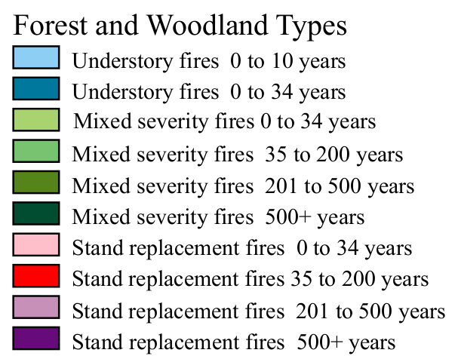
Historic fire Regimes in the United States
(Image: Jim Menakis; Brown & Smith, 2000, p. 7)
Notes:
Here’s what presumed historic fire regimes look like across the USA. There are many different ones. We need to be careful about applying principles and lessons learned from one fire regime to others where different climate, ignition sources, seasonality of fires, fire behavior, or fire effects are different. For example, spring burns of midwestern prairies generally have a lot of resource benefits for native plant communities, but spring burns in southern CA shrublands are incredibly damaging. (Taylor, n.d.)
Image: Fire regime types based on Kuchler’s Potential Natural Vegetation types (prepared by Jim Menakis) (Brown & Smith, 2000, p. 7)

Slide 10
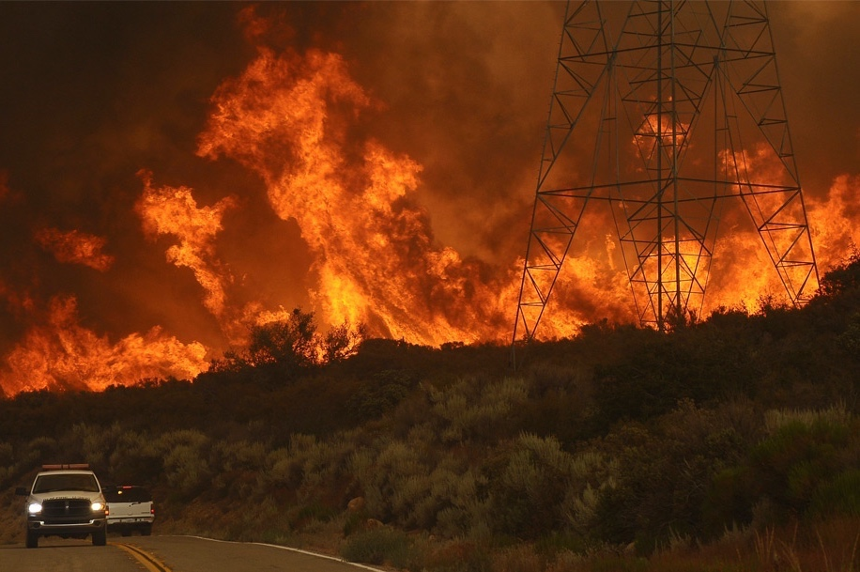
What is the Fire Regime for Southern California in Shrublands?
High-severity, stand-replacing crown fires that occur mostly in the fall with a historic fire interval of between 70-100 years*.
(Photo: NPS; Taylor, n.d.)
(Litman, 2013, p. 4; NPS, 2018; Witter, Taylor, & Davis, 2007)
Notes:
“Stand-replacement fire regime (applies to forests, woodlands, shrublands, and grasslands)— Fires kill aboveground parts of the dominant vegetation, changing the aboveground structure substantially. Approximately 80 percent or more of the aboveground dominant vegetation is either consumed or dies as a result of fires” (Brown & Smith, 2000, p. 5).
* This number varies based on the source of information. Santa Monica Mountains historic range: approximately 70-100 years with a current interval of 28 years (NPS, 2018)

Slide 11
What affects wildland fire behavior?
Notes:
Students: Think about the causes of wildland fire behavior? What makes it burn hotter, faster, slower? What direction is it burning?

Slide 12
Wildland Fire Behavior Triangle
Weather, Topography, and Fuels are all variables that affect how a wildfire behaves.
Weather
Fuels
Topography
(NPS, n.d.c)
Notes:
Just like there is a fire triangle, made up of heat, oxygen, and fuel, there is another triangle called the fire behavior triangle. The three legs of this triangle are fuels, weather, and topography. (NPS, n.d.c)

Slide 13
fuels
Wildland Fire Behavior Triangle

Slide 14
Fuels
What is a fuel?
Fuel Characteristics
Fuels are all living and dead plant material that can be ignited by a fire.
Fuel characteristics strongly influence fire behavior and the resulting fire effects on ecosystems.
Fuel Moisture Level
Chemical Makeup
Density
(Photo: Bethany Szczepanski)
Patches of Chaparral and Oak Woodlands with non-native grasses. Any of this can be considered “fuel.”
(NPS, n.d.b)
Notes:
“A fuel’s composition, including moisture level, chemical makeup, and density, determines its degree of flammability” (NPS, n.d.c).
“Chaparral—Generally, fuels are not as easily ignited as grass fuels, but once ignited will burn readily if conditions are right. Plant density can vary with site, and sometimes with species. This is but one factor that affects fuel continuity in a stand.
Another factor is the basic within-plant geometry that varies by species. Geometry and arrangement of the woody fuel portion and the leaves of chaparral plants are key to understanding the ability of chaparral stands to propagate fire. The woody fuel inside a given shrub varies in size class ranging from fine fuel (<0.12 inch diameter) to heavy fuel (3 or 4 inches and larger in the case of some manzanita species). The arrangement and distribution of these size classes within a shrub varies by species. Two extremes illustrate this: the arrangement of the woody portions of chamise and manzanita species. The smaller woody size classes are quite dominant in chamise and tend to be in proximity throughout the crown; the opposite is true for manzanita. The leaves of chamise are small and needlelike and are often relatively dense on a given twig. Manzanita is a broadleaf shrub. The leaves of some species are relatively sparse— being held distant from each other by the woody structure of the shrub. Other species of manzanita have dense clusters of leaves— so dense that their thick sclerophyllous structures act like an insulator.
With few exceptions, fully developed stands of chaparral have no understory layer of vegetation, and therefore no potential for the “ ladder effect” to propagate fire. However, when a litter layer exists, which occurs under gentle slope conditions, it can significantly aid fire spread under marginal burning conditions. In this situation, fuel moisture content becomes an important factor” (Brown & Smith, 2000, p. 148-149).
Photo: Santa Cruz Island, Prisoner’s Harbor – Patches of Chaparral and Oak Woodlands with non-native grasses. Any of this can be considered “fuel.”

Slide 15
fuel Characteristics
Fuel Moisture Level
Chemical Makeup
Density
Fuel moisture is a measure of the amount of water in a fuel (vegetation) available to a fire, and is expressed as a percent of the dry weight of that specific fuel.
A plant’s chemical makeup will determine how readily it will burn.
The density of fuel influences its flammability.
Chaparral is a very dense plant community.
Giant Coreopsis with declining fuel moisture
National Fuel Moisture Database
(Photo: Bethany Szczepanski)
(NOAA, n.d.;; NPS, n.d.c Witter, Taylor, & Davis, 2007)
Notes:
Moisture Level
“Moisture level is the most important consideration. Live trees usually contain a great deal of moisture and dead logs contain very little. The moisture content and distribution of these fuels define how quickly a fire can spread and how intense or hot a fire may become.”
“High moisture content will slow the burning process, because heat from the fire must first eliminate moisture.” (NPS, n.d.c)
Click the link in the slide to visit the National Fuel Moisture Database from the Wildland Fire Assessment System. Zoom in on the area you live and click on a study to look at fuel moisture levels.
More on Moisture Level from NOAA:
“The fuel moisture index is a tool that is widely used to understand the fire potential for locations across the country. Fuel moisture is a measure of the amount of water in a fuel (vegetation) available to a fire, and is expressed as a percent of the dry weight of that specific fuel. For example, if a fuel were totally dry, the fuel moisture content would be zero percent. Fuel moisture is dependent upon both environmental conditions (such as weather, local topography, and length of day) and vegetation characteristics.
When fuel moisture content is high, fires do not ignite readily, or at all, because heat energy has to be used to evaporate and drive water from the plant before it can burn.
When the fuel moisture content is low, fires start easily and will spread rapidly - all of the heat energy goes directly into the burning flame itself.
When the fuel moisture content is less than 30 percent, that fuel is essentially considered to be dead. Dead fuels respond solely to current environmental conditions and are critical in determining fire potential. The dead fuel moisture threshold (10–hour, 100–hour, or 1,000–hour), called a time lag, is based upon how long it would take for 2/3 of the dead fuel to respond to atmospheric moisture.
Small fuels (less than 1/4 inch in diameter), such as grass, leaves, and mulch respond more quickly to changes in the atmospheric moisture content, and take 10 hours to adjust to moist/dry conditions. Larger fuels lose or gain moisture less rapidly through time. Fuels that are 3 inches to 8 inches in diameter, such as dead fallen trees and brush piles can take up to 1,000 hours to adjust to moist conditions, and are represented by the 1,000–hour dead fuel moisture index. 1,000+ hour fuels do not burn easily, but if they do burn, they will generate extreme heat often causing dangerous fire behavior conditions” (NOAA, n.d.).
“By the middle of fall in Southern California, live fuel moisture is critically low” (Witter, Taylor, & Davis, 2007, p. 174).
Chemical Makeup
“A fuel’s chemical makeup determines how readily it will burn. Some plants, shrubs, and trees contain oils or resins that promote combustion, causing them to burn more easily, quickly, or intensely than those without such oils.” (NPS, n.d.c)
Some chaparral plants do contain aromatic chemicals however, this is not the reason they burn. The California Chaparral Institute explains:
Myth: Chaparral plant species are NOT "oozing combustible resins" or "born" to burn.
“Such comments are frequently seen in articles about fires in chaparral, giving the impression that the reason chaparral shrubs are so flammable is primarily due to the presence of flammable chemicals, waxes, or oils in their leaves and stems. While it is true some chaparral plant species (and many other drought-tolerant plants including pines) have aromatic chemicals within their tissues, this does not mean that's why they ignite or burn so hot when they do. Chaparral plants ignite and burn hot when the environmental conditions are right, namely high temperature, low humidity, and low fuel moistures (the amount of moisture in the plant). In addition, the leaves and stems on many chaparral shrubs are quite small, creating perfect burning conditions - a lot of surface area and space for oxygen. Chaparral shrubs burn so easily because they provide fine, dry fuels during drought conditions. While plant chemicals are certainly involved in the burning process, they do not really make a significant contribution to the flammability of chaparral in general. This also explains why it is usually quite difficult to get chaparral to burn in the spring. There's too much moisture in the plants. If "oozing combustible resins” were the main cause of flammability, chaparral would burn easily during any season” (CCI, n.d.).
Density
“Density of a fuel influences its flammability. If fuel particles are close together, they will ignite each other, causing the fuel to burn readily. But if fuel particles are so close that air cannot circulate easily, the fuel will not burn freely.” (NPS, n.d.c)
“The dominant vegetation types [in the Santa Monica Mountains] are chaparral (55%) and coastal sage scrub (20%) which are particularly good fire fuels because of their high density and continuity, small twig and stem size, and the large proportion of dead biomass” (Witter, Taylor, & Davis, 2007, p. 174).
Fuel characteristics in the Santa Monica Mountains:
“Shrubland vegetation is continuous and is composed of small diameter twigs and stems with high surface area to volume ratio. These dry quickly and ignite rapidly. One third to one half of the plant matter is dead . With no water in dead stems, it takes less energy to start burning. The erect shrub architecture allows air to flow through the vegetation, increasing the fire intensity and rate of spread” (Witter, 2010).

Slide 16
Weather
Wildland Fire Behavior Triangle

Slide 17
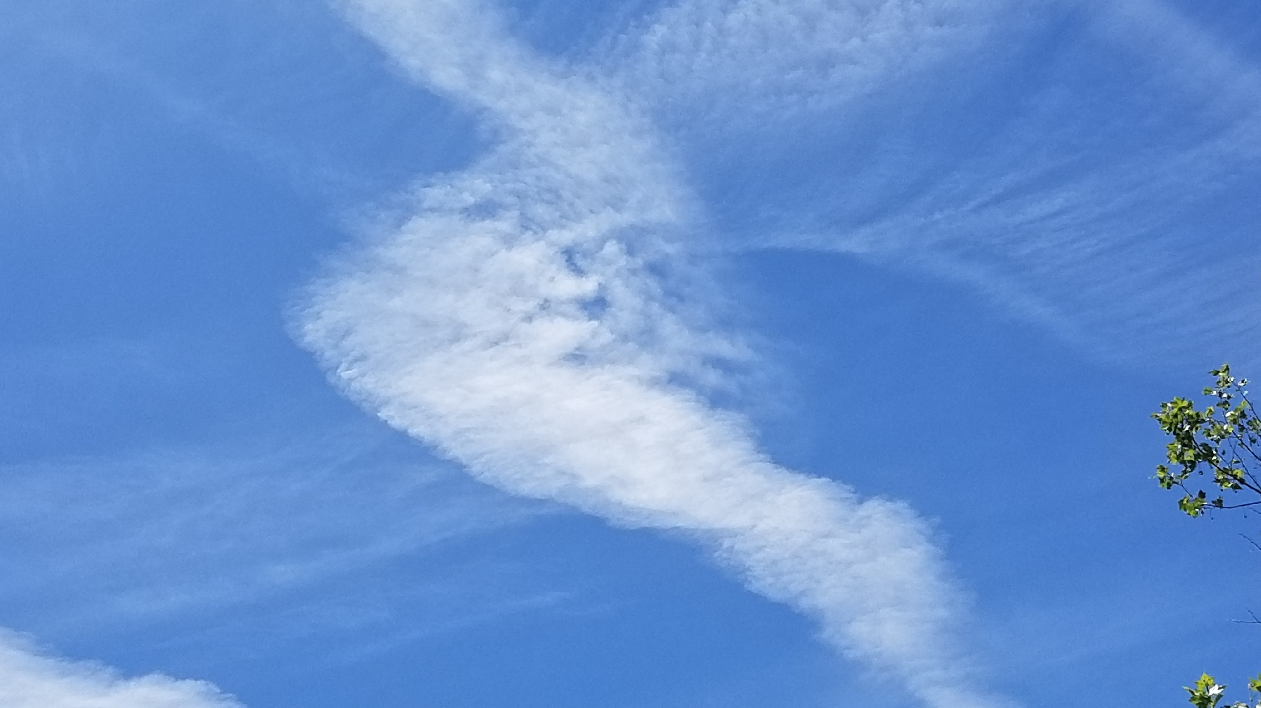
Weather conditions that contribute to fire behavior:
Temperature & Climate
Santa Ana Winds
Humidity
(Photo: Bethany Szczepanski)

Slide 18
Temperature & Climate
Climate
Temperature
The statistics of weather over long periods of time determined by temperature and rainfall.
The temperature of a fuel and their moisture level is determined by the surrounding air temperature.
At higher temperatures, fuels are more likely to ignite.
Hot temperatures lead to hot & dry fuels
(Witter, Taylor, & Davis, 2007; Photo: Bethany Szczepanski)
Notes:
Climate: the statistics of weather over long periods of time.
Determined by temperature and rainfall, climate impacts ecosystems and is one way of distinguishing biomes.
Rainfall in Santa Monica Mountains:
“The average annual rainfall is 430 mm/year, and falls predominantly between November and March with an extended dry season from May to October” (Witter, Taylor, & Davis, 2007, p. 174).
“Temperature of fuels is determined by the ambient temperature because fuels attain their heat by absorbing surrounding solar radiation. The temperature of a fuel influences its susceptibility to ignition. In general, fuels will ignite more readily at high temperatures than at low temperatures” (NPS, n.d.c).

Slide 19
What is the fire climate in Southern California?
Notes:
Fire Climate-The long-term weather pattern that determines the fire weather and the length of the fire season.

Slide 20
What is the fire climate in Southern California?
Number of fires per month & Area burned per month 1925-2005
Compare this graph with the next two slides to assess the fire climate.
How do they all relate?
(Witter, Taylor, & Davis, 2007; Taylor, n.d.)
Notes:
Assess the area burned and number of fires and when they occur in Southern California.

Slide 21
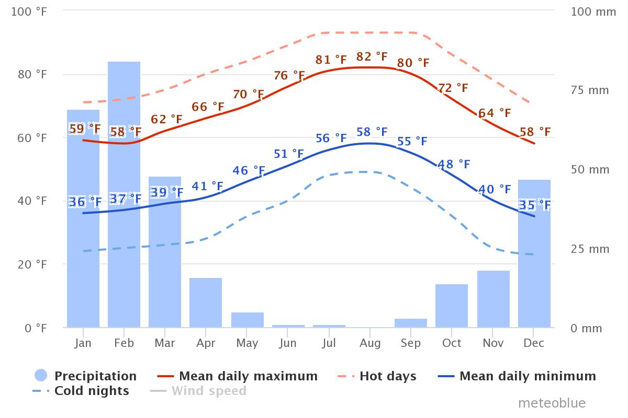
What is the fire climate in Southern California?
Average Climate Santa Monica Mountains December 1988- December 2018
Temperature (Fahrenheit)
Rainfall (Millimeters)
How does the temperature and rainfall correspond to the previous graph?
How does it correspond to the next graph?
(Meteoblue, 2018; Witter, Taylor, & Davis, 2007)
Notes:
Assess the long term climate data, how does the temperature and rainfall relate to the area burned?
The "mean daily maximum" (solid red line) shows the maximum temperature of an average day for every month for Santa Monica Mountains. Likewise, "mean daily minimum" (solid blue line) shows the average minimum temperature. Hot days and cold nights (dashed red and blue lines) show the average of the hottest day and coldest night of each month of the last 30 years as of 12/15/18.
For updated climate info: https://www.meteoblue.com/en/weather/forecast/modelclimate/santa-monica-mountains_united-states-of-america_5393231

Slide 22
What is the fire climate in Southern California?
How does the live fuel moisture correspond to the temperature, rainfall, and fire season?
(Witter, Taylor, & Davis, 2007; Taylor, n.d.)
Notes:
Assess the live fuel moisture, how does it relate to the climate and area burned?
A year’s weather patterns create patterns in live fuel moisture. Live Fuel Moisture affects fire behavior. Ignitions begin as early in spring as fuels begin to dry out. They ramp up in summer when it gets really dry and in fall Santa Ana winds kick in and fires can increase 10-50 thousand-fold in size. 50% of all acres that burn do so in month of October. (Taylor, n.d.)

Slide 23
Look at them all together. What are the trends?
Average Climate Santa Monica Mountains December 1988- December 2018
Temperature (Fahrenheit)
Rainfall (Millimeters)
(Meteoblue, 2018; Taylor, n.d.; Witter, Taylor, & Davis, 2007)
Notes:
“This combination of vegetation and climate make the Santa Monica Mountains, and Southern California in general, one of the world’s most severe fire climates” (Witter, Taylor, & Davis, 2007, p. 174).

Slide 24
Santa Ana Winds
“In autumn, after months with no rain, shrublands are at their driest and most fire prone.”
“Unfortunately, this is also the season for the Santa Ana Winds. Sometimes called the ‘devil winds,’ Santa Anas are a major cause of extreme wildfire behavior in southern California.”
“These winds originate over the Great Basin or Mohave Desert and flow downhill to the coast, becoming hotter and drier as they go; relative humidity may drop to 10 percent or below. Santa Ana winds can reach high speeds, up to 100 mph in some cases, especially in mountain passes and canyons, fanning the flames and sending wildfires out of control.”
(Image: Litman, 2013, p. 4)
(Litman, 2013, p. 4).
Notes:
“Wind is one of the most important factors because it can bring a fresh supply of oxygen to the fire and push the fire toward a new fuel source” (NPS, n.d.c).
Winds in the Santa Monica Mountains:
“Seasonal föehn winds (Santa Anas), averaging 30-50 kph, occur mostly in the fall months at the end of the dry season and are often associated with high temperatures and low humidity. The Santa Ana winds, which blow predominantly from the north or northeast, are funneled through the north-south canyons of the mountains” (Witter, Taylor, & Davis, 2007, p. 174).

Slide 25
Santa Anas, Drought, & Fire Relation
(Taylor, n.d.)
Notes:
We have a combination of dry winds and seasonal drought that make for a handful of terrible fire weather days every year. This creates consistent annual conditions for wildfires with really extreme behavior. Frequency and strength of Santa Ana wind events ramps up steadily from Sept through Dec while the drought index begins to fall. When the drought index falls below about 400, wildfires pretty much stop happening. Note that Although Santa Ana winds peak in Dec-Jan, fire activity peaks in Oct and declines through Nov and Dec. (Taylor, n.d.)
“Large fires are more likely to occur during and after droughts (Davis and Michaelsen, 1995). Fire-climate modeling predicts that relatively small increases in frequency and duration of droughts produces substantial increases in area burned by wildfires. Current forecasts for future climate in southern California predict that rainfall will become more variable, with more droughts and more floods. We can expect our current Mediterranean-type fire regime to continue for the foreseeable future, but with a greater frequency of conditions for wildfires as the number and duration of droughts increase” (NPS, n.d.a).

Slide 26
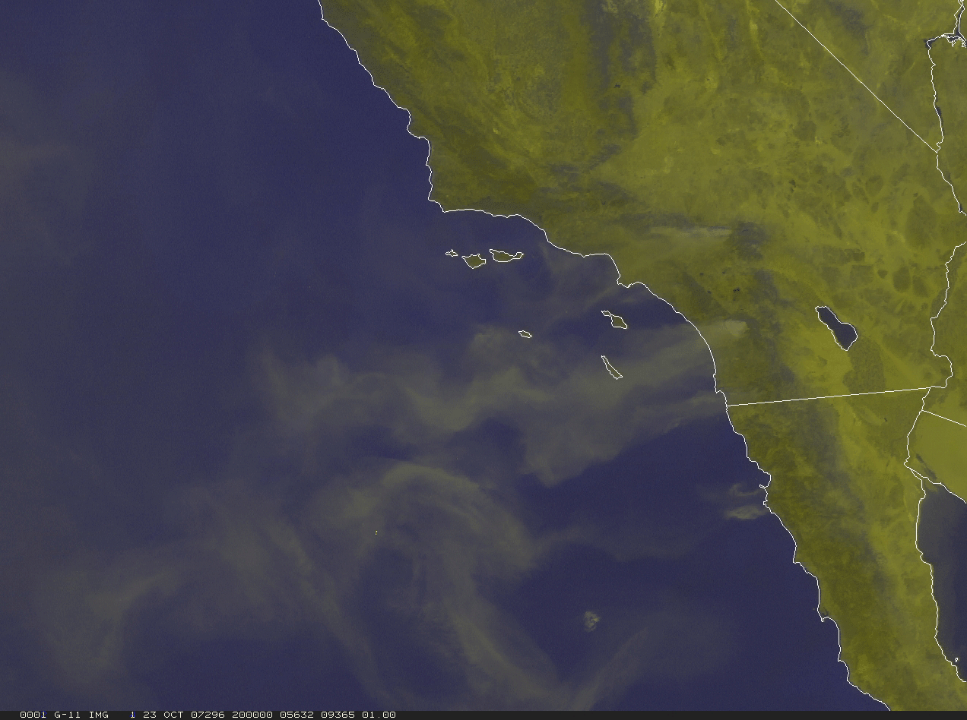
Smoke being blown out to sea by Santa Ana Winds
September 23, 2007 Fires
There are often several fires at once across the region.
(Image: Robert Taylor; Taylor, n.d.)
Notes:
Put some smoke in the air and you can see the Santa Ana winds that make our fire regime one of the most extreme on Earth. We often get several fires at once and have big firestorms across the region. The view from space on Sept 23, 2007 looks kind of peaceful with wisps of smoke wafting lazily across the landscape looking a lot like the smoke from a candle you just blew out. (Taylor, n.d.)

Slide 27
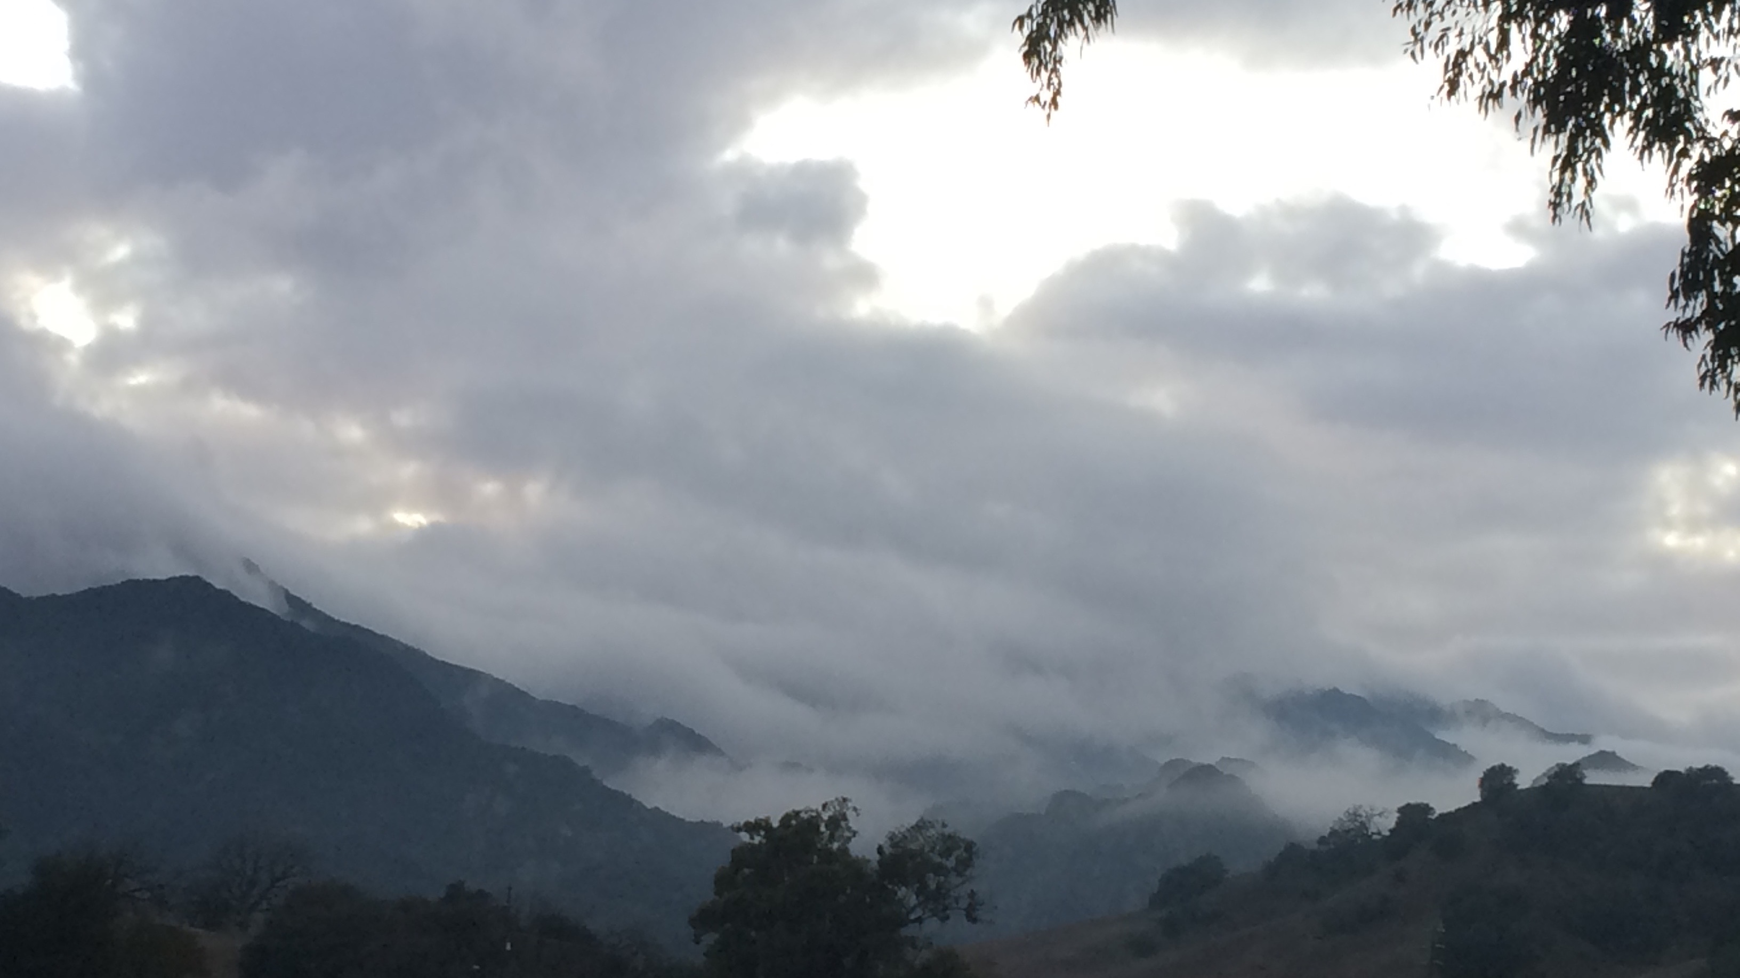
Humidity
The amount of water vapor in the air will affect the level of moisture in a fuel.
If the humidity level is low, fuels will become dry and will catch fire more easily than when humidity is higher.
(Photo: Bethany Szczepanski) Santa Monica Mountains Fog
(NPS, n.d.b)
Notes:
“Humidity, the amount of water vapor in the air, affects the moisture level of a fuel. At low humidity levels, fuels become dry and, therefore, catch fire more easily and burn more quickly than when humidity levels are high” (NPS, n.d.c).

Slide 28
Topography
Wildland Fire Behavior Triangle

Slide 29
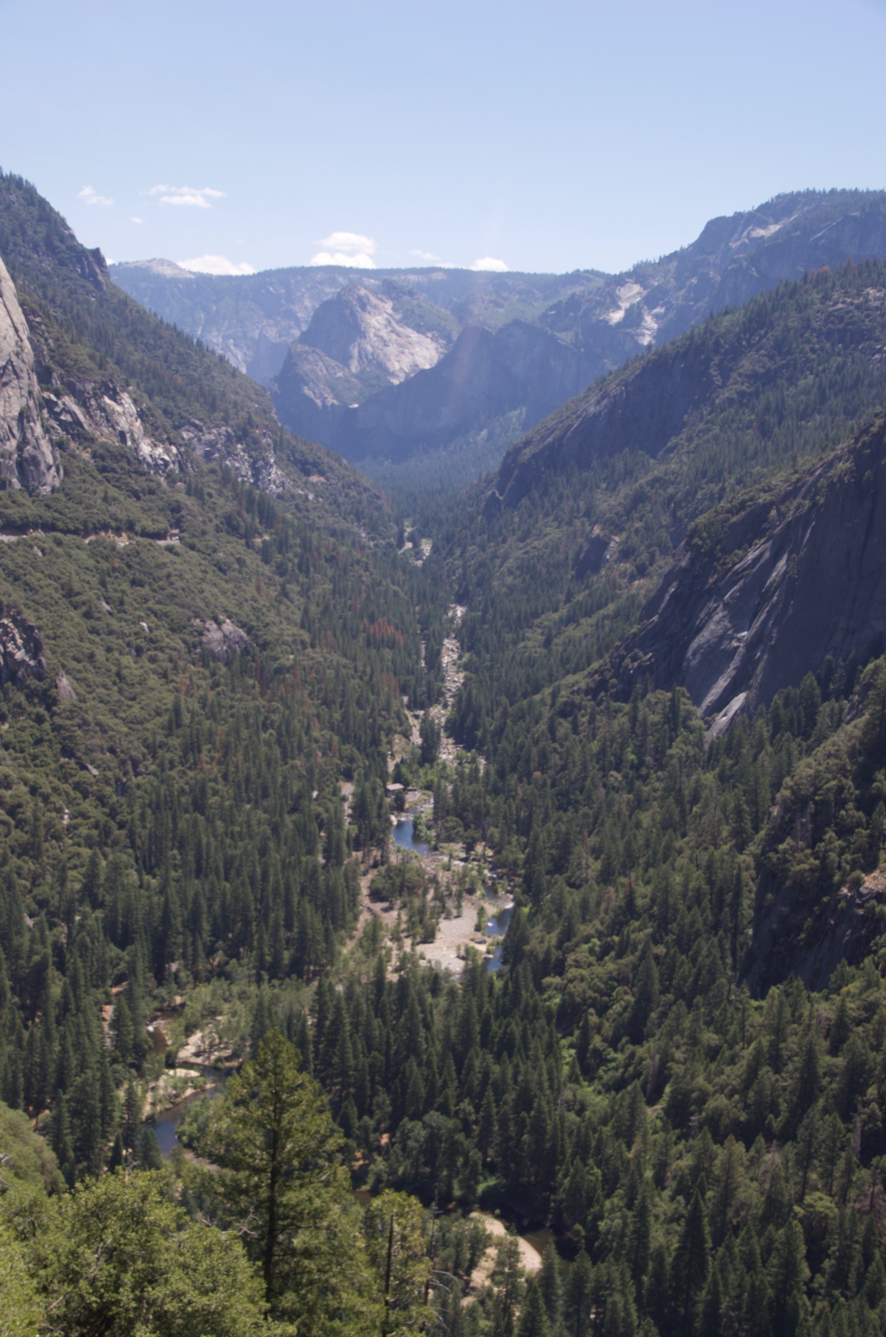
Topography
Topography can have an influence on how a fire behaves.
It will typically move more quickly uphill than downhill or than on flat terrain.
Yosemite National Park
(Photo: Bethany Szczepanski)
(NPS, n.d.c)
Notes:
“Topography describes land shape. It can include descriptions of elevation with the height above sea level; slope, the steepness of the land; aspect, the direction a slope faces (e.g., the south side of a canyon will have a north-facing slope); features, such as canyons, valleys, rivers, etc.
These topographical features can help or hinder the spread of fire.
For example, a rocky slope can act as a great natural fire break due to a lack of fuel and wide gap of open space. Drainages can act as fire breaks, as well if fuels are moist or there is little vegetation.
Beyond the shape of the land, it is also important to consider elevation, slope, and aspect. Elevation and aspect can determine how hot and dry a given area will be. For example, higher elevations will be drier but colder than low ones, and a north-facing slope will be slower to heat up or dry out). Slope can determine how quickly a fire will move up or down hills. For example, if a fire ignites at the bottom of a steep slope, it will spread much more quickly upwards because it can pre-heat the upcoming fuels with rising hot air, and upward drafts are more likely to create spot fires.” (NPS, n.d.c)

Slide 30
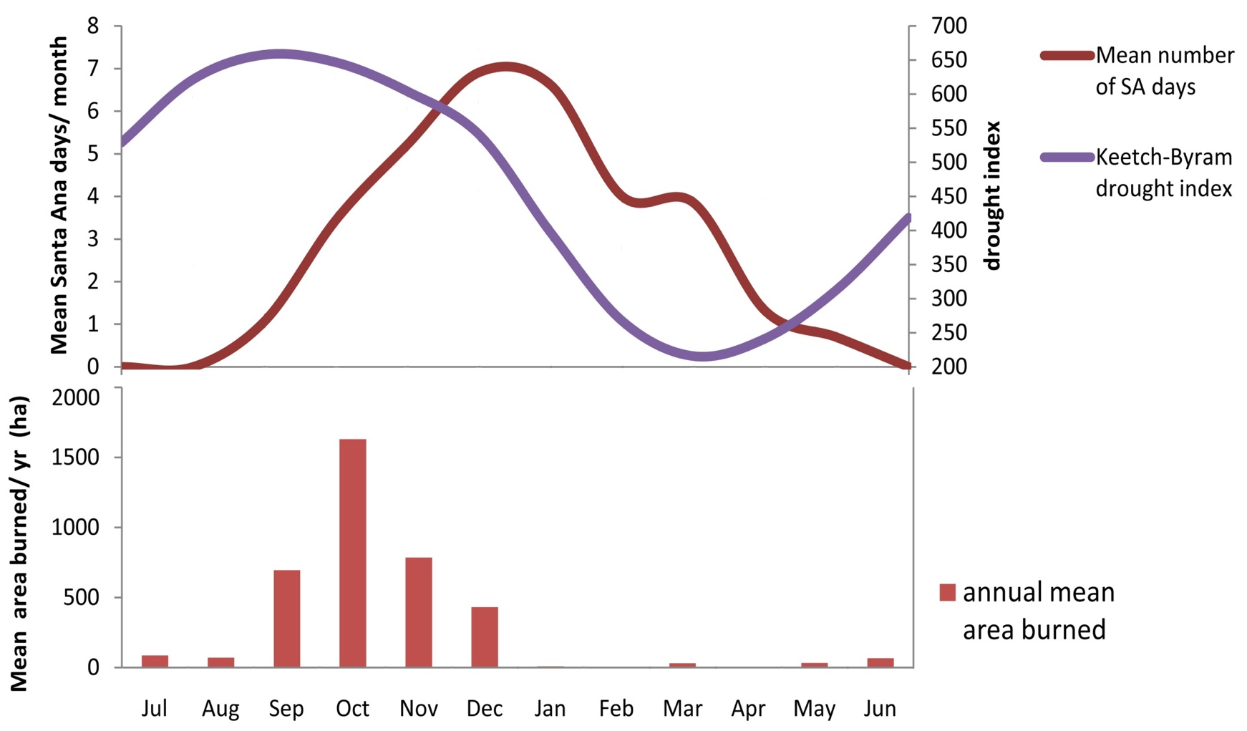
Questions for thought
Average Climate Santa Monica Mountains December 1988- December 2018
Fuels, Weather, Climate, Winds, Humidity, Topography
Think about all of these variables together and answer the questions:
Temperature (Fahrenheit)
Rainfall (Millimeters)
Why do we have fires in Southern California?
Why does Southern California have a high-severity, stand-replacing crown fire regime?
Notes:
Thank you for learning about Wildland Fire: A Physical Process. To continue your journey into Santa Monica Mountains National Recreation Area: Fire Ecology continue on to the Wildland Fire in the Santa Monica Mountains unit.

Slide 31
References
Ames, B. J. (2012). What is a flame [Streaming Video]. Retrieved from https://vimeo.com/40271657.
Brown, J. K., & Smith, J. K. (Eds.). (2000). Wildland fire in ecosystems (Gen. Tech. Rep. RMRS-GTR-42-vol. 2). Department of Agriculture, Forest Service, Rocky Mountain Research Station.
California Chaparral Institute (CCI). (n.d.). Chaparral myths. Retrieved April 16, 2018, from http://www.californiachaparral.com/chaparralmyths.html
Hanes, T. L. (1971). Succession after fire in the chaparral of southern California. Ecological Monographs,41(1), 27-52. doi:10.2307/1942434
Keeley, J. E., Fotheringham, C. J., & Morais, M. (1999). Reexamining fire suppression impacts on brushland fire regimes. Science,284(5421), 1829-1832. doi:10.1126/science.284.5421.1829
Keeley, J.E., Fotheringham, C.J. (2001). Historic fire regime in southern California shrublands. Conservation Biology, 15 (6):1536-1548.
Meteoblue. (2018). Climate Santa Monica Mountains. Retrieved December 15, 2018, from https://www.meteoblue.com/en/weather/forecast/modelclimate/santa-monica-mountains_united-states-of-america_5393231
National Oceanic and Atmospheric Administration (NOAA). (n.d.). Did you know: Dead fuel moisture. Retrieved April 15, 2018, from https://www.ncdc.noaa.gov/monitoring-references/dyk/deadfuelmoisture
National Park Service (NPS). (n.d.a). Fire regime/history. Retrieved April 09, 2018, from https://www.nps.gov/samo/learn/management/firehistory.htm
National Park Service (NPS). (n.d.b). Learning about Fire Ecology Basics. Retrieved January 29, 2018, from https://www.nps.gov/articles/learning-about-fire-ecology-basics.htm
National Park Service (NPS). (n.d.c). Wildland Fire Behavior. Retrieved January 29, 2018, from https://www.nps.gov/articles/wildland-fire-behavior.htm
National Park Service (NPS). (n.d.d). Wildland Fire Facts: There Must Be All Three (U.S. National Park Service). Retrieved March 15, 2018, from https://www.nps.gov/articles/wildlandfire-facts-fuel-heat-oxygen.htm
National Park Service (NPS). (2006, March 6). Santa Monica Mountains National Recreation Area Fire Management Plan(United States, National Park Service, Santa Monica Mountains National Recreation Area). Retrieved May 8, 2018, from https://www.nps.gov/samo/learn/management/upload/SAMO_FMP_Review_Final_2012.pdf
National Park Service (NPS). (2018). Fire ecology. Retrieved April 22, 2018, from https://www.nps.gov/samo/learn/management/fireecology.htm
Platt, W. J., Orzell, S. L., & Slocum, M. G. (2015). Seasonality of fire weather strongly influences fire regimes in south Florida savanna-grassland landscapes. Plos One,10(1). doi:10.1371/journal.pone.0116952
Radke, K.W-H., Arndt, A.M., Wakimoto, R.H. (1982). Fire history of the Santa Monica Mountains. Dynamics and management of mediterranean-type ecosystems, tech. coords. C.E. Conrad and W.C. Oechel, 438-443. USDA Forest Service General Technical Report PSW-58. Pacific Southwest Forest and Range Experiment Station, Berkeley, CA.
Schoenberg, F. P., Peng, R., & Woods, J. (2003). On the distribution of wildfire sizes. Environmetrics,14(6), 583-592. doi:10.1002/env.605
Sommers, W. T., Coloff, S. G., Conard, S. G. (2011). Fire regimes. In Synthesis of knowledge: Fire history and climate change (pp. 27-40). JFSP Synthesis Reports. 19. Retrieved April 13, 2018 from https://digitalcommons.unl.edu/cgi/viewcontent.cgi?article=1018&context=jfspsynthesis
Taylor, R. S. (n.d.). Fire regime, fire history, and fire behavior in the Santa Monica Mountains [PowerPoint slides]. Santa Monica Mountains National Recreation Area, California
Witter, M., Taylor, R., Davis, S. (2007). Vegetation response to wildfire and history in the Santa Monica mountains, California. In Flora and ecology of the Santa Monica Mountains: Proceedings of the 32nd annual Southern California Botanists symposium, ed. D.A. Knapp, (pp. 173-194). Southern California Botanists Special Publication No. 4, Fullerton, CA.
Witter, M. (2010). Why we have fires [Poster]. Santa Monica Mountains National Recreation Area, California
Wooten, G. (n.d.). Fire and fuels management: Definitions, ambiguous terminology and references. Retrieved April 13, 2018, from https://www.nps.gov/olym/learn/management/upload/fire-wildfire-definitions-2.pdf

