Slide 1

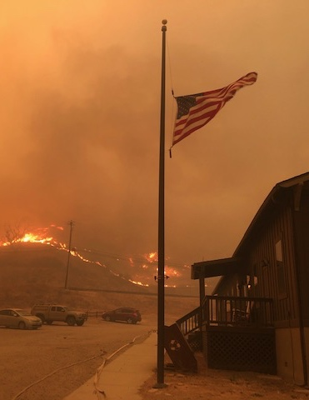
Wildland Urban Interface
Santa Monica Mountains National Recreation Area
Fire is the inevitable outcome of the climate and vegetation of California that has been here for millions of years and will remain with us into the future. “Wildfires, like other natural hazards on the landscapes we inhabit, are therefore a phenomena we must learn to live with.”
–Max A. Moritz
(Halsey 2008, p. 107; Witter, personal communication, 2/20/19)
Learning to Live with Wildfires
(Photo: NPS)
Notes:
Reflect on this quote. Pair share or write thoughts.

Slide 2
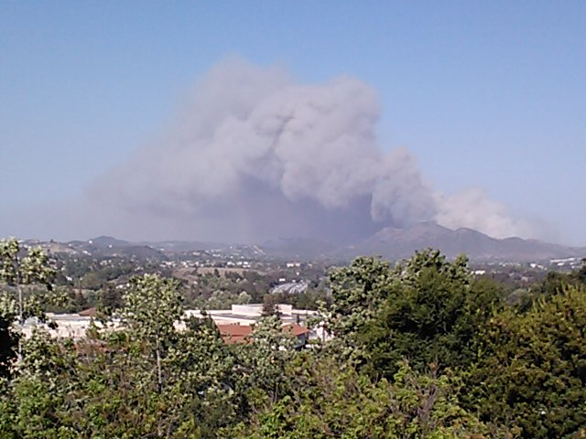
What is the Wildland Urban Interface (WUI)?
The Wildland-Urban Interface is the area where homes and wildlands meet. It is a significant area for wildfire impact and management.
(Photo: NPS)
(NPS, 2016b)
Notes:
“As the frequency of wildland fires has increased, the threat to housing developments in the wildland urban interface has becomes a regular occurrence” (NPS, 2016b).
“Even homes located one to two miles away from natural areas are at risk of wildfire damage as embers can be blown over a mile ahead of fire” (NPS, 2016b).
“The Santa Monica Mountains have one of the most extreme fire climates in the world and periodically burn in large, dramatic wildfires (NPS 2005). Approximately 13% of this fire-prone area is developed, with communities that are among the wealthiest in Los Angeles County and the state of California. Fires in this region are often extremely damaging and costly because of both wildfire suppression costs and property losses, and are usually considered to be major social disasters” (Witter, Taylor, & Davis, 2007).

Slide 3
Stakeholders of the Wildland Urban Interface
Stakeholders
Local Citizens & Home Owners
Public Land Managers
Fire Departments
Plants & Animals
Local Governments
Business Owners
  Real Estate Companies
  Insurance Companies
  Utility Companies
Who is impacted by wildfires in the WUI?
Stakeholders need to be ready for the next wildfire.
Notes:
Stakeholders are people who have a direct or indirect interest in an area, issue, or event. These could be individuals or groups. They will each hold a certain position on an issue, area, or event. These positions are determined by the value or relative worth they place on something. It could be aesthetic, economical, cultural, social, recreational, scientific, religious, political, etc.
The definition of stakeholders could be expanded to include the whole community including all living things: the plants, animals, and humans. People are just one of the many living things in a community with a legitimate interest in the outcome of any particular land use decision.

Slide 4
Wildfire Preparation
“Considering the inevitably of fire in southern California, it’s best to learn how to let fire burn
around us instead of through us.”
–Richard Halsey (Halsey, 2008, p. 29)

Slide 5
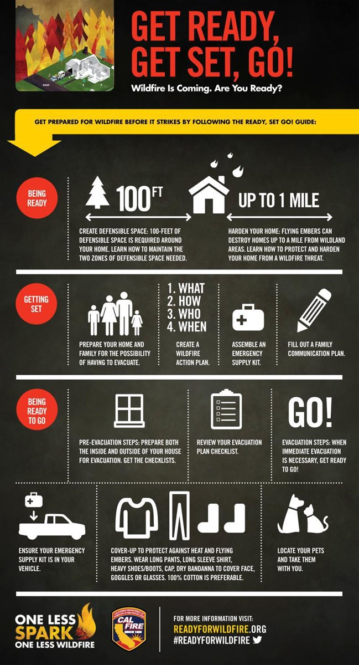
Preparation for the next wildfire
Get Ready!
Get Set!
Go!
GET READY for the next wildfire by hardening your homes and creating defensible (survivable) space.
GET SET by preparing for an evacuation.
GO! By following your evacuation plan & checklist to evacuate quickly and early.
How do you prepare for a wildfire?
(Image: CalFire, 2017d)
(Cal Fire, 2017f)

Slide 6
Get Ready
Preparation for Wildfire

Slide 7
Get Ready!
Fire Risk Reduction
Choose a low risk home site for new construction; understand your risks for existing homes
Harden your home with appropriate fire safe building designs & structural materials
Create survivable and sustainable (defensible) space around your home and community
(Cal Fire, 2017f; Halsey, 2008, p. 66,75, 84-85; Witter, personal communication, 2/19/19)

Slide 8
Get Ready!
Fire Risk Reduction
Understand Your Location
Be aware of how fire will behave on the topography around your home.
“Homes located in ‘natural chimneys,’ such as narrow canyons and saddles, are especially fire-prone because winds are funneled into these canyons and eddies are created.”
Homes located in steep and narrow canyons or ridges are also vulnerable to radiating heat from fire.
Look at historic fire patterns – homes are at greatest risk in fire corridors that have burned repeatedly in modern historic times (Syphard et al., 2012).
(Halsey, 2008, p. 75)
(Halsey, 2008, p. 75)

Slide 9
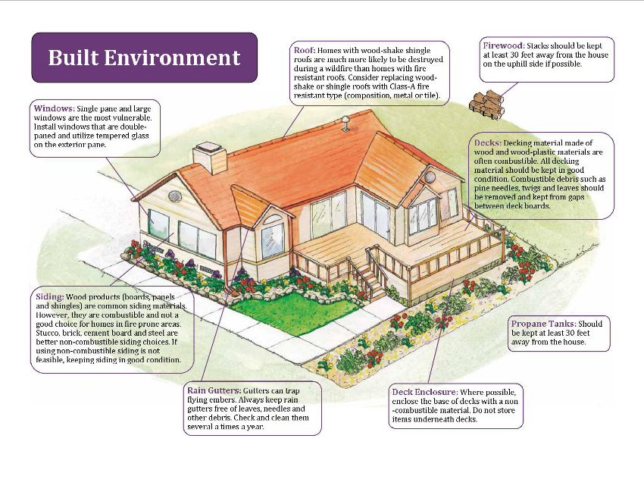
Get Ready!
Harden Your Home
Fire Risk Reduction
Wildfires can ignite a home with flying embers that are blown inside attics, under houses, or on wood shingle roofs.
They can also ignite by direct flames carried by nearby vegetation or debris piles along a wall.
Also, homes can ignite through radiant heat from the fire that can crack or break windows allowing embers to blow inside.
Building density, design, and building materials are all important safety considerations.
The roof is the most vulnerable. It is exposed to airborne embers that can fly from up to two miles away.
Use exterior materials that are fire-resistant to harden your home.
National Fire Protection Association - Your Home Can Survive a Wildfire Video
(Image: WRWC, 2018)
(Halsey, 2008, p. 75; NFPA, 2015; NPS, 2015)
Notes:
Click the link in the video to watch a 13 minute video from the National Fire Protection Association about keeping your home safe during a wildfire.
“Hardening your home from wildfire means fortifying or retrofitting your home to be impervious to heat and embers. This can be your best defense against ember intrusion. After that, move out into the yard starting with the first few feet adjacent to the building, then out to the wildlands as needed” (Litman, 2013, p. 9).
Wildfires can ignite a building with:
flying sparks and embers that get blown inside attics, under houses or on wooden shingle roofs;
direct flames that can ignite walls if there is vegetation growing on them or if there are adjacent debris piles;
radiant heat, that can crack or break windows and allow embers to blow into the house.
Flying embers cause by far the majority of home losses. (Witter, personal communication, 2/19/19)
Roof – most vulnerable surface for embers to land
Use fire resistant materials on roof
Composition
Metal
Tiles
Clean rain gutters and roof of leaf debris regularly
Remove branches that hang over roof
Vents and Eves – embers gather under eves or in through vents and ignite combustible materials
Close eaves and vents with 1/8” metal screens – keeps embers out of attic
Use baffled attic vents
Deck/Balconies – embers collect on or under decks and balconies
Enclose underside of decks, balconies and foundation of home- enclose with solid flame resistant sheeting
Use non-flammable construction material
Use fire resistant decking surface
Keep deck clear of combustible items, such as, baskets, debris and dried plants
Use fire resistant outdoor furniture
Windows – extreme heat from fire can cause windows to break and allow embers in the house
Install double paned window with tempered glass for windows and skylights
Seal up gaps in windows and doors, including garage
Exterior Walls – build or remodel with fire resistant materials
Cement
Brick
Stucco
Masonry
Remove plants that climb up house and under eves
(NPS, 2015)
Fore more information visit: http://www.readyforwildfire.org/Hardening-Your-Home/

Slide 10
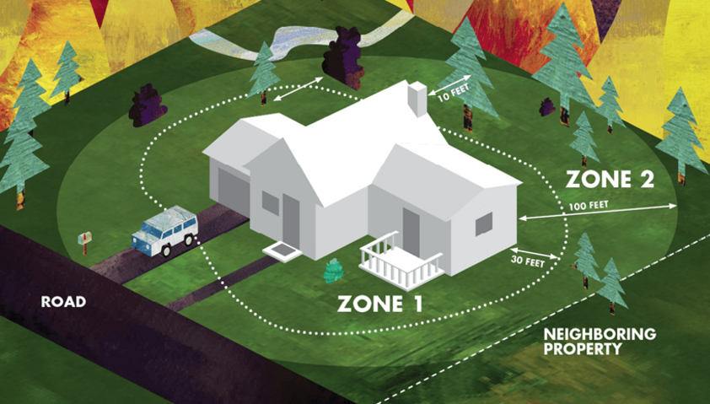
Get Ready!
Create Defensible & Survivable Space
Keep your property lean and green.
Fire Risk Reduction
Defensible space is the area around a structure free of flammable plants and objects that will create a buffer zone to slow or halt wildfire spread to a structure. Defensible space also creates a zone that is essential for fire fighters to operate safely, while working to protect a home during a wildfire.
Zone 1 – Critical Space
  Extends 0-30 feet from your house, structures or decks
  Remove dying & dead vegetation
  Remove ladder fuels by trimming low tree branches
  Cut grass regularly
  Use stone, brick, concrete, or decomposed granite landscaping next to buildings
Zone 2 – Fuel Reduction
  Extends 30-100 feet from your house
  Thin and space out vegetation
  Avoid planting highly flammable vegetation
  Remove leaf litter & dead & woody debris
  Remove any overhanging tree branches
Cal Fire Inspects for Defensible Space Video
(Image: Cal Fire, 2017e)
(Cal Fire, 2011; Cal Fire, 2017e; NPS, 2016a)
Notes:
Click the link in the slide to watch a 2 minute Cal Fire video about defensible space.
“Defensible space is the area around a structure free of flammable plants and objects that will create a buffer zone to slow or halt wildfire spread to a structure. Defensible space also creates a zone that is essential for fire fighters to operate safely, while working to protect a home during a wildfire.
Zone 1 “Critical space” extends 0-30 feet from your house, structures or decks
Dying and dead vegetation are the main fuels for fires, although if hot enough live vegetation burns too. It is recommended that you keep the critical zone (0-30 feet from the house) clear of anything that could catch fire from blown embers such as leaves, weeds, flammable or high maintenance trees and shrubs, wood or scrap piles, storage, or furniture.
Remove all dead plant material including weeds and dry grass, branches or stems
Rake up all dry/dead leaves on the ground, especially underneath decks and porches
Remove any tree branches hanging over the roof and trim them 10 feet away from roof/ chimney
Remove any leaves on the roof and clean out rain gutters
Remove vegetation away from decks, sheds and porches
Remove woodpiles and other debris pile 30’ from structure
Remove ladder fuels (low level vegetation that allows fire to spread from the ground to the tree canopy) by trimming low tree branches 6’-10’ from ground
Cut or mow grass regularly
Use rock and stone landscaping next to buildings
Zone 2 “Fuel reduction” extends 30-100 feet from your house
You can reduce fuel load and minimize the chance of fire jumping from plant to plant by thinning vegetation and increase spacing between plants, create small clusters of vegetation, eliminate ladder fuels by trimming lower levels of branches of shrubs and trees, avoid planting vegetation that is highly flammable and that accumulates dead woody material or produces lots of leaf litter.
Remove dead and woody debris
Avoid planting vegetation that creates lots of leaf litter
Remove leaf litter that accumulates
Thin landscape and remove 40% of live vegetation
Trim existing tree limbs creating space between trees –about 10ft between tips of limbs
Trim low level branches for trees and shrubs
Space plants out (2-4 times the height of plants) to prevent fire spread between them and plant in small clusters
New tree plantings should be 20-30 feet apart
(NPS, 2016a)
Fore more information visit: http://www.readyforwildfire.org/Defensible-Space/

Slide 11
Get Set
Preparation for Wildfire

Slide 12
Get Set!
Create a Wildfire Action Plan that includes evacuation planning for your home, family and pets.
Assemble an Emergency Supply Kit for each person in your household.
Fill-out a Family Communication Plan that includes important evacuation and contact information.
(Cal Fire, 2017b)
Notes:
Before wildfire strikes, it is important that you get Set. Prepare yourself and your home for the possibility of having to evacuate. (Cal Fire, 2017b)
Be mentally prepared that your home may not be there when you get back.
Fore more information visit: http://www.readyforwildfire.org/Get-Set/

Slide 13
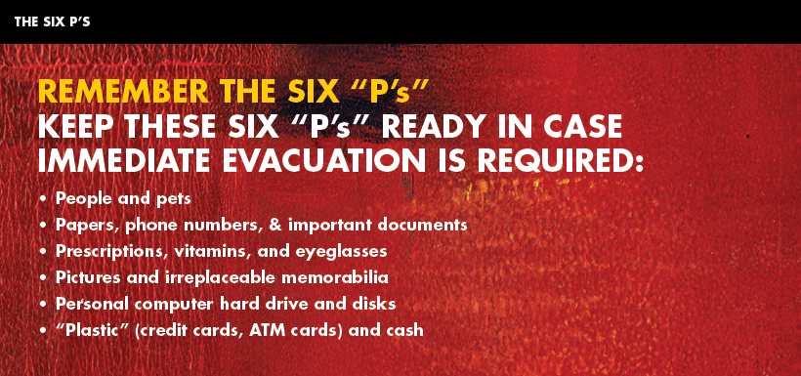
Get Set!
Wildfire Action Plan
Create an Evacuation Plan
Be Prepared
  Emergency meeting location
  Escape routes
  Have a plan to evacuate pets and animals
  Create a Family Communication Plan with out-of-area friends or relatives
  Have fire extinguishers in your home & know how to use them
  Know where gas, electric, & water main shut-off controls are located & how to shut them down
  Assemble an Emergency Supply Kit for each person
  Have a list of emergency contact numbers
(Image: Cal Fire)
(Cal Fire, 2017b)
Notes:
Your Wildfire Action Plan must be prepared, and familiar to all members of your household well in advance of a wildfire. Use the checklist below to help create your plan. Each family’s plan will be different, depending on a variety of issues, needs, and situations.
Create an evacuation plan that includes:
A designated emergency meeting location outside the fire or hazard area. This is critical to determine who has safely evacuated from the affected area.
Several different escape routes from your home and community. Practice these often so everyone in your family is familiar in case of emergency.
Have an evacuation plan for pets and large animals such as horses and other livestock.
A Family Communication Plan that designates an out-of-area friend or relative as a point of contact to act as a single source of communication among family members in case of separation. (It is easier to call or message one person and let them contact others than to try and call everyone when phone, cell, and internet systems can be overloaded or limited during a disaster.)
Be Prepared:
Have fire extinguishers on hand and train your family how to use them (check expiration dates regularly).
Ensure that your family knows where your gas, electric, and water main shut-off controls are located and how to safely shut them down in an emergency.
Assemble an Emergency Supply Kit for each person, as recommended by the American Red Cross. (See next section for details.)
Maintain a list of emergency contact numbers posted near your phone and in your emergency supply kit.
Keep an extra Emergency Supply Kit in your car in case you cannot get to your home because of fire or other emergency.
Have a portable radio or scanner so you can stay updated on the fire.
Tell your neighbors about Ready, Set, Go! and your Wildfire Action Plan.
(Cal Fire, 2017b)
For more information visit: http://www.readyforwildfire.org/Get-Set/ and https://www.ready.gov
For more information on preparing your family: http://www.readyforwildfire.org/Prepare-Your-Family/
For more information on Emergency Supply Kits: http://www.readyforwildfire.org/Emergency-Supply-Kit/
For more information on Wildfire Action Plan: http://www.readyforwildfire.org/Wildfire-Action-Plan/

Slide 14
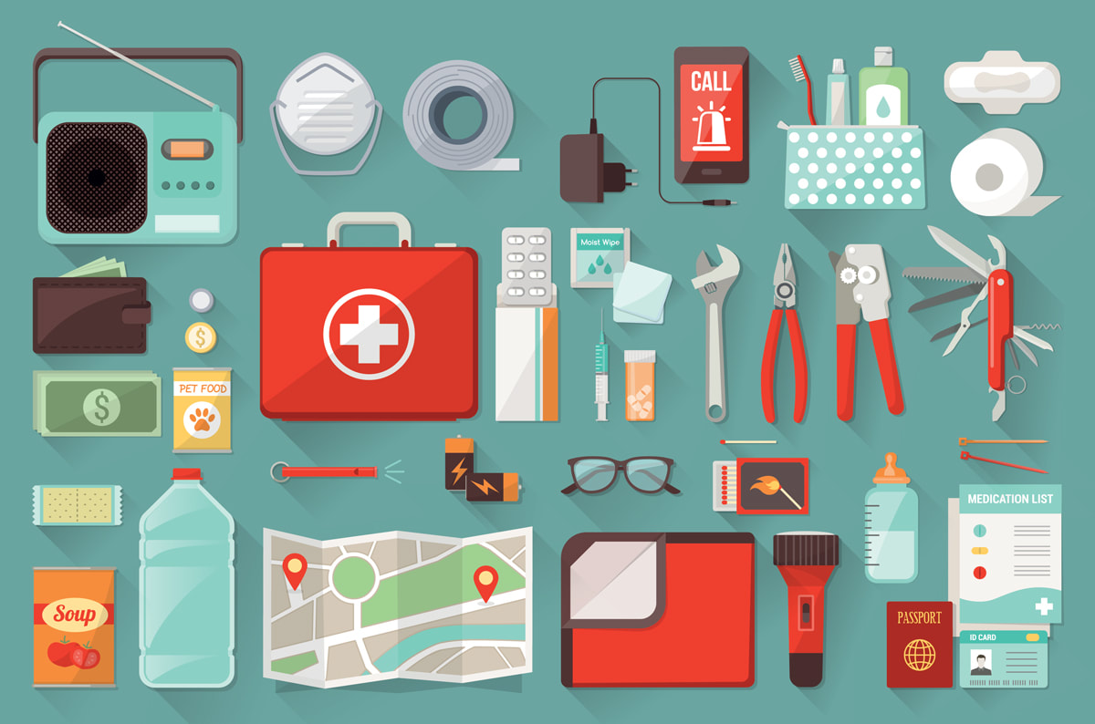
Get Set!
Emergency Supply Kit
Emergency Supply Kit
  3 Day supply of non-perishable food
  3 gallons of water per person
  Map with evacuation routes
  Prescriptions
  Clothing
  Eyeglasses or Contact Lenses
  Car keys
  Credit cards
  First-aid kit
  Flashlight
  Battery powered radio with extra batteries
  Sanitation supplies
  Copies of important documents
  Pet food and water
What should you have in an Emergency Supply Kit?
(Image: Alberta Emergency Management Agency)
(Cal Fire, 2017a)
Notes:
Put together your emergency supply kit long before a wildfire or other disaster occurs and keep it easily accessible so you can take it with you when you have to evacuate. Plan to be away from your home for an extended period of time. Each person should have a readily accessible emergency supply kit. Backpacks work great for storing these items (except food and water) and are quick to grab. Storing food and water in a tub or chest on wheels will make it easier to transport. Keep it light enough to be able to lift it into your car.
EMERGENCY SUPPLY KIT CHECKLIST
Three-day supply of non-perishable food and three gallons of water per person.
Map marked with at least two evacuation routes
Prescriptions or special medications
Change of clothing
Extra eyeglasses or contact lenses
An extra set of car keys, credit cards, cash or traveler’s checks
First aid kit
Flashlight
Battery-powered radio and extra batteries
Sanitation supplies
Copies of important documents (birth certificates, passports, etc.)
Don’t forget pet food and water!
Items to take if time allows:
Easily carried valuables
Family photos and other irreplaceable items
Personal computer information on hard drives and disks
Chargers for cell phones, laptops, etc.
Always keep a sturdy pair of shoes and a flashlight near your bed and handy in case of a sudden evacuation at night.
(Cal Fire, 2017a)
Image from: http://www.aema.alberta.ca/build-a-kit

Slide 15
Get Set!
Family Communication Plan
Know how you are going to evacuate family members including helping toddlers & small children to understand how they will respond to a fire.
Practice your family’s fire escape plan.
(Cal Fire, 2017g)
Notes:
How to Prepare to Evacuate from a Wildfire
Evacuation plans for families with young children should include helping toddlers understand how to quickly respond in case of fire, and how adults can escape with babies. Prepare ahead of time by practicing your family’s fire escape plan, and what to do to be safe when there is a wildfire nearby.
Preparing Seniors and Disabled Family Members
Seniors and people with disabilities also need special consideration when preparing for a disaster.
(Cal Fire, 2017g)
For more information and resources for these matters visit: http://www.readyforwildfire.org/Prepare-Your-Family/

Slide 16
Go !
Preparation for Wildfire

Slide 17
Go !
Evacuate Early!
Leave as soon as evacuation is recommended by fire officials!
Listen to your radio/TV for announcements from law enforcement and emergency personnel. You may lose communications if the power goes out.
Know when to evacuate and what to do if you become trapped.
Review and follow your evacuation plan checklist if time allows.
Ensure your Emergency Supply kits are in your vehicle.
To protect against flying embers: dress in long pants, long sleeve shirt, heavy shoes, hat, and a bandanna and glasses for face cover.
Take your pets with you!
Cal Fire - Ready, Set, Go video
(Cal Fire, 2017c)
Notes:
Click the link in the slide to play the Cal Fire 6 minute Ready, Set, Go video to review Ready, Set, Go!
Give your household the best chance of surviving a wildfire by being ready to go and evacuating early. This includes going through pre-evacuation preparation steps (only if time allows) to increase your home’s defenses, as well as creating a Wildfire Action Plan for your family. Being ready to go also means knowing when to evacuate and what to do if you become trapped.
Review your evacuation plan checklist.
Ensure your Emergency supply kit is in your vehicle.
Cover-up to protect against heat and flying embers. Wear long pants, long sleeve shirt, heavy shoes/boots, cap, dry bandanna for face cover, goggles or glasses. 100% cotton is preferable.
Locate your pets and take them with you.
PRE-EVACUATION PREPARATION STEPS
When an evacuation is anticipated, follow these checklists (if time allows) to give your home the best chance of surviving a wildfire.
Home Evacuation Checklist – How to Prepare for Evacuation:
Inside the House
Shut all windows and doors, leaving them unlocked.
Remove flammable window shades, curtains and close metal shutters.
Remove lightweight curtains.
Move flammable furniture to the center of the room, away from windows and doors.
Shut off gas at the meter; turn off pilot lights.
Leave your lights on so firefighters can see your house under smoky conditions.
Shut off the air conditioning.
Remove any ammunition and loaded guns out of the house for the safety of the firefighters.
Outside
Gather up flammable items from the exterior of the house and bring them inside (patio furniture, children’s toys, door mats, trash cans, etc.) or place them in your pool.
Take portable propane tanks with you away from the house if possible to remove the possibility of explosions.
Turn off and move propane BBQ appliances far away from structures.
Connect garden hoses to outside water valves or spigots for use by firefighters. Fill water buckets and place them around the house.
Don’t leave sprinklers on or water running, they can affect critical water pressure.
Leave exterior lights on so your home is visible to firefighters in the smoke or darkness of night.
Put your Emergency Supply Kit in your vehicle.
Back your car into the driveway with vehicle loaded and all doors and windows closed. Carry your car keys with you.
Have a ladder available and place it at the corner of the house for firefighters to quickly access your roof.
Seal attic and ground vents with pre-cut plywood or commercial seals.
Patrol your property and monitor the fire situation. Don’t wait for an evacuation order if you feel threatened.
Check on neighbors, the elderly, people with limited mobility, people with children, and people who may be asleep or otherwise unaware that fire is near and make sure they are preparing to leave.
Animals
Locate your pets and keep them nearby.
Prepare farm animals for transport and think about moving them to a safe location early.
WHEN TO EVACUATE
Leave as soon as evacuation is recommended by fire officials to avoid being caught in fire, smoke or road congestion. Don’t wait to be ordered by authorities to leave. Evacuating the forest fire area early also helps firefighters keep roads clear of congestion, and lets them move more freely to do their job. In an intense wildfire, they will not have time to knock on every door. If you are advised to leave, don’t hesitate! Officials will determine the areas to be evacuated and escape routes to use depending upon the fire’s location, behavior, winds, terrain, etc.
Law enforcement agencies are typically responsible for enforcing an evacuation order. Follow their directions promptly.
You will be advised of potential evacuations as early as possible. You must take the initiative to stay informed and aware. Listen to your radio/TV for announcements from law enforcement and emergency personnel.
You may be directed to temporary assembly areas to await transfer to a safe location.
The terms “Voluntary” and “Mandatory” are used to describe evacuation orders. However, local jurisdictions may use other terminology such as “Precautionary” and “Immediate Threat.” These terms are used to alert you to the significance of the danger. All evacuation instructions provided by officials should be followed immediately for your safety.
Do not return to your home until fire officials determine it is safe. Notification that it is safe to return home will be given as soon as possible considering safety and accessibility.
PETS
Plan ahead. Know where you will take or leave your pets. In case you are not home when disaster strikes, arrange in advance for a neighbor to check on or transport your pets. Make sure your neighbors have your contact numbers (cell phone, work, home, etc.). In the event of evacuation pets may not be allowed inside human emergency shelters – have an alternate prearranged location to take your animals.
Make sure your pets are always wearing properly fitted collars with personal identification, rabies and license tags.
Each animal should have it’s own pet carrier. Birds, rodents and reptiles should be transported in cages. Cover cages with a light sheet or cloth to minimize their fear.
Store vaccination/medical records, veterinary contact information, proof of owner- ship, a current photo, and a Disaster Preparedness Kit in one location.
Pet Disaster Preparedness Kit
Pet carrier for each pet
Two week supply of food and water
Non-spill food and water bowls
Pet first-aid kit
Medications and dosing instructions
Car litter box and litter
Plastic bags for waste disposal
Paper towels
Disinfectants
Leashes/collars/harnesses
Blankets
Toys and treats
Newspaper
IF YOU MUST LEAVE YOUR PET
If you must leave your pets, bring them indoors. Never leave pets chained outdoors!
Use a room with no windows and adequate ventilation, such as a utility room, garage, bathroom, or other area that can be easily cleaned. Do not tie pets up!
Leave only dry foods and fresh water in non-spill containers. If possible open a faucet to let water drip into a large container or partially fill a bathtub with water.
WHEN YOU RETURN HOME:
Be alert for downed power lines and other hazards.
Check propane tanks, regulators, and lines before turning gas on.
Check your residence carefully for hidden embers or smoldering fires.
WHAT TO DO IF YOU BECOME TRAPPED
While in your vehicle:
Stay calm.
Park your vehicle in an area clear of vegetation.
Close all vehicle windows and vents.
Cover yourself with wool blanket or jacket.
Lie on vehicle floor.
Use your cell phone to advise officials—call 911.
While on foot:
Stay calm.
Go to an area clear of vegetation, a ditch or depression on level ground if possible.
Lie face down, cover up your body.
Use your cell phone to advise officials—call 911.
While in your home:
Stay calm, keep your family together.
Call 911 and inform authorities of your location.
Fill sinks and tubs with cold water.
Keep doors and windows closed, but unlocked.
Stay inside your house.
Stay away from outside walls and windows.
(Cal Fire, 2017c)

Slide 18
Wildfire Suppression Strategies
Wildland Urban Interface
Notes:
How do fire officials manage wildfire?

Slide 19
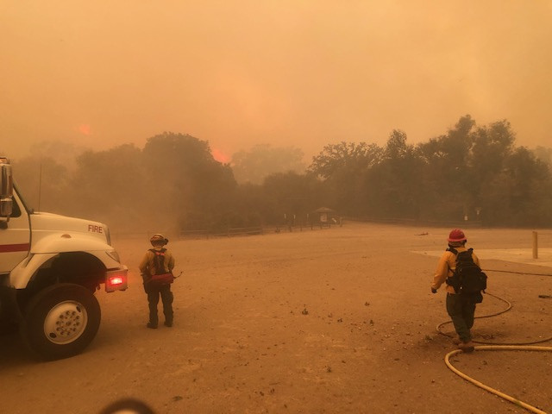
Wildfire Suppression
Wildfire Suppression tactics:
Fire Engines
Firebreak
Air Tankers
Helicopters
Backfire
(NPS, 2006, p. 16)
Notes:
Wildfire suppression is defined as a response to wildland fire that results in curtailment of fire spread and eliminates all identified threats from the direct and indirect effects of the fire and/or management actions.
The two important points about wildfire management in the Santa Monica Mountains National Recreation Area are:
1. support and education for community fire safety (house out defensible space and Ready, Set, Go preparations)
2. We are absolutely dependent on robust fire suppression by LA and Ventura County (Witter, personal communication, 2/20/19)
Note about wildfire suppression from Robert Taylor, Fire GIS Specialist, NPS:
Remember the Fire Triangle: Oxygen, Fuel, and Heat
•These three elements make up the fire triangle. Remove any one of them and the fire will not burn.
•Heat first comes from the ignition source that in nature is lightning or lava.
•Fuel is any material that will burn. Some fuels are more likely to burn than others. For instance, dead trees, leaves, needles and grasses have far less water in them than living ones. Dead plants usually burn sooner and hotter than live ones.
•At least 16 percent oxygen must be in the air for a fire to start. The air we breathe has 21 percent oxygen, more than enough to allow a fire to burn.
•“Take away any one of those things and a fire stops burning. All firefighting is based on these basic ideas. From the dawn of firefighting, we have employed three main tactics to stop a fire. We scratch dirt (to remove fuel and/or deny oxygen to the fire), we squirt water (to remove heat from the fire), and we light backfires (to deny fuel to the fire). These basic processes are timeless. The rest is details (shovels or bulldozers, bucket brigades or 747 airplane water tankers, a handheld burning branch or a helicopter dropping burning ping pong balls).” (Personal Communication, Robert Taylor, 5/10/18)

Slide 20
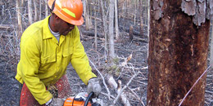
Wildfire Suppression
Fire Engine
Fire Break
Wildfires are first fought by a fire engine crew using fire hoses spraying water and foam.
Crews lay the hose from the base of the fire and up both sides.
Handcrews, bulldozer crews, and hotshots fight the fire on the ground with hand and mechanical tools to clear vegetation (fuel) and create an area without any fuel for the fire to burn. These are fire breaks.
A fire break is a natural or constructed barrier used to stop or check fires that may occur, or to provide a control line from which to work.
If the fire is not contained with engine crews…
(Photo: NPS, n.d.c)
(Halsey, 2008, p. 56; USFS & NPS, n.d.)
Notes:
Engine Crew: Firefighters assigned to an engine. (USFS & NPS, n.d.)
Hotshot Crew: A highly trained fire crew used mainly to build fireline by hand. (USFS & NPS, n.d.)

Slide 21
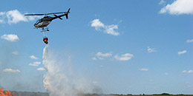
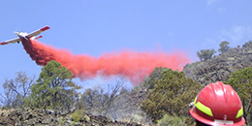
If the fire needs more support…
Wildfire Suppression
Air Tankers
Helicopters
The role of an air tanker is to lay fire retardant along the flanks (sides) and across the top of the fire to slow the spread.
Tankers do not put the fire out, they help limit the spread.
In general, aircraft do not work well in windy conditions as the retardant drifts in the wind or the flames jump over the retardant line.
Helitack crews use helicopters to support firefighters on the ground by dropping retardant, water, or foam with a bambi bucket.
They are used for:
  Reconnaissance
  Logistical support such as airlifting food, water, and equipment to firefighters
  Transporting crews to remote portions of the fire.
The effectiveness of helicopters drops once wind speeds increase to 35 miles per hour or more.
(Helicopter photo: Colleen Holland; Air Tanker photo: Dan Messaros; NPS, n.d.a)
(Halsey, 2008, p. 57-58; USFS & NPS, n.d.)
Notes:
Bambi Bucket: A collapsible bucket slung below a helicopter. Used to dip water from a variety of sources for fire suppression. (USFS & NPS, n.d.)
Helitack Crew: A group of firefighters trained in the technical and logistical use of helicopters for fire suppression. (USFS & NPS, n.d.)
For more photos visit: https://www.nps.gov/fire/wildland-fire/connect/photo-gallery/equipment/aerial-resources.cfm

Slide 22
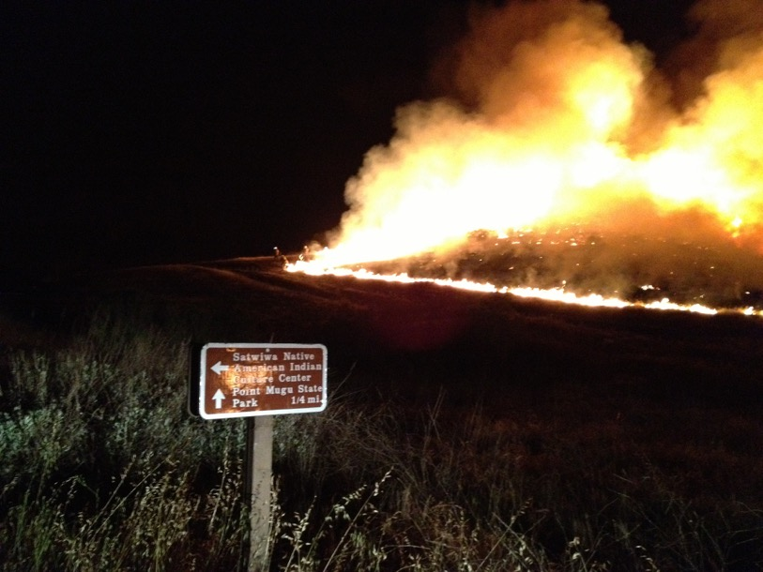
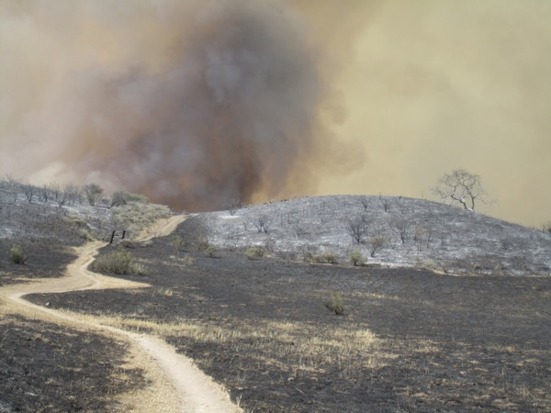
Backfire set on May 2, 2013 at Rancho Sierra Vista during the Springs fire.
Wildfire Suppression
Backfires
Sometimes, firefighters fight fire with fire!
Backfires are another tool used in fire suppression.
Backfires are intentionally set fires to burn the fuel in the path of an oncoming wildfire.
This can help stop or change the direction of a wildfire.
Backfire area the next day. The smoke in the background is from the oncoming active wildfire.
(Photo: NPS)
(USFS & NPS, n.d.)
Notes:
Backfire: A fire set along the inner edge of a fireline to consume the fuel in the path of a wildfire and/or change the direction of force of the fire's convection column. (USFS & NPS, n.d.)

Slide 23
Wildfire Management Strategies
Research shows:
Wildfire management strategies differ between ecosystems.
Preventive fuels management programs in Mediterranean shrublands have not been successful in preventing large-scale, intense wildfires.
So, in southern California chaparral, there is no need to introduce additional fire (prescribed fire) through management actions as is done in some forest ecosystems.
“Fuel buildup” is the normal process of growth & maturation of chaparral vegetation and does not need to be removed.
During wildfires, aggressive fire suppression tactics help to maintain a nearly normal fire regime.
Research & Fire History!
How do fire managers know which strategies will work best in their ecosystems?
(NPS, 2006, p. 4)
Notes:
Santa Monica Mountains National Recreation Area (SMMNRA) fire management:
“The forest model of successful fire suppression > fuel buildup > extreme wildfires is not true for all fire-adapted ecosystems.
In the Mediterranean shrublands of southern California, fire suppression programs have not been successful in preventing large-scale, intense, wildfires and “fuel buildup” is the normal process of growth and maturation of the dominant chaparral vegetation.
Because fire has not been successfully excluded from southern California shrubland ecosystems, there is no need to introduce additional fire through management actions to restore southern California shrublands.
In fact, the number of fires in the SMMNRA has increased throughout this century. This is attributed to population growth and expansion of the wildland urban interface zone (Keeley & Fotheringham, 2001).
It has been suggested that aggressive fire suppression tactics in southern California is an ecologically positive management action that has been responsible for maintaining a more nearly normal fire regime than would occur in the absence of suppression actions (Keeley & Fotheringham, 2001)” (NPS, 2006, p. 4).
“In the growing wildland urban interface zone of the SMMNRA there is a need to manage wildland fire so that threats to life, property and park resources are reduced and fire’s function as a natural process is maintained. Fire management actions in the SMMNRA need to deal primarily with fire hazards created by development at the urban wildland interface and not to correct “unnatural” fuel buildup on the landscape. The financial costs of fire management actions must be assessed and be commensurate with protection of the values at risk” (NPS, 2006, p. 4).

Slide 24
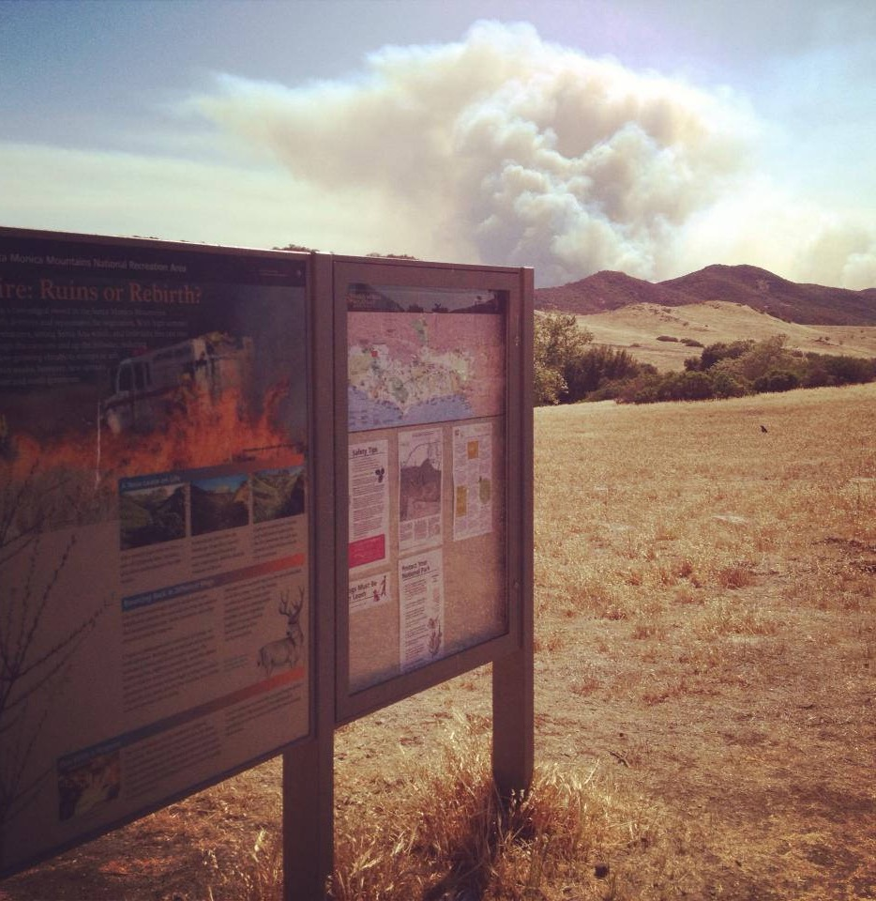
Questions for thought
What can you do in your home and with your family to prepare for a wildfire?
Wayside interpretative sign with information on fire ecology at Rancho Sierra Vista.
(Photo: NPS)

Slide 25
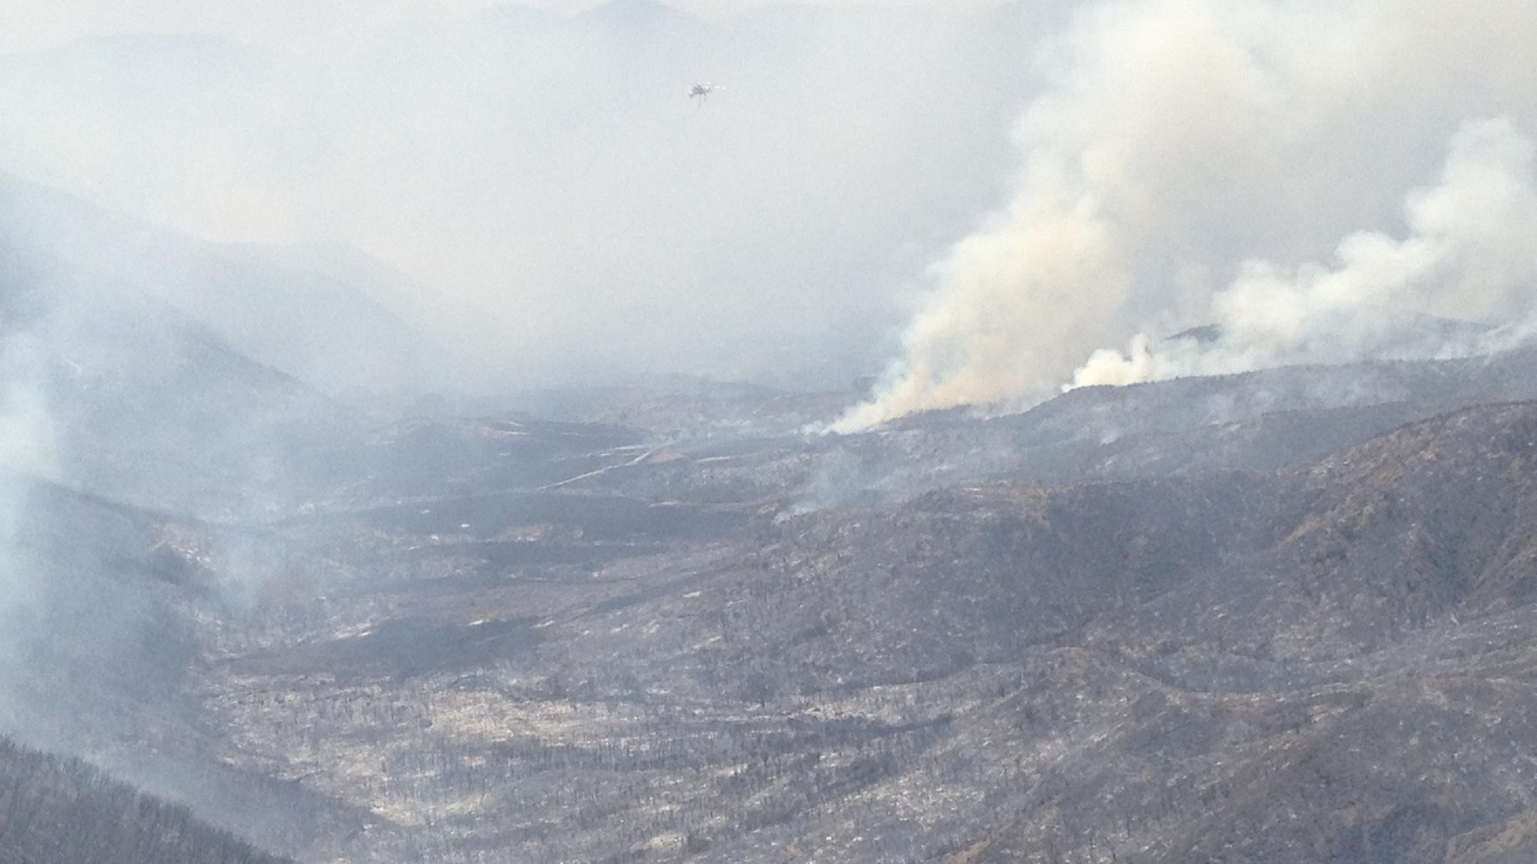
Closing Thoughts
“…those who live next to wildland areas can not develop a sustainable, fire-safe environment without understanding the natural rhythms of the landscape that surrounds them. It is the lack of such connections that accounts for many of the misconceptions dealing with chaparral, fire, and our relationship with the natural world.” –Richard Halsey (Halsey, 2008. p. viii)
(Photo: NPS)
2013 Springs Fire: View of Serrano Valley
Notes:
Thank you for learning about the Wildland Urban Interface: Learning to Live with Wildfires. To continue your journey into Santa Monica Mountains National Recreation Area: Fire Ecology continue on to the Wildland Fire Careers unit.

Slide 26
References
Cal Fire. (2011, April 11). Cal Fire inspects for defensible space [Streaming Video]. Retrieved May 05, 2018, from https://www.youtube.com/watch?v=GPRJeUQByRk
Cal Fire. (2011, February 10). Cal Fire – Who we are [Streaming Video]. Retrieved May 08, 2018, from https://www.youtube.com/watch?v=6oNdpgnjQS8
Cal Fire. (2017a). Assemble an emergency supply kit. Retrieved May 5, 2018, from http://www.readyforwildfire.org/Emergency-Supply-Kit/
Cal Fire. (2017b). Getting Set. Retrieved May 5, 2018, from http://www.readyforwildfire.org/Get-Set/
Cal Fire. (2017c). Go! Evacuation guide. Retrieved May 7, 2018, from http://www.readyforwildfire.org/Go-Evacuation-Guide/
Cal Fire. (2017d). Infographic: Ready for wildfire. Retrieved May 4, 2018, from http://www.readyforwildfire.org/Infographic/
Cal Fire. (2017e). Maintain defensible space. Retrieved May 4, 2018, from http://www.readyforwildfire.org/Defensible-Space/
Cal Fire. (2017f). Prepare for wildfire: Ready for wildfire. Retrieved May 4, 2018, from http://www.readyforwildfire.org/Prepare-For-Wildfire/
Cal Fire. (2017g). Prepare your family. Retrieved May 5, 2018, from http://www.readyforwildfire.org/Prepare-Your-Family/
Halsey, R. W. (2008). Fire, chaparral, and survival in southern California. San Diego, CA: Sunbelt Publications.
Katelman, T., Sverdlov, D., Naficy, C., Keys, E., Prosser, K., Umgertis, S., . . . Henson, C. (2013). Santa Monica Mountains community wildfire protection plan (K. Glass, Ed.). Retrieved May 8, 2018, from https://www.nps.gov/samo/learn/management/upload/SMM_CWPP_02MAY2012_FINAL_v3.pdf
Keeley, J. E., & Fotheringham, C. J. (2001). Historic fire regime in southern California shrublands. Conservation Biology,15(6), 1536-1548. doi:10.1046/j.1523-1739.2001.00097.x
Litman, L. (Ed.). (2013). California’s native landscape. Forestland Steward, Summer 2013. Retrieved March 21, 2018, from http://calfire.ca.gov/foreststeward/pdf/news-summer2013.pdf
Martinuzzi, S., Stewart, S. I., Helmers, D. P., Mockrin, M. H., Hammer, R. B., & Radeloff, V. C. (2015). The 2010 wildland-urban interface of the conterminous United States. Research Map NRS-8.(United States, Department of Agriculture, Forest Service, Northern Research Station). Newtown Square, PA. Retrieved from https://doi.org/10.2737/NRS-RMAP-8.
National Fire Protection Association (NFPA). (2015, November 09). Retrieved May 05, 2018, from https://www.youtube.com/watch?v=vL_syp1ZScM
National Park Service (NPS). (n.d.a). Wildland fire: Aerial resources photo gallery. Retrieved May 9, 2018, from https://www.nps.gov/fire/wildland-fire/connect/photo-gallery/equipment/aerial-resources.cfm
National Park Service (NPS). (n.d.b). Wildland fire: Fire management plans. Retrieved May 8, 2018, from https://www.nps.gov/fire/wildland-fire/what-we-do/fire-management-plans.cfm
National Park Service (NPS). (n.d.c). Wildland fire: Hand tools photo gallery. Retrieved May 9, 2018, from https://www.nps.gov/fire/wildland-fire/connect/photo-gallery/equipment/hand-tools.cfm
National Park Service (NPS). (n.d.d). Wildland fire: Wildfires, prescribed fires and fuels. Retrieved May 8, 2018, from https://www.nps.gov/fire/wildland-fire/what-we-do/wildfires-prescribed-fires-and-fuels.cfm
National Park Service (NPS). (2005). Environmental impact statement fire management plan. United State Department of the Interior, National Park Service. Santa Monica Mountains National Recreation Area, Thousand Oaks, CA.
National Park Service (NPS). (2006, March 6). Santa Monica Mountains National Recreation Area Fire Management Plan(United States, National Park Service, Santa Monica Mountains National Recreation Area). Retrieved May 8, 2018, from https://www.nps.gov/samo/learn/management/upload/SAMO_FMP_Review_Final_2012.pdf
National Park Service (NPS). (2009). Conducting a prescribed fire [Streaming Video]. Retrieved May 09, 2018, from https://www.nps.gov/grca/learn/management/fire_info.htm
National Park Service (NPS). (2015). Harden your home. Retrieved May 4, 2018, from https://www.nps.gov/samo/learn/management/harden-your-home.htm
National Park Service (NPS). (2016a). Create defensible space. Retrieved May 4, 2018, from https://www.nps.gov/samo/learn/management/create-defensible-space.htm
National Park Service (NPS). (2016b). Is your home ready for wildfire? Retrieved May 4, 2018, from https://www.nps.gov/samo/learn/management/fire-and-fuel-zones.htm
Syphard, A.D., Keeley, J.E., Massada, A.B., Brennan, T.J., & Randeloff, V.C. (2012). Housing arrangement and location determine the likelihood of housing loss due to wildfire. PLoS ONE, 7(3). doi: 10.1371/journal.pone.0033954
USDA Forest Service (USFS), & National Park Service (NPS). (n.d.). Fire terminology. Retrieved May 9, 2018, from https://www.fs.fed.us/nwacfire/home/terminology.html#F
West Region Wildfire Council (WRWC). (2018). Home hardening. Retrieved May 5, 2018, from http://www.cowildfire.org/home-hardening/
Witter, M., Taylor, R., Davis, S. (2007). Vegetation response to wildfire and history in the Santa Monica mountains, California. In Flora and ecology of the Santa Monica Mountains: Proceedings of the 32nd annual Southern California Botanists symposium, ed. D.A. Knapp, (pp. 173-194). Southern California Botanists Special Publication No. 4, Fullerton, CA.

