Slide 1
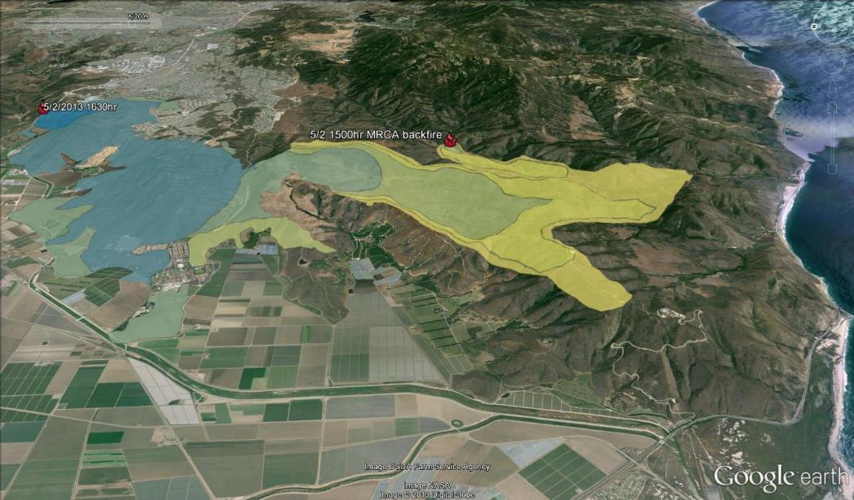
Santa Monica Mountains National Recreation Area Springs Fire Progression
5/2/2013 1700hr
(Map: Robert Taylor; Taylor, n.d.)
Notes:
This is the second part of the powerpoint file.

Slide 2
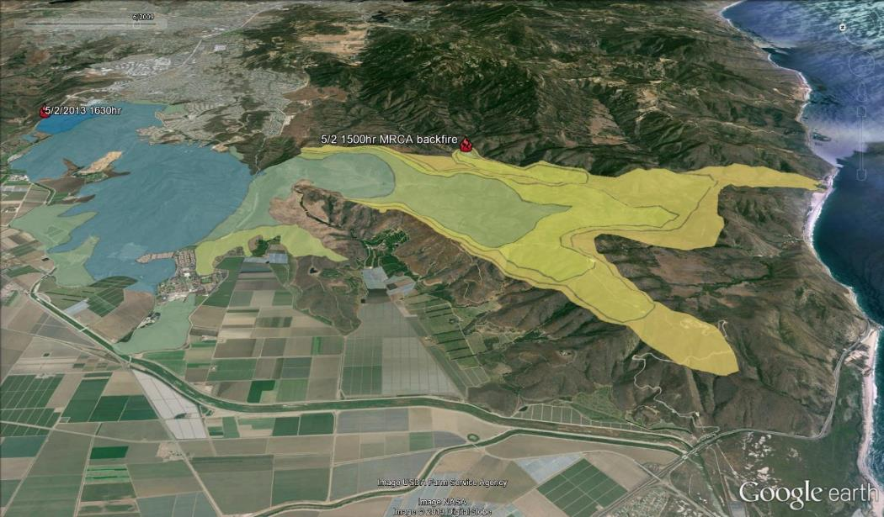
Santa Monica Mountains National Recreation Area Springs Fire Progression
5/2/2013 1800hr
(Map: Robert Taylor; Taylor, n.d.)

Slide 3
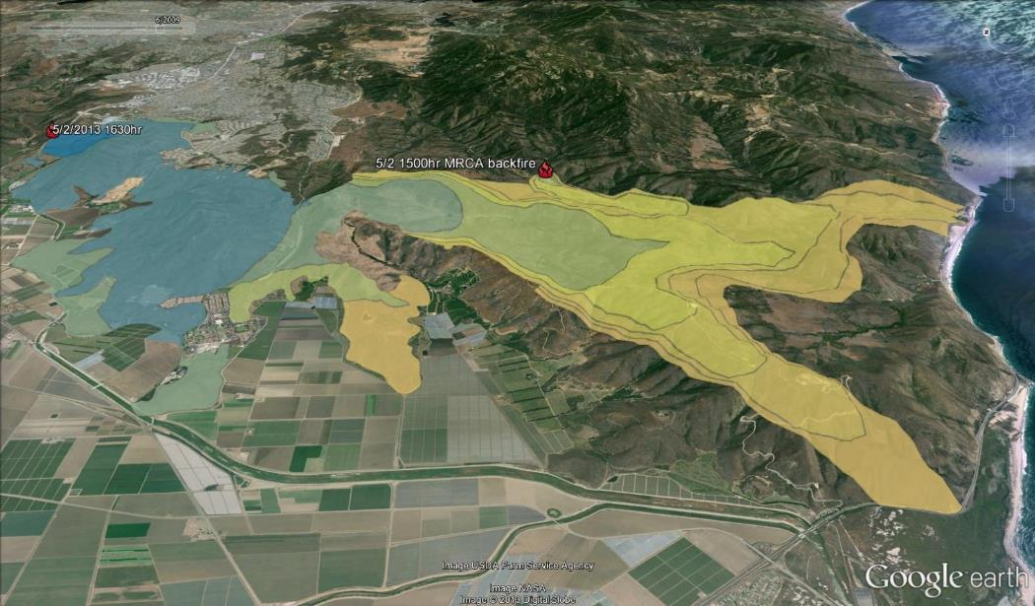
Santa Monica Mountains National Recreation Area Springs Fire Progression
5/2/2013 1900hr
(Map: Robert Taylor; Taylor, n.d.)

Slide 4
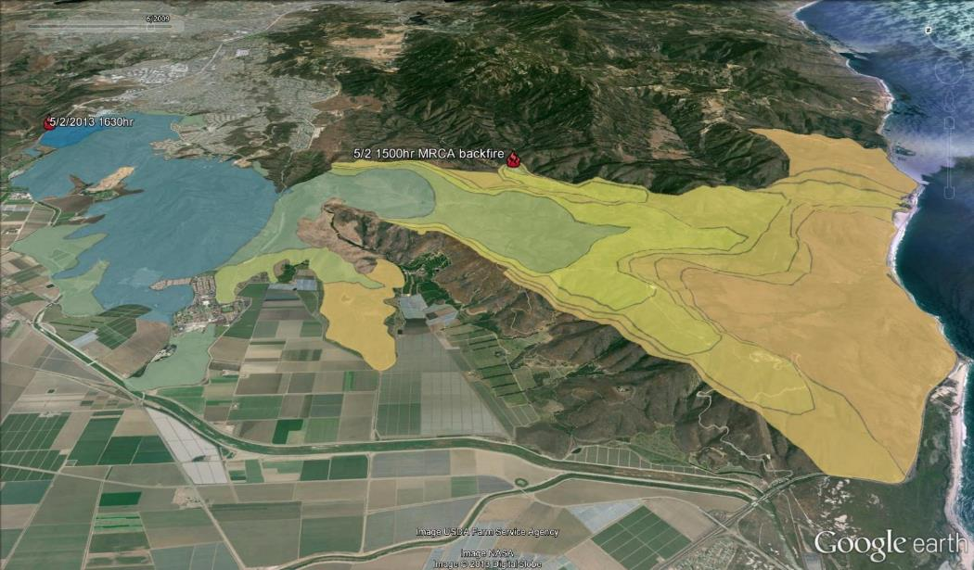
Santa Monica Mountains National Recreation Area Springs Fire Progression
5/2/2013 2400hr
(Map: Robert Taylor; Taylor, n.d.)

Slide 5
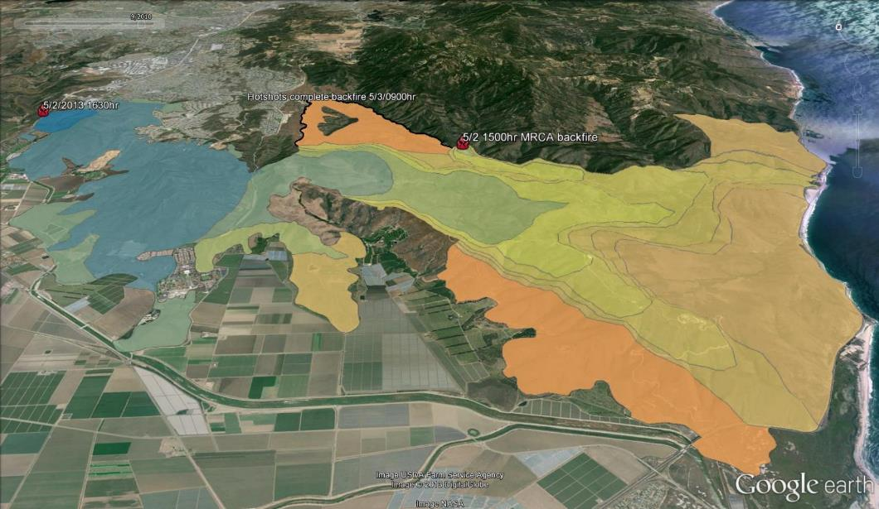
Santa Monica Mountains National Recreation Area Springs Fire Progression
5/3/2013 0900hr
(Map: Robert Taylor; Taylor, n.d.)

Slide 6
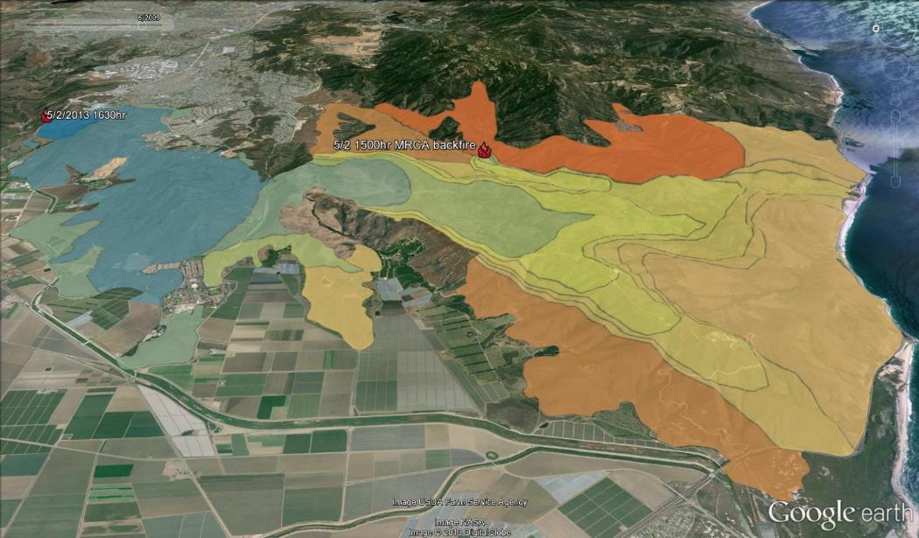
Santa Monica Mountains National Recreation Area Springs Fire Progression
5/3/2013 1200hr
(Map: Robert Taylor; Taylor, n.d.)

Slide 7
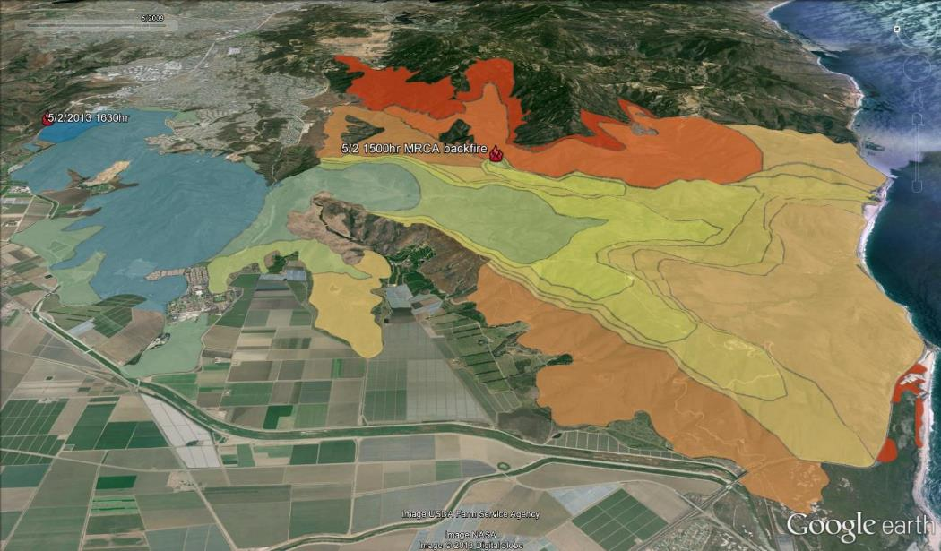
Santa Monica Mountains National Recreation Area Springs Fire Progression
5/3/2013 1400hr
(Map: Robert Taylor; Taylor, n.d.)

Slide 8

Santa Monica Mountains National Recreation Area Springs Fire Progression
5/3/2013 1800hr
(Map: Robert Taylor; Taylor, n.d.)

Slide 9
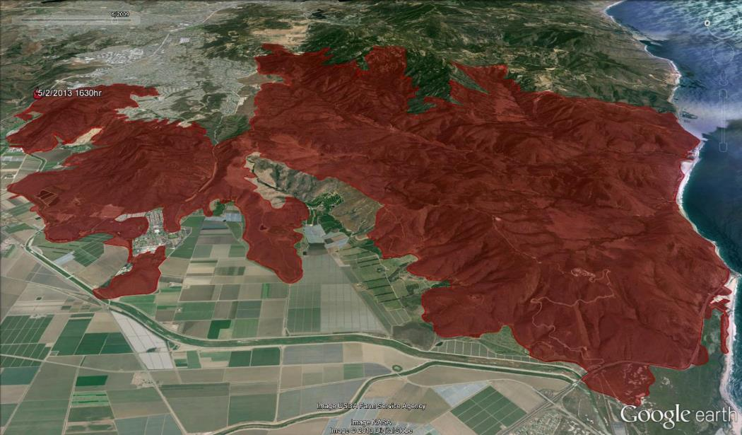
Santa Monica Mountains National Recreation Area Springs Fire Progression
Final perimeter
(Map: Robert Taylor; Taylor, n.d.)

Slide 10
Santa Monica Mountains National Recreation Area Springs Fire Progression
Day 1 - Santa Ana winds out of the NE blew the fire about 10 miles to the beach in 12 hours. These are the blue, green, and yellow- colored timesteps.
Day 2 - Then a steady breeze out of the SW set up. It blew the fire back inland. These are the orange and red timesteps.
(Map: Robert Taylor, NPS, 2015; Personal Communication, Taylor, 4/24/18)
Notes:
“The fire burned 24,238 acres in a day and a half within the 20 year-old footprint of the 1993 Green Meadow Fire, the largest fire on record (38,478 acres) in the mountains. The Springs Fire is the 5th largest wildfire and it burned 12% of the SMMNRA in the most undeveloped section of the park. There was minimal property damage to the surrounding communities as the fire burned mostly through undeveloped private property and parkland. The fire was declared 100% contained on May 12, 2013” (NPS, 2015).
The Springs Fire Story by Robert Taylor, Fire GIS Specialist at Santa Monica Mountains National Recreation Area & Coast Mediterranean Network, National Park Service:
“On day 1, sustained Santa Ana winds out of the NE blew the fire about 10 miles to the beach in 12 hours. These are the blue, green, and yellow- colored timesteps.
Overnight the wind backed off some. Hotshots conducted the backburn indicated in the center of the map during the night.
We knew winds were going to turn onshore at some time, but exactly when that would happen was unclear. I was pretty sure people refusing to leave houses along Deer Creek Road were going to be in mortal danger on day 2.
Mid-morning of the second day we had what they call "battling winds." That is when the regular prevailing sea breeze started asserting itself against the fading Santa Ana wind event. Winds shifted back and forth locally for a little while. Fire behavior in lower Sycamore Canyon started getting more active.
Then a steady breeze out of the SW set up. It blew the fire back inland. The progression map shows those timesteps of the fire progression in oranges and reds. Seabreeze was still pretty hot and dry, because all the Santa Ana air wasn't offshore long enough to get cool and moist like a regular sea breeze would be. The fire made some big runs towards the very wealthy community of Hidden Valley.
About 4pm on day 2 the sea breeze started getting cool and moist. The fire spread stopped pretty abruptly as a result. It stopped short of Hidden Valley. It stopped short of those very vulnerable houses along Deer Creek Road. Everyone was safe. Yay!” (Personal Communication, Taylor, 4/24/18)
In the next few slides, initiate a classroom conversation about the fire conditions that may have contributed to the fires behaviors : Weather, Drought, Humidity, Fuels, Winds, and Topography.
If you take the field trip to Rancho Sierra Vista associated with this program, you can see the edge of the Springs Fire perimeter.

Slide 11
Springs Fire Conditions & Behavior
Weather
  Drought
  Temperature
  Humidity
  Winds
    Santa Ana Winds
Fuel
  Fuel Moisture
Topography
What conditions do you think contributed to the fire behavior? How?
Notes:
“Fire conditions for the Springs Fire were typical for a destructive Santa Monica Mountains wildfire where low humidity and high gusty off-shore winds rapidly spread the fire in first hours of the fire. However this fire was very large for the time of year as it started on an out of season Red Flag event beside the highway with 10 miles of open space in its path before it stopped at the Pacific Ocean” (NPS, 2013, p. 20).
The fire occurred under extreme weather conditions with low humidity, high temperatures and strong Santa Ana winds. (NPS, 2015)

Slide 12
Santa Monica Mountains National Recreation Area
Springs Fire Weather & Topography
May 2, 2013 Weather Conditions
Topography
Do you think the slope, aspect, elevation, and features of the area had an impact on the fire behavior?
Click to look at the topography of Point Mugu State Park:
  Point Mugu State Park Topo Map
Temperature -74˚
Relative Humidity – 3%
Preceding winter rainfall – less than 6 inches, mostly early in the season (Nov-Dec)
(NPS, 2013; Topozone, n.d.)
Notes:
“The weather conditions recorded at the Cheeseboro Canyon RAWS station 14 miles east of the burn were 74° with 3% relative humidity and 27 –mph northeast winds gusting to 48 mph. The Burning Index at Cheeseboro Canyon was 17, Extreme. The preceding winter rainfall in the area was less than 6 inches, resulting in live fuel moisture levels typically found in late June or early July rather than May. Ventura County Fire reported 77% live fuel moisture for this area in April; the long-term average is 135-140%” (NPS, 2013, p. 15-16).

Slide 13
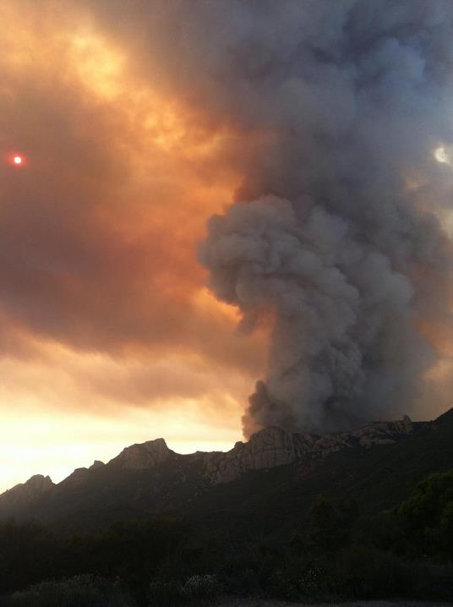
Santa Monica Mountains National Recreation Area
Springs Fire Winds
Wind Conditions May 2, 2013:
High, sustained winds from the northeast (“Santa Ana” conditions) were well established before the fire started.
At the start of the fire: Winds were 27mph with gusts up to 48mph
Springs Fire toward Sandstone Peak
(Photo: NPS)
(NPS, 2015)
Notes:
“The fire began during a period of high, sustained winds from the northeast (“Santa Ana” conditions) that are unusual for the spring. A Red Flag fire weather warning was in effect for the Santa Monica Mountains (SMM) and surrounding areas for May 1-3. Strong off-shore winds (blowing in a southerly direction) were well established before the fire started” (NPS, 2013, p. 15-16).
“The fire behavior was predominantly wind-driven with rapid backing fire on the east flank. The major fire progression was within the first 36 hours of ignition. On the first day of the fire the strong wind pushed the fire to the coast. The fire traveled at a rate of 120-160 chains per hour (1-2 mph) with wind domination. Spotting was a quarter to half mile downwind. Flame lengths were 30’ to 50’ with head fire alignment. The flanking fire spread at 15 to 30 chains per hour with backing fire rate of one to five chains per hour. A low pressure cell changed the weather pattern on the third day and fire suppression tactics became direct and took another two days to confine the fire and two more days to control it” (NPS, 2013, p. 19).

Slide 14


Santa Monica Mountains National Recreation Area: Springs Fire Vegetation
April 2013: 77% Live Fuel Moisture in the burn area
Long term average for April: 135-140%
How was the Live Fuel Moisture different this year?
(NPS, 2013)
Notes:
The preceding winter rainfall in the area was less than 6 inches, resulting in live fuel moisture levels typically found in late June or early July rather than May. Ventura County Fire reported 77% live fuel moisture for this area in April; the long-term average is 135-140%” (NPS, 2013, p. 15-16).
Fuels that contributed to the fire behavior were mostly Coastal Sage Scrub (CSS) and Chaparral.

Slide 15
more recently…
Woolsey Fire

Slide 16
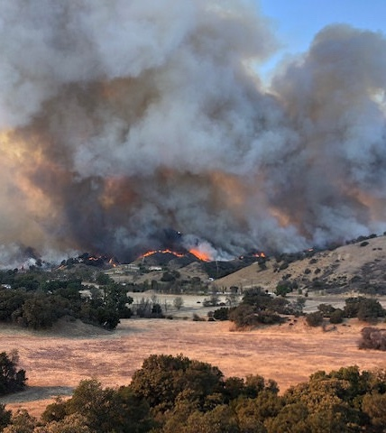
Woolsey Fire
November 8 – 21, 2018
Los Angeles and
Ventura Counties

Slide 17
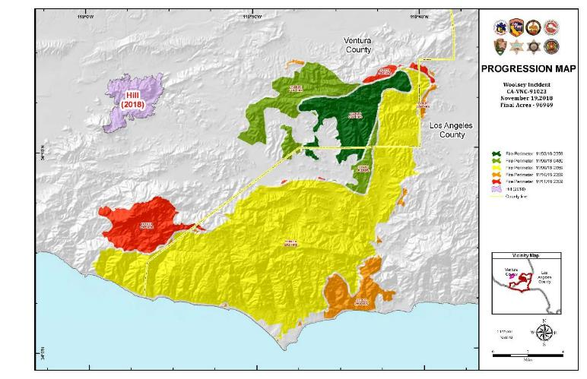
Woolsey fire facts
Started November 8, 2018 above Simi Valley
Jumped the 101 Freeway Nov 9th, burned 72,697 acres (75%) in 24 hours
96,949 total acres burned
100% contained on November 21, 2018
Cause: under investigation
Notes:
Woolsey fire behavior
Important and dramatic fact of these fires is how fast they spread

Slide 18
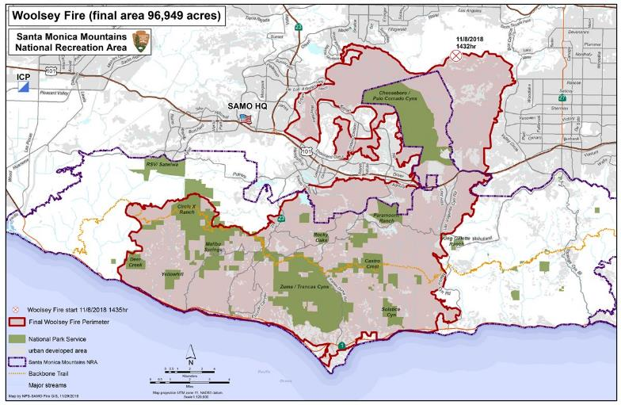
Woolsey fire facts
96,949 acres burned
1500 structures destroyed with 341 damaged
3 civilian fatalities
3 firefighter injuries
Notes:
Impact of Woolsey Fire

Slide 19
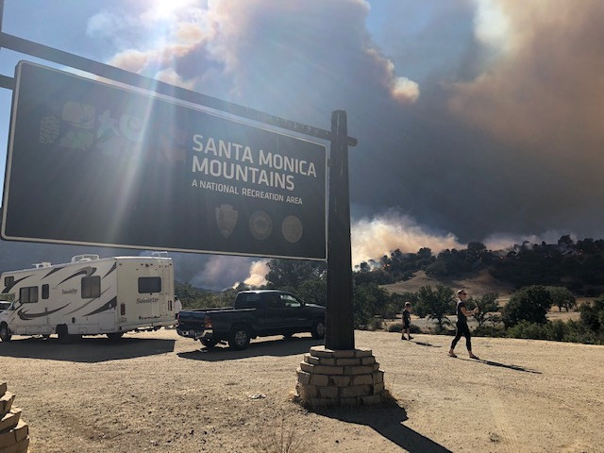
Woolsey Fire in the santa Monica mountains National Recreation Area
This fire burned more acres within the recreation area than any other fire in recorded history.
21,000 of the 23,595 National Park Service acres (88%) have burned.
Park partners have also sustained significant damage.
(Photo: NPS)
Notes:
Santa Monica Mountains sustained significant damage from the fire. 47% of the total land within the recreation area burned.
The church and train station remain at Paramount Ranch

Slide 20
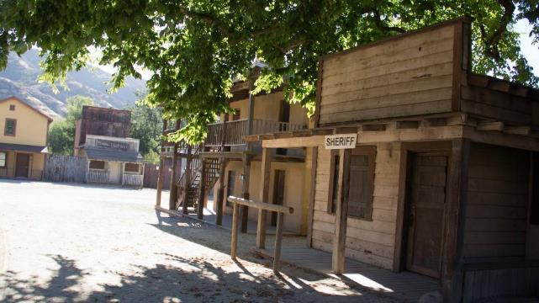
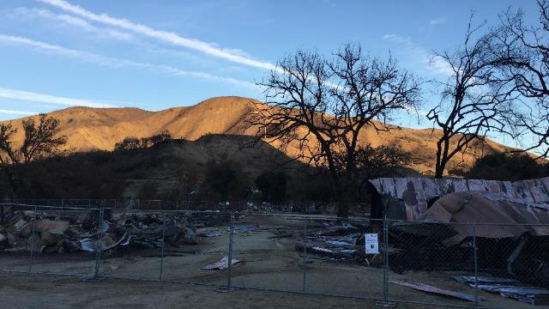
santa Monica mountains National Recreation Area
Structural Damage
Paramount Ranch Western Town
National Historic Register site
(Photos: NPS; Bethany Szczepanski)
Notes:
Paramount:
Only site in the National Park Service that interprets American film history
Still a working movie ranch that allows the public to see filmmaking in action
In 1927, Paramount Pictures purchased 2,700 acres of the old Rancho Las Virgenes for use as a "movie ranch." Thus began an era of film production that had continued until last week with more than 300 films, television shows and commercials being shot here. The current ranch is comprised of 765 acres.
Famous Hollywood actors, from Bob Hope and Marlene Dietrich to Sandra Bullock and Bradley Cooper, have strolled around the dusty streets that could be magically transformed into a real town that included a general store, a sheriff’s jail, a saloon, drugstore and a variety of other settings. After it was purchased by Paramount Pictures, a veritable who's who of Hollywood, such as director Cecil B. Demille and actors Gary Cooper and Claudette Colbert, practiced their craft here for the next 25 years.
But it was the diverse landscape that was the real star of the show. It offered filmmakers the freedom to create distant locales such as colonial Massachusetts in The Maid of Salem (1937), ancient China in The Adventures of Marco Polo (1938), a South Seas island in Ebb Tide (1937), and numerous western locations including San Francisco in Wells Fargo (1937). The art of illusion was mastered in this landscape.
In the 1950s, Western Town was created for television shows, such as The Cisco Kid. More recent television productions at Paramount include The Mentalist, Weeds, episodes of the X-Files and Hulu’s Quickdraw.
More recently, Western Town gained attention as Main Street in HBO’s hit series “Westworld.” For five years in the 1990s, it stood in as Colorado Springs, Colorado, providing the backdrop for many of actress Jane Seymour’s frontier adventures on the popular TV show Dr. Quinn, Medicine Woman. Also, Sandra Bullock had a leading role in The Lake House here.
Less known is the history of the Paramount Racetrack. The track operated from 1956 to 1957 and was known as one of the most challenging in the nation. The movie, The Devil’s Hairpin, was filmed on the course, which closed down after three fatalities within 18 months from its opening. Most of the track still winds through the grass and oak woodlands of the park. (SMMNRA, 2018)

Slide 21
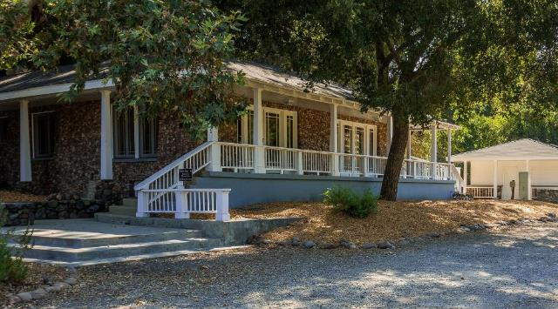
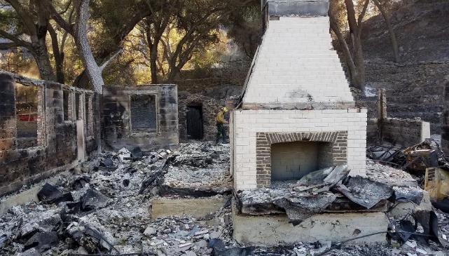
santa Monica mountains National Recreation Area
Structural Damage
Peter Strauss Ranch/
Harry Miller House
(Photos: NPS)
Notes:
Peter Strauss Ranch:
Named for Emmy Award-winning actor Peter Strauss
The tile concert area built in 1939 hosted legends Johnny Cash and Willie Nelson in the 1950s
In the early 20th century, the automobile manufacturer Harry Miller, famous for his patented master carburetor featured at the Indianapolis 500, purchased the ranch as a weekend retreat from his factory and residence in Los Angeles. In 1926, Miller built the current stone ranch house, the look-out tower, and the aviary. He held grand parties there during Prohibition, having someone watch for the cops from the tower. The man would then run to the house to warn them to put the booze away. Harry also had other large animals there as part of his private zoo. During the Great Depression, Miller suffered financial ruin after attempting to build aircraft engines, forcing him to sell the property.
In the mid-1930s, the property was purchased by Warren Shobert and Arthur Edeson, who renamed the property "Shoson" and transformed it into a recreational fairyland resort for children and adults. The Lake Encanto Dam, creating Lake Encanto, was constructed on Triunfo Creek. The resort was later renamed "Lake Enchanto." Competition from other, larger amusement parks and resorts led to the decline of Lake Enchanto, which fell into disrepair and closed around 1960.
In 1976, actor Peter Strauss purchased the property after being moved by the area's natural beauty while filming the mini-series Rich Man, Poor Man at nearby Malibu Lake. Strauss restored the property to a more natural look and lived there until 1983, when he sold it to the Santa Monica Mountains Conservancy. The National Park Service purchased the ranch in 1987.
Other Structural Damage:
The bridge on Mulholland Highway and Troutdale adjacent to the Peter Strauss house is destroyed

Slide 22
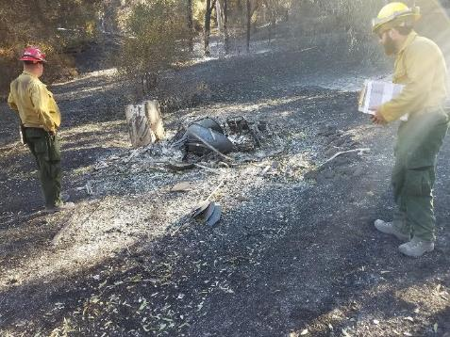
What’s next?
  Within 1 year:
  The Burned Area Emergency Response (BAER) team
  Provides “first-aid” care
  Writes a plan to provide emergency stabilization to protect life and property & to prevent further degradation of natural and cultural resources.
  Within 3 years:
  Burned Area Rehabilitation (BAR) plan.
  Supports the healing process and provides a “bridge” to long term recovery.
Issues
Observations
Findings
Recommendations
Notes:
It will take time to fully assess the damage and determine the best course of action.
Burned Area Emergency Response (BAER) teams are a collection of scientists, foresters, and representatives from various government agencies responsible for identifying hazards and recommending mitigation they feel is needed to protect communities and resources from post-fire impacts such as erosion.
They identify where flooding or debris flows are likely to occur and how to reduce the impacts by clearing culverts or channels and having storm patrols; they identify where burned trees may be hazardous and need to be cut down; or where exposed cultural resource sites need to be protected from looting when they are exposed after the fire.

Slide 23
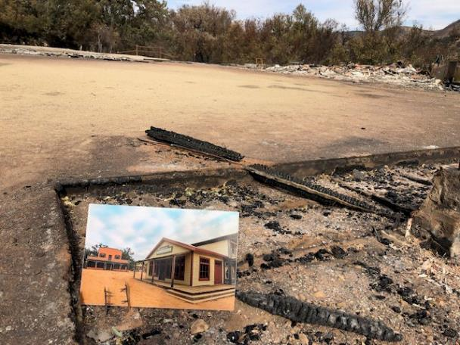
What’s next?
  Restoring Paramount Ranch
  A campaign has been created to rebuild the historic ranch.
  Ultimately, the goal is to build a number of permanent structures with more fire-resistant materials.
(Photo: NPS)

Slide 24
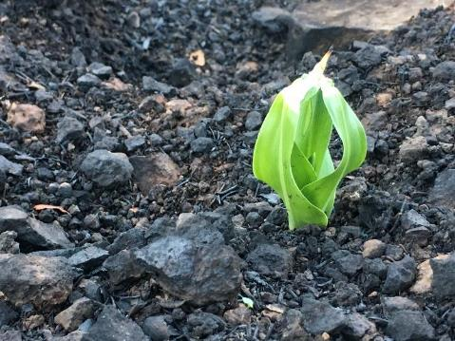
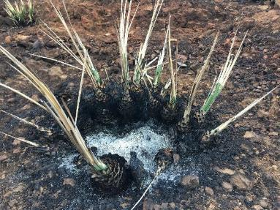
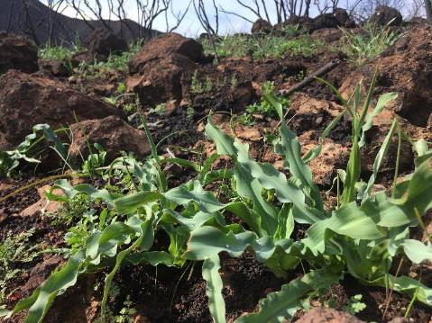
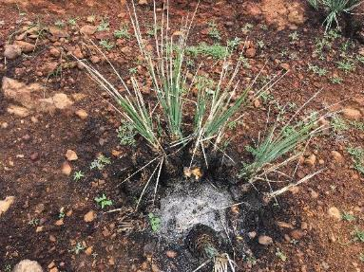
What’s next?
  What about the plants?
  Chaparral Yucca & Soap Plant started re-sprouting less than 2 weeks after the fire!
12/8/18 – Two weeks after the fire
12/8/18 – Two weeks after the fire
2/1/19 – Two months after the fire
2/1/19 – Two months after the fire
Notes:
Chaparral Yucca or Our Lord’s Candle (Hesperoyucca whipplei)
Will the mountains look the way they once did?
It depends on the rainfall…the amount and pattern of rain in the next few years.
Without enough rain, native recovery is slowed and gives plants such as mustards, grasses, and thistles the chance to spread.
Many of the park’s oaks were burned from top to bottom. Recovery depends on how deeply the burn reached inside the tree and their access to water.
A big concern is vegetation type conversion. When the dominant shrubland vegetation is replaced by non-native grass and forb species (like mustards or thistles).
With sufficient and well-timed rainfall, we could see post-fire wildflower growth throughout the burned areas during the next spring.
Other plants to look for after a fire: laurel sumac (malosma laurina), Chamise (Adenostoma fasciculatum), Greenbark Ceanothus (Ceanothus spinosus), Bigpod Ceanothus (Ceanothus megacarpus)

Slide 25
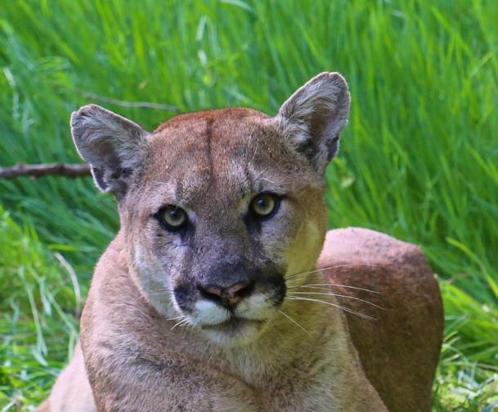
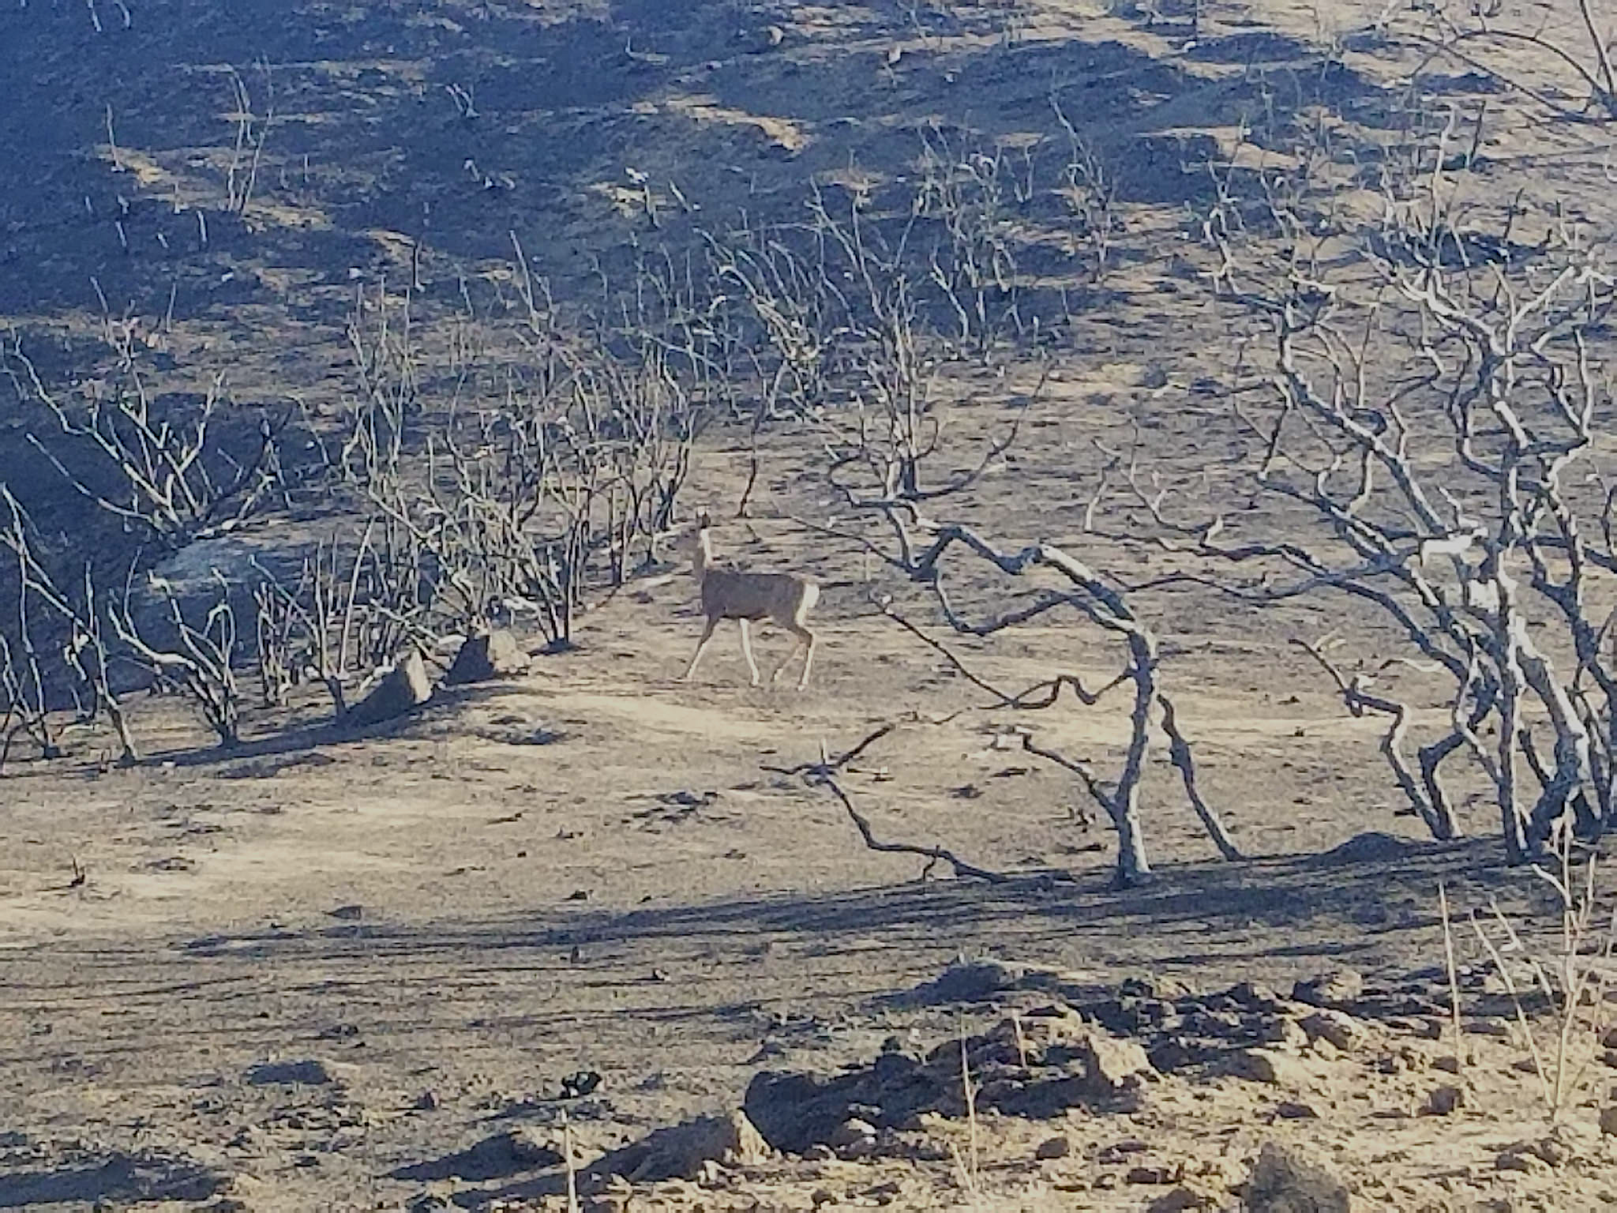
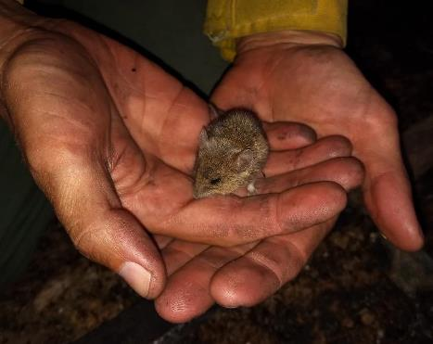
What’s next?
  What about the wildlife?
  Wildlife have instincts to avoid danger.
  What happened to the mountain lions and bobcats?
  11 lions were in or near the fire perimeter & 9 have survived the fire and appear to be moving normally.
  All 4 collared bobcats appear to be moving however, the entire home ranges of these cats has burned.
Notes:
In general, large animals like deer, coyotes, bobcats, and mountain lions can run and may be able to escape the flames.
Smaller animals have a more difficult time escaping. Those that can, will burrow underground.
Birds and bugs that can fly will flee the flames.
Even after escaping the flames, the burned landscape presents many challenges to survival, particularly with the possibility of burned paws.
Chaparral fires typically burn everything. Early years after the fire favors animals (birds, reptiles, small mammals) that like more open, dry conditions. As the vegetation returns animals that like lots of shrub cover, shade and litter become more common again
P-64, a 4 year old male, perished shortly after the fire (cause unknown) and P-74, a young male, is believed to have perished in or shortly after the fire.
Mountain Lions:
13 mountain lions currently have collars working (as of February 2019)
The National Park Service has studied more than 60 mountain lions in and around the Santa Monica Mountains.
• The #1 cause of death among study animals is intraspecific strife, or mountain lions killing other mountain lions.
• A total of 18 mountain lions have been struck and killed by vehicles in the study area since 2002 (note only six were study animals).
• A typical home range is around 200 square miles for adult males and 75 square miles for adult females.
• Mountain lions typically eat about one deer per week, along with other smaller prey as the opportunity arises. NPS researchers have analyzed more than 600 kills, of which 87% were mule deer (the second-most common prey was coyotes and then raccoons).
• 17 of 18 mountain lions have tested positive for exposure to one or more anticoagulant rodenticides (rat poison) and three have died directly of poisoning.

Slide 26
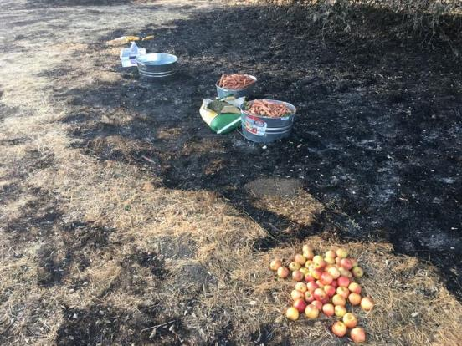
What’s next?
  What can we do to help the wildlife?
  Please keep wildlife wild!
  The best thing you can do is leave them alone.
  Leaving out food or water may habituate wildlife and make them dependent on people.
  Animals are highly resourceful and have been surviving wildfires for a very long time.
Notes:
It is against the law to leave food and water out for animals on NPS land (36 Code of Federal Regulations/CFR 2.2) with a fine of up to $5,000 and up to six months imprisonment.
If you see an injured animal you can call the California Wildlife Center (310) 458-WILD.

Slide 27
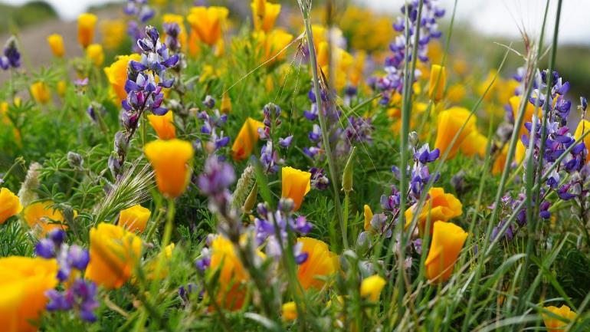
What will it take for the region to bounce back?
There is no quantifiable answer but in general it needs two things:
  Time
  The right amount of rain
Fire Followers
Lupine & Poppy
Notes:
Too much rain too close together could cause mud and debris flows, washing out seeds ad new sprouts.
But, if we don’t get enough, germinating seeds might not make it.
With the right amounts of rain, we could get a post-fire bloom of fire following wildflowers.
The effort humans can put into recover “is miniscule” compared to what nature will have to do and a major factor in how the environment will respond is the condition of the land before the fire. With recent years of drought, conditions are not encouraging but there is no simple way to predict how the mountains will recover.
Who pays for restoration?
Initially, the money for recovery efforts comes out of the BAER plan (DOI emergency funds)

Slide 28
Questions for thought
Consider the fire weather conditions near you right now? What is the temperature? How much rainfall has there been this year? Are the Santa Ana Winds blowing?
Could the current conditions increase the chance of a wildfire?
Have you experienced a wildfire? Share your story.
Notes:
Thank you for learning about Wildland Fire in the Santa Monica Mountains. To continue your journey into Santa Monica Mountains National Recreation Area: Fire Ecology continue on to the Fire Ecology: The relationship between wildfire & the biotic & abiotic environment unit.

Slide 29
References
National Park Service (NPS). (2005). Environmental impact statement fire management plan. United State Department of the Interior, National Park Service. Santa Monica Mountains National Recreation Area, Thousand Oaks, CA.
National Park Service (NPS). (2013). Springs Fire: Burned Area Emergency Response Plan(United States, National Park Service, Santa Monica Mountains National Recreation Area). Retrieved April 24, 2018, from https://www.nps.gov/samo/learn/management/upload/_SpringsFireBAERPlan_FINAL_4-1-web-reduced.pdf
National Park Service (NPS). (2015, March 1). 2013 Springs fire. Retrieved April 20, 2018, from https://www.nps.gov/samo/learn/management/2013-springs-fire.htm
National Park Service (NPS). (2018). Modern fire history. Retrieved April 20, 2018, from https://www.nps.gov/samo/learn/management/modernfirehistory.htm
Santa Monica Mountains National Recreation Area (SMMNRA). (2018, November 16). Campaign Launched to Rebuild Paramount Ranch. Retrieved from https://www.nps.gov/samo/learn/news/campaign-launched-to-rebuild-paramount-ranch.htm
Taylor, R. S. (n.d.). Fire regime, fire history, and fire behavior in the Santa Monica Mountains [PowerPoint slides]. Santa Monica Mountains National Recreation Area, California
Topozone. (n.d.). Point Mugu State Park topo map, Ventura county CA. Retrieved April 24, 2018, from https://www.topozone.com/california/ventura-ca/park/point-mugu-state-park/
Witter, M., Taylor, R., Davis, S. (2007). Vegetation response to wildfire and history in the Santa Monica mountains, California. In Flora and ecology of the Santa Monica Mountains: Proceedings of the 32nd annual Southern California Botanists symposium, ed. D.A. Knapp, (pp. 173-194). Southern California Botanists Special Publication No. 4, Fullerton, CA.
Wooten, G. (n.d.). Fire and fuels management: Definitions, ambiguous terminology and references. Retrieved April 13, 2018, from https://www.nps.gov/olym/learn/management/upload/fire-wildfire-definitions-2.pdf

