Slide 1

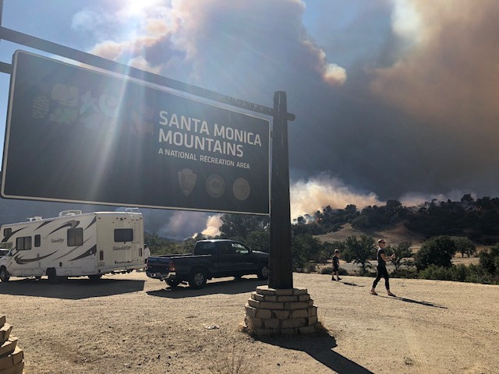
Wildland fire
Santa Monica Mountains National Recreation Area
In the Santa Monica Mountains
2018 Woolsey Fire
Notes:
“The Santa Monica Mountains have one of the most extreme fire climates in the world and periodically burn in large, dramatic wildfires (NPS 2005). Approximately 13% of this fire-prone area is developed, with communities that are among the wealthiest in Los Angeles County and the state of California. Fires in this region are often extremely damaging and costly because of both wildfire suppression costs and property losses, and are usually considered to be major social disasters.
In contrast, biologists have considered fire in the Santa Monica Mountains to be a normal event that maintains the vigor and diversity of its shrubland plant communities. Chaparral is the classic example of an auto-successional cycle where wildfire burns all of the aboveground vegetation and at the same time stimulates the regeneration of the same species that grew there previously from both the soil seed bank and resprouting shoots (Hanes 1971). The observed resilience of chaparral to fire has led to the sometimes uncritical acceptance of the idea that any fire, any time, and any where is good for chaparral. Plants are not adapted to fire per se, but to a specific fire regime defined by the range of variability in fire type, season, size, frequency, and intensity. When the parameters of the fire regime exceed their normal range species can be extirpated, causing shifts in community composition and structure to occur” (Witter, Taylor, & Davis, 2007, p. 173).

Slide 2
Santa Monica Mountains National Recreation Area Modern Fire History
Twenty largest fires to burn into the Santa Monica Mountains National Recreation Area, 1920-2019
From 1925 through 2019, more than 345 fires have been documented to occur within the boundaries of the Recreation Area.
In the greater Santa Monica Mountains area, modern fire return intervals are MUCH shorter than we think they were historically.
Fire Name
Clampitt
Woolsey
Dayton Canyon
Green Meadow
Sherwood/Zuma
Wright
Malibu
Kanan
Springs
Topanga
Devonshire-Parker
Simi Hills
Potrero #42
(Unnamed)
Old Topanga
Woodland Hills #65
Topanga #50
Ventu Park
Potrero
Calabasas
Date
09/25/1970
11/08/2018
10/09/1982
10/26/1993
12/28/1956
09/25/1970
10/23/1935
10/23/1978
05/02/2013
09/28/2005
10/15/1967
10/31/1949
11/00/1930
12/02/1958
11/02/1993
11/06/1943
11/23/1938
11/07/1955
09/06/1973
10/21/1996
Total Acres
115,537
96,949
43,096
38,478
35,169
28,202
28,195
25,588
24,251
23,396
23,093
20,578
20,391
18,119
16,202
14,919
14,532
13,956
12,297
12,189
Cause
Power Lines
Under Investigation
Arson
Arson
Unknown
Unknown
Unknown
Arson
Under Investigation
Arson
Unknown
Unknown
Unknown
Unknown
Arson
Unknown
Hot Coals Dumped
Unknown
Unknown
Power Line
Do you notice a fire season trend? Which fire happened during a different time of the year?
(NPS, 2018; Taylor, n.d.)
Notes:
“The modern fire history of the Santa Monica Mountains extends back to 1925 when the Los Angeles County Fire Department first started keeping records for this area. The fire history includes fire perimeters mapped with some degree of accuracy and the dates of the fires.
From 1925 through 2012, 343 fires have been documented to occur within the boundaries of the Recreation Area. Most fires are very small, just a fraction of an acre, and not all small fires are documented in this database. However, recent documentation of small fires is more complete than in earlier times and documentation of large fires is very good for the entire reporting period” (NPS, 2018).
“Most modern fires are quickly controlled while they are still small. But fires that start during extreme fire weather in the fall burn fiercely, spread rapidly, and can get very large before a change in the weather gives firefighters the chance to stop them. All of the largest fires in our modern fire history have occurred during Santa Ana wind events in the fall. These large fires burn much more land than all the smaller fires combined. The largest 10 percent of fires account for about 90 percent of all area burned. Power lines, which make sparks when high winds blow them into things or when trees blow down on them, and arson, are the two most common causes for large fires” (NPS, 2018).

Slide 3
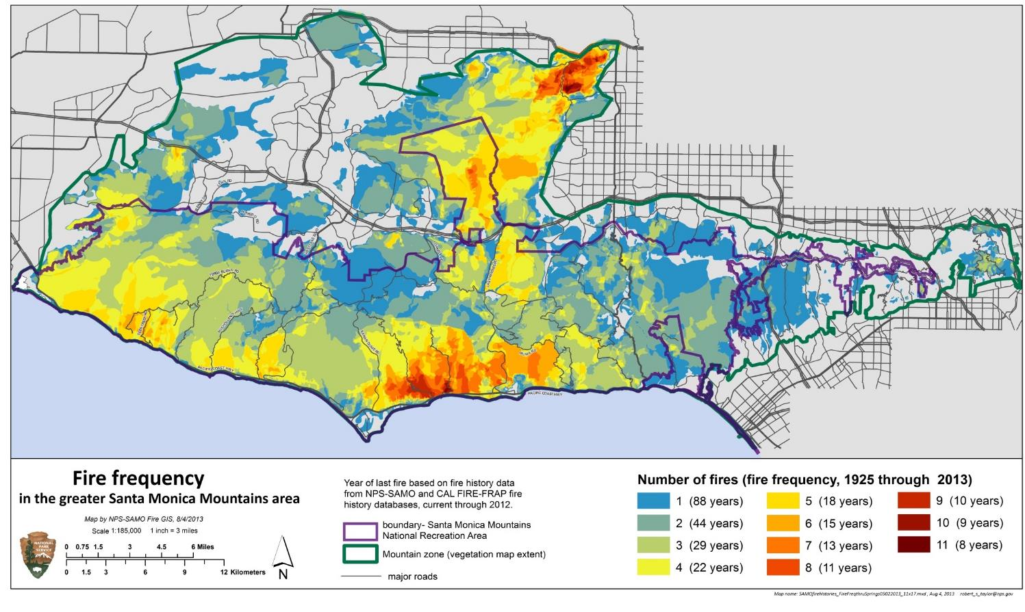
fire Frequency in Santa Monica Mountains
Santa Ana winds blowing through the canyons
Geographic distribution of winds
&
Human fire ignitions along highways & canyon roads
Why do you think certain areas like Malibu Canyon burn more than others?
Notes:
“The National Recreation Area boundary is in purple. What we call the Mountain Zone is in green.
There is a fire corridor through the middle of the mountains, an area where fires occur again and again. This geographic distribution is a function of of strong winds that push through Malibu Canyon, the only gap in the mountains from the inland valleys to the coast. Ignitions that start along Malibu Canyon and to the north along the 101 and 118 freeways follow this corridor to the sea. (Witter, personal communication, 2/20/19)
The western half of SAMO sees a lot more fire than the eastern half. The Malibu Canyon area sees the most fire of all.
These factors are likely to continue in the future, so future fire patterns are likely to look a lot like this historic one” (Taylor, n.d.).

Slide 4
Past Fires by Decade
Santa Monica Mountains
Notes:
Click through the next 11 slides to see the past fire history in the Santa Monica Mountains National Recreation Area and have the students look for trends.

Slide 6
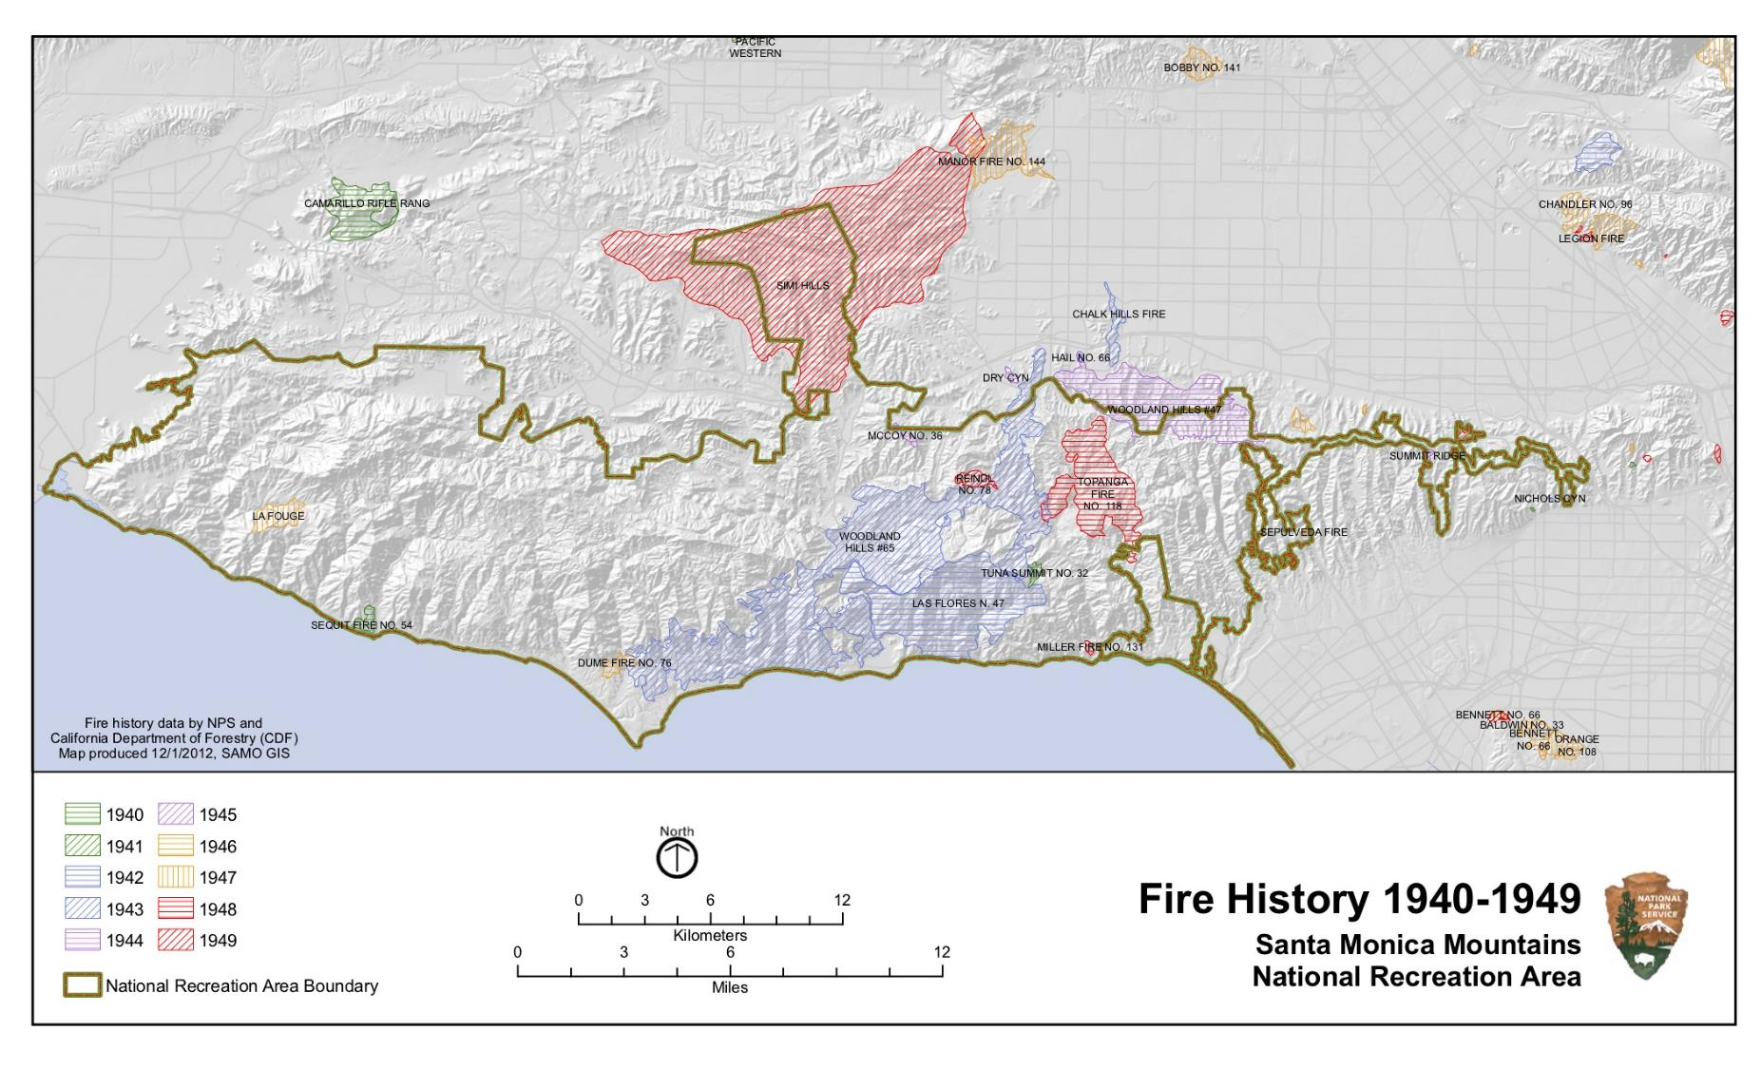

Slide 8
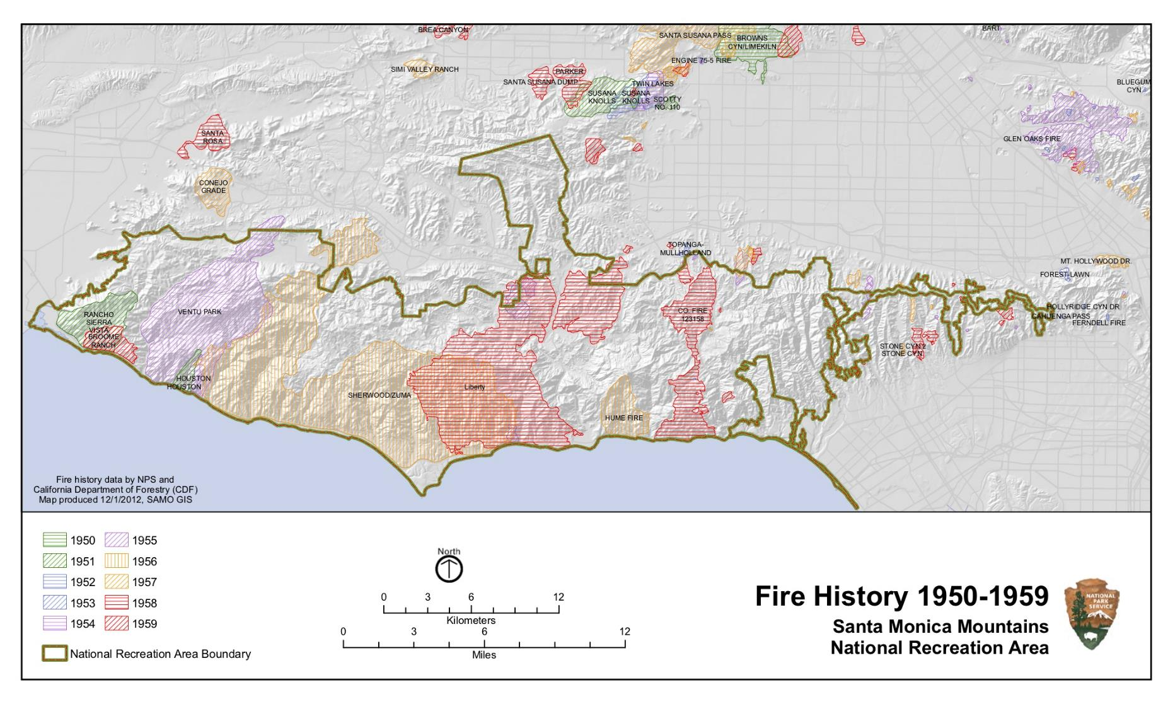

Slide 9
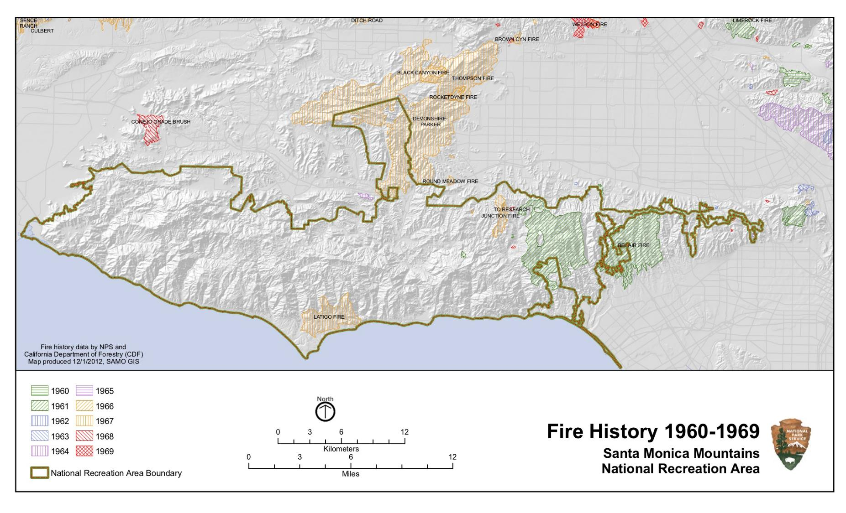

Slide 10
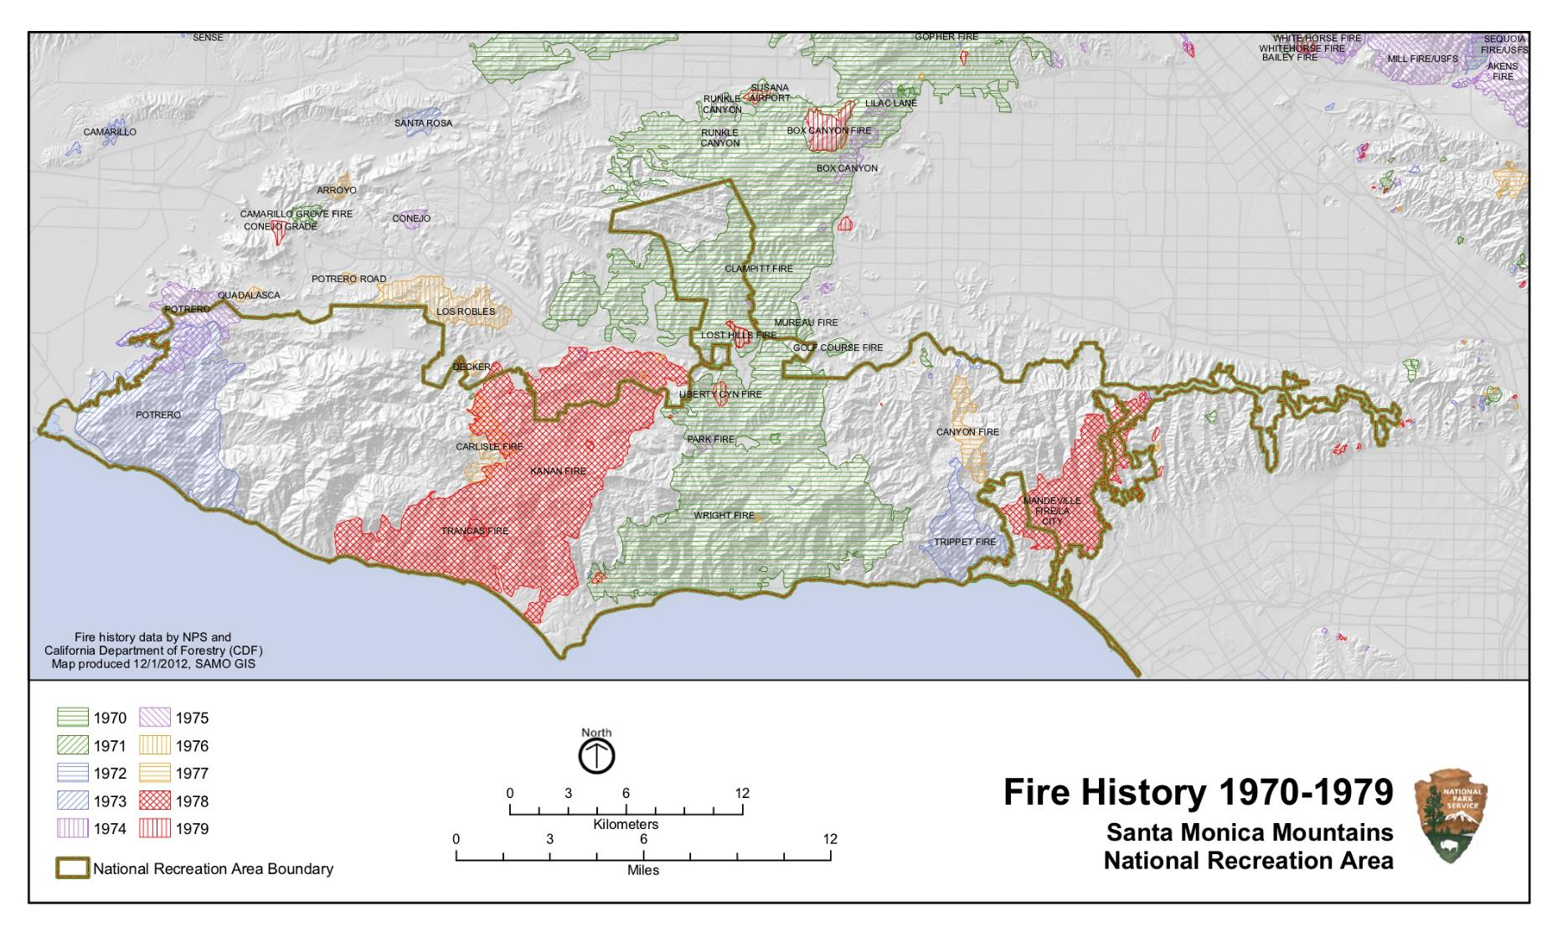

Slide 11
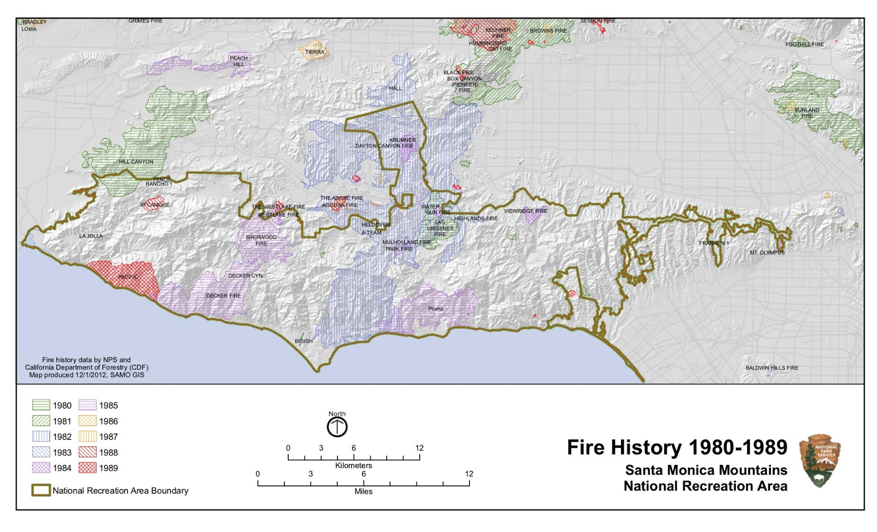

Slide 12
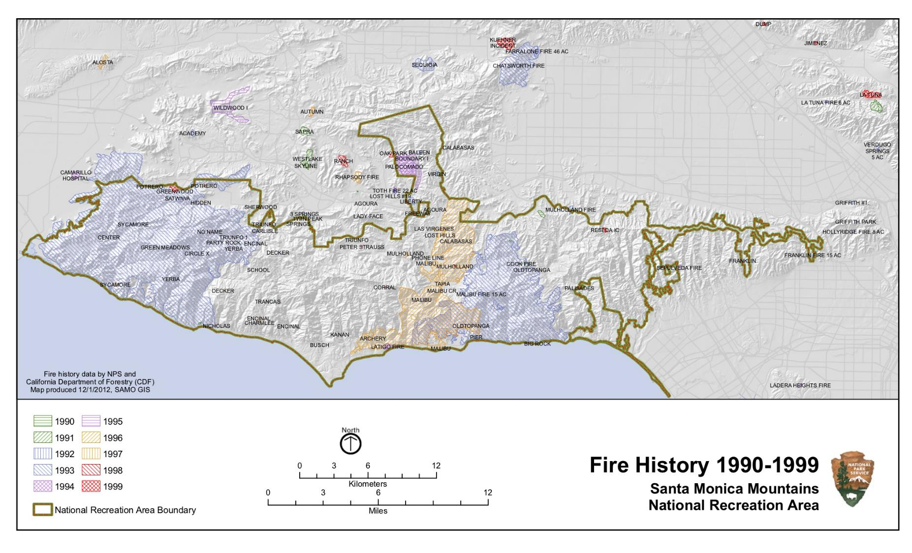

Slide 13
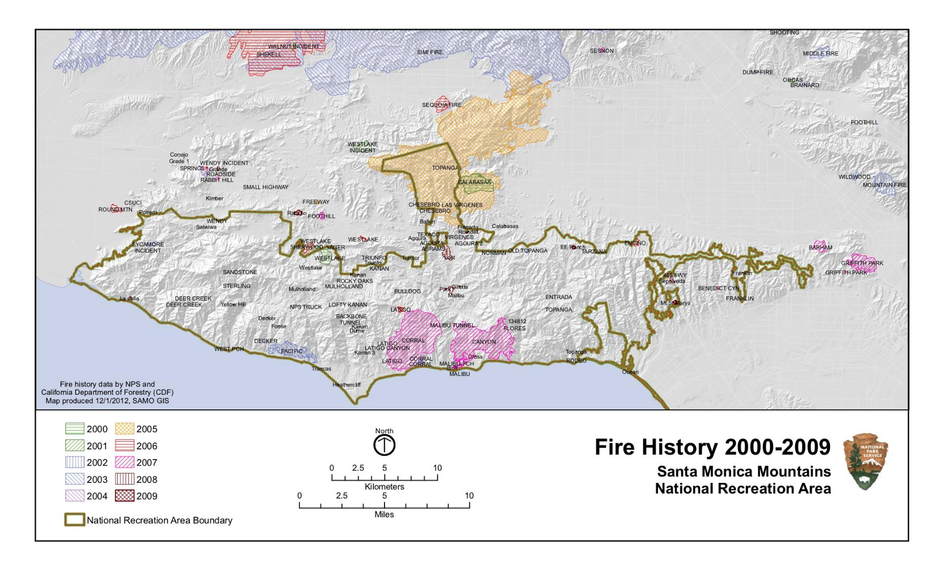

Slide 14
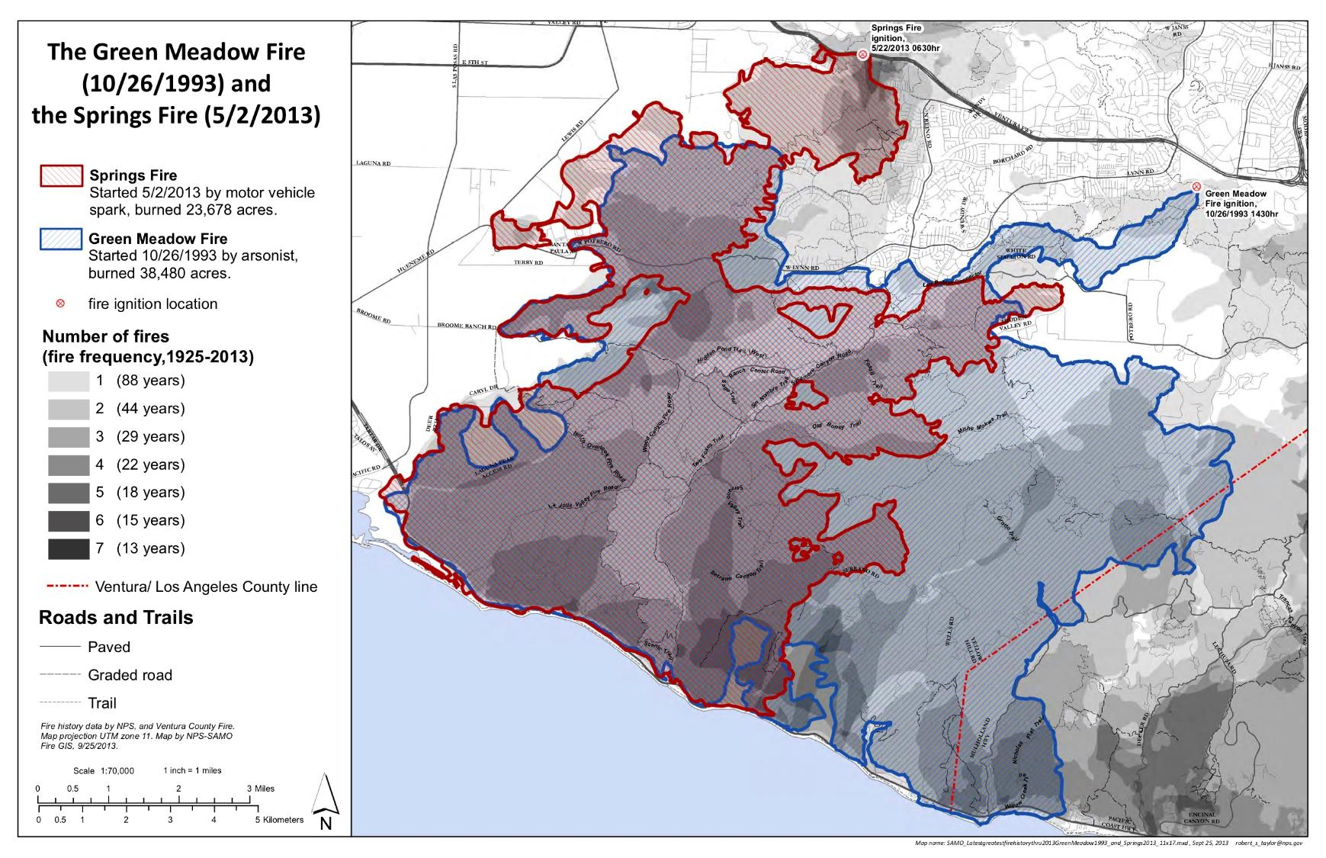

Slide 16
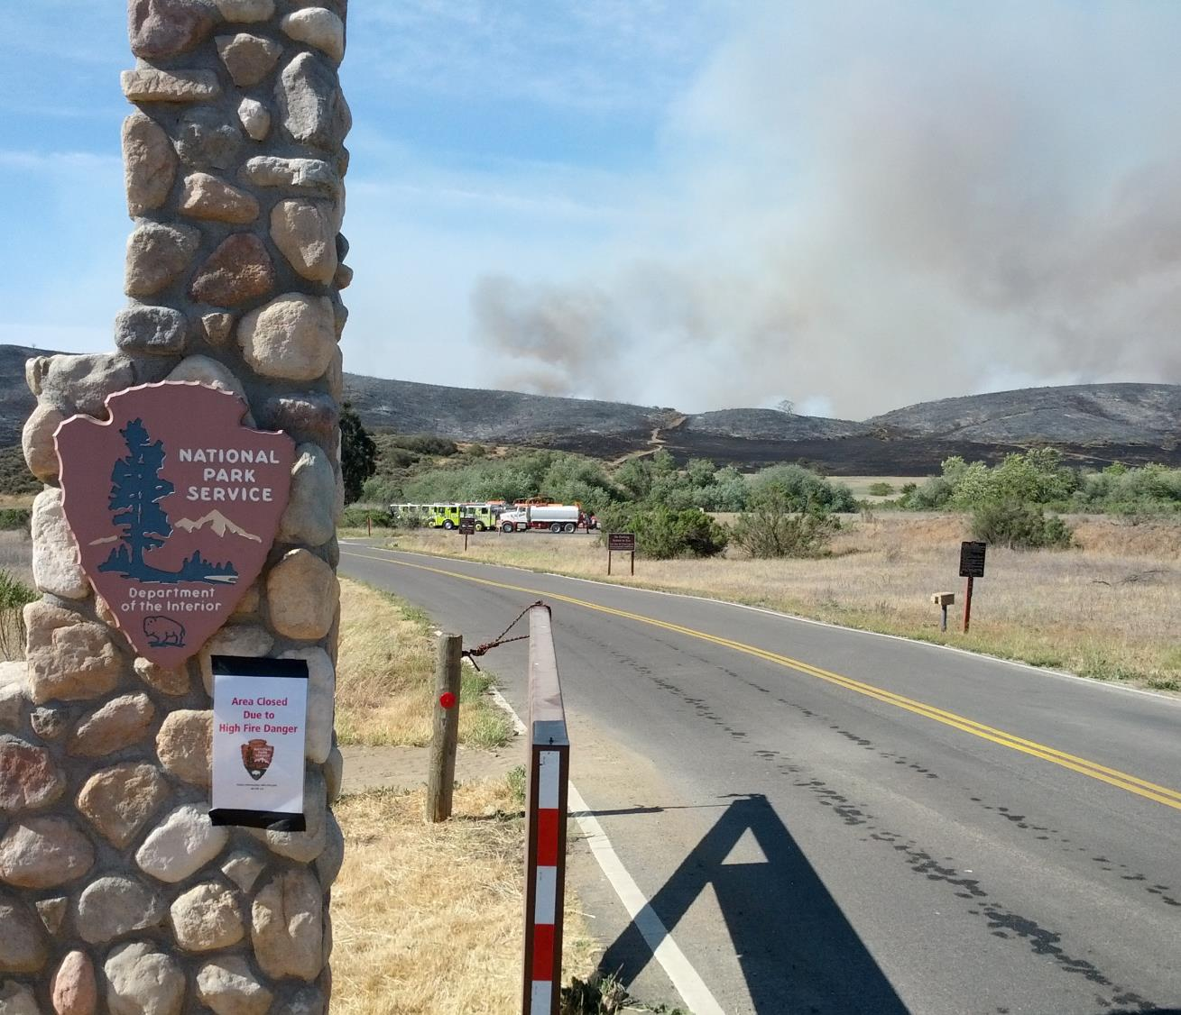
2013 Springs Fire
Santa Monica Mountains National Recreation Area
Springs Fire from Rancho Sierra Vista
(Photo: NPS)

Slide 17
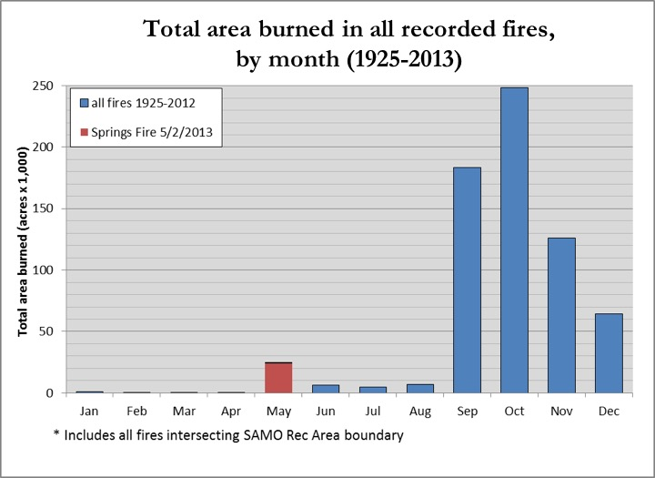
Santa Monica Mountains National Recreation Area
Springs Fire
The Springs Fire began on May 2, 2013 on the Conejo Grade section of the 101 Freeway in Camarillo, CA by accidental ignition from a passing car or truck.
The fire burned 24,238 acres in a day and a half.
It is the 5th largest wildfire in the park and it burned 12% of the Recreation Area.
The fire was declared 100% contained on May 12, 2013.
What is different about this fire than most fires in this fire regime?
(NPS, 2015)
Notes:
“The Springs Fire began on May 2, 2013 on the Conejo Grade section of the 101Freeway in Camarillo, CA by accidental ignition from a passing car or truck. The fire occurred under extreme weather conditions with low humidity, high temperatures and strong Santa Ana winds” (NPS, 2015).
“The Springs Fire was reported to the Ventura County Communications Center on Thursday May 2, 2013 at about 0630 AM. It started on a steep embankment on the south side of Highway 101 along the Conejo Grade during the heavy morning commute. This section of highway is an area of frequent fire ignitions. Two Ventura County Fire engines arrived on scene shortly after the fire was reported, but the steep 100-foot embankment could not be scaled and hose lays could not be established and the fire escaped” (NPS, 2013, p. 15).
For more information visit: https://www.nps.gov/samo/learn/management/2013-springs-fire.htm
For the complete Burned Area Emergency Response Plan (BAER) visit: https://www.nps.gov/samo/learn/management/upload/_SpringsFireBAERPlan_FINAL_4-1-web-reduced.pdf
Answer to question:
“The spring season fire was unprecedented for the time of year in which it burned. All other large fires in the Santa Monica Mountains National Recreation Area have previously occurred in the fall at the end of the summer dry season when fuel moisture is low and Santa Ana winds occur more frequently. The year’s low rainfall was concentrated early in the season and created very dry fuel conditions for so early in the spring. This allowed for the rapid fire spread that occurred” (NPS, 2015).

Slide 18
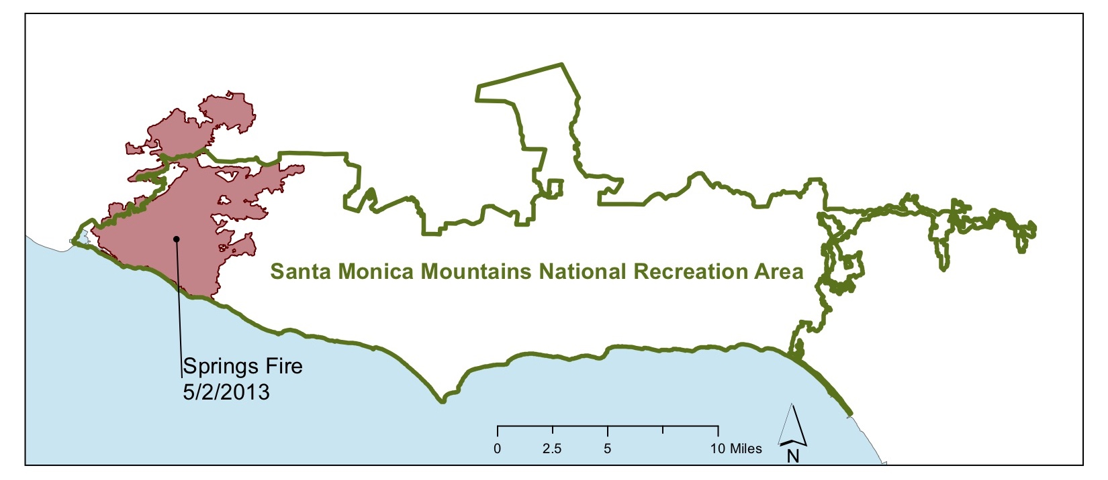
Santa Monica Mountains National Recreation Area
Springs Fire

Slide 19
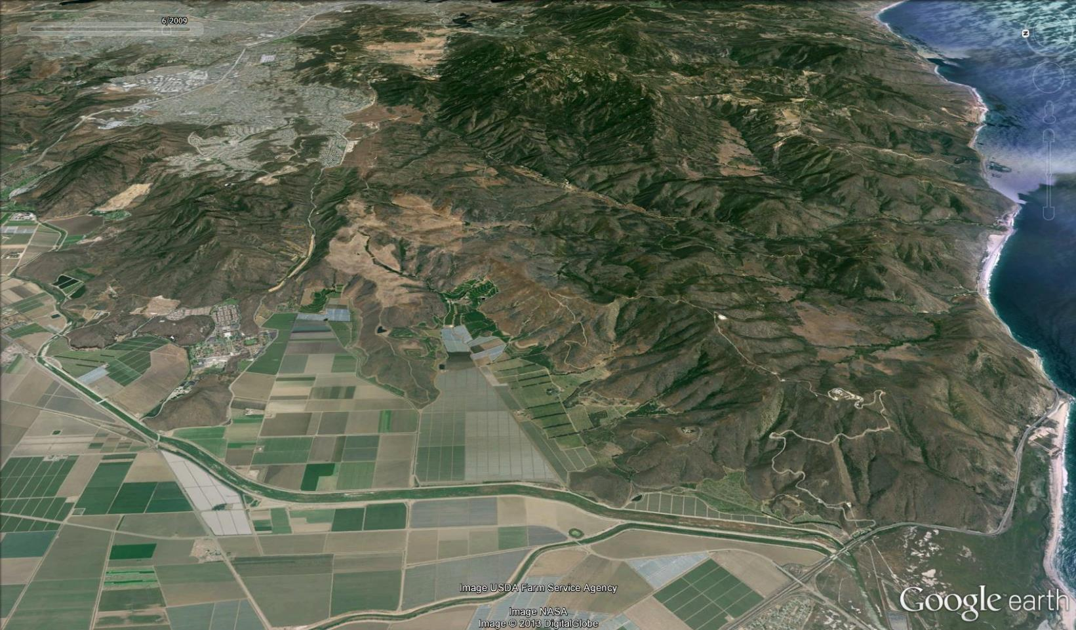
Santa Monica Mountains National Recreation Area Springs Fire Progression
5/2/2013 0600hr
(Map: Robert Taylor; Taylor, n.d.)
Notes:
Click through the slides to see the progression of the Springs Fire.

Slide 20

Santa Monica Mountains National Recreation Area Springs Fire Progression
5/2/2013 0630hr
(Map: Robert Taylor; Taylor, n.d.)

Slide 21

Santa Monica Mountains National Recreation Area Springs Fire Progression
5/2/2013 0800hr
(Map: Robert Taylor; Taylor, n.d.)

Slide 22
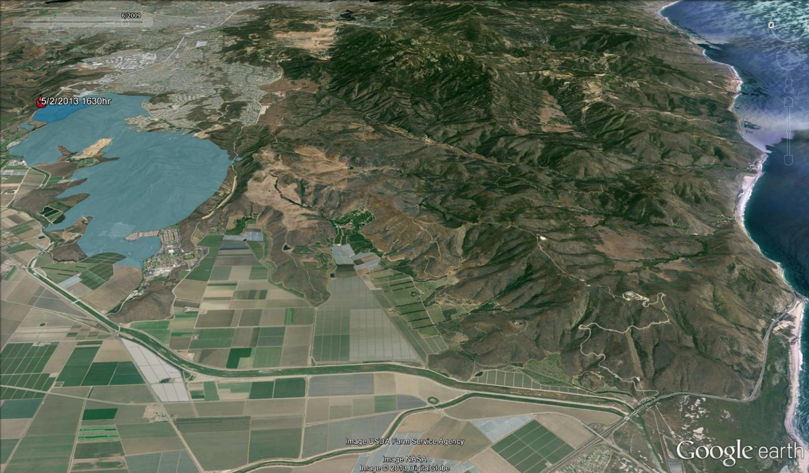
Santa Monica Mountains National Recreation Area Springs Fire Progression
5/2/2013 1100hr
(Map: Robert Taylor; Taylor, n.d.)

Slide 23
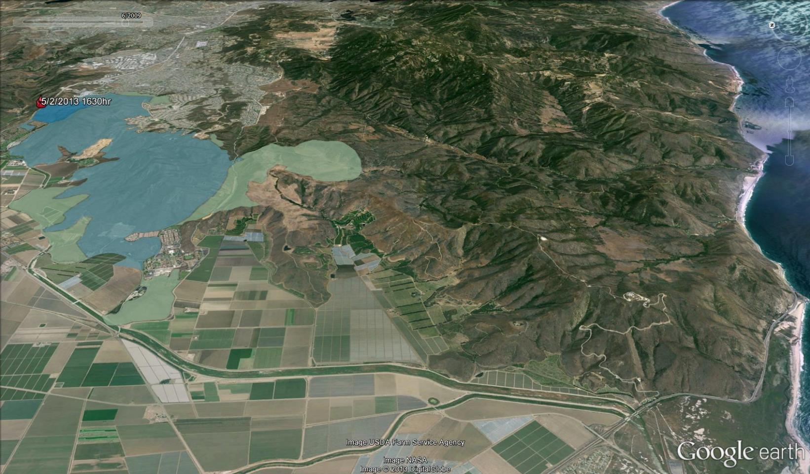
Santa Monica Mountains National Recreation Area Springs Fire Progression
5/2/2013 1300hr
(Map: Robert Taylor; Taylor, n.d.)

Slide 24
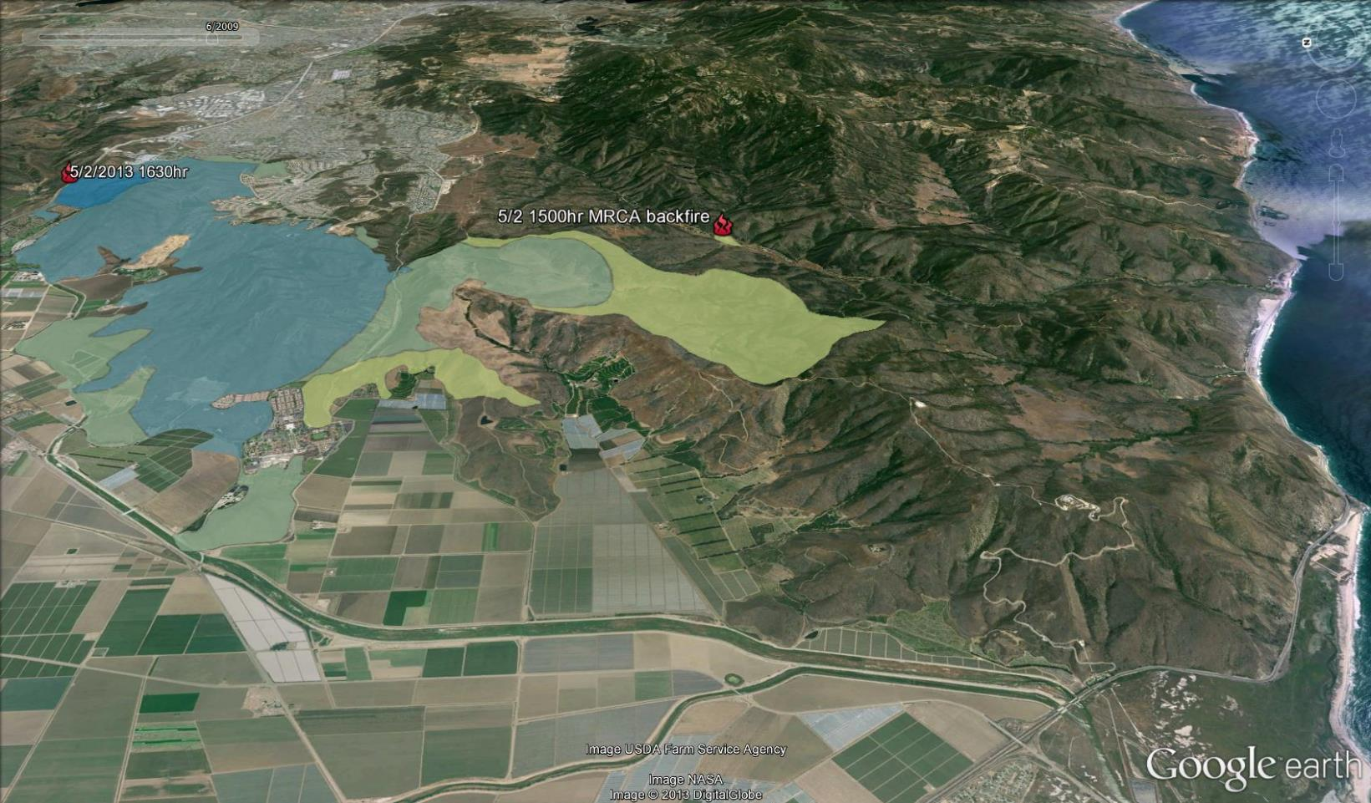
Santa Monica Mountains National Recreation Area Springs Fire Progression
5/2/2013 1500hr
(Map: Robert Taylor; Taylor, n.d.)
Notes:
Backfire—Intentionally setting fire to fuels inside a control line to contain a fire. The wildfire burns toward the backfire area. When it meets the already burned area, it has no fuel left to burn. (Wooten, n.d.)
Powerpoint file continued in part 2 file (P2)

