Slide 1
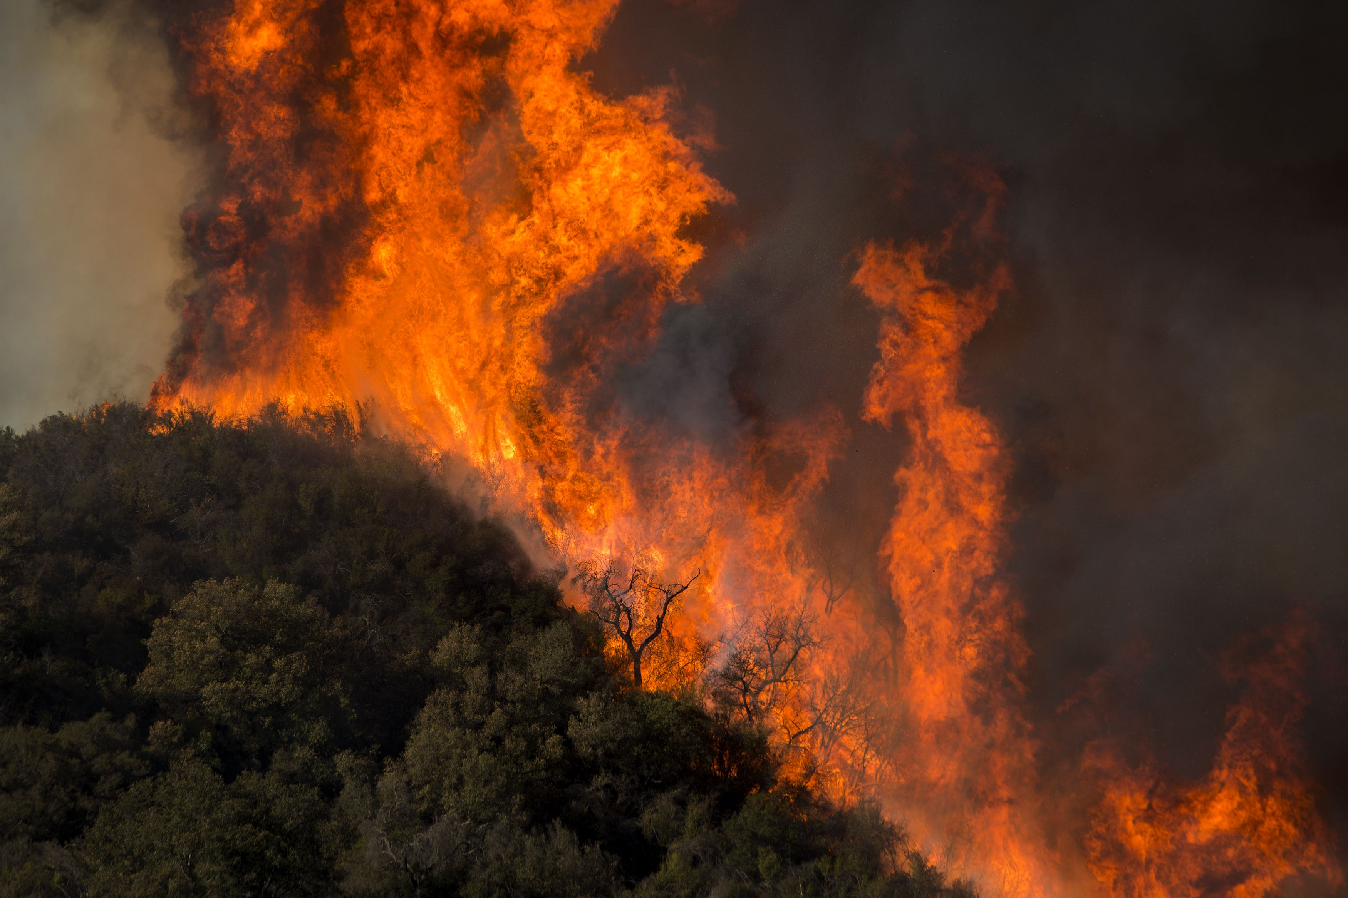
Wildfires and Our Home

Slide 2
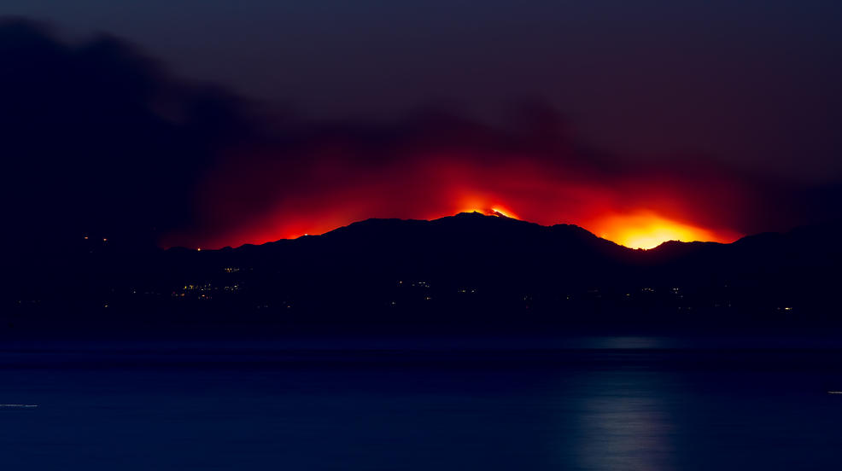
What comes to your mind when you hear the word FIRE?
Notes:
Have the students express and words, feelings, or thoughts when they hear the word fire.

Slide 3
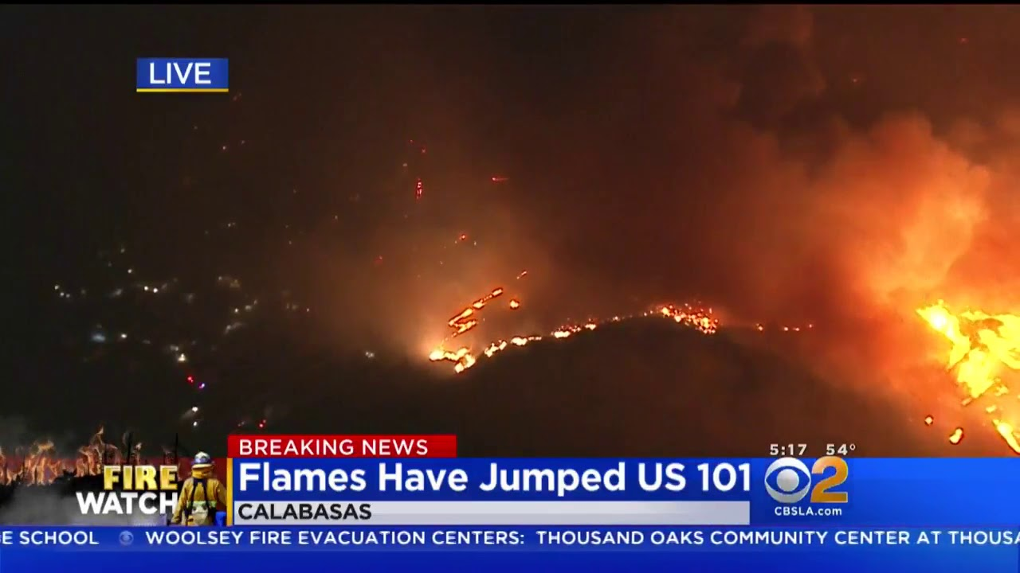
Fires in California
How many of you have heard about fires in the news?
Fires are a part of people’s lives in California because of where we live.

Slide 4
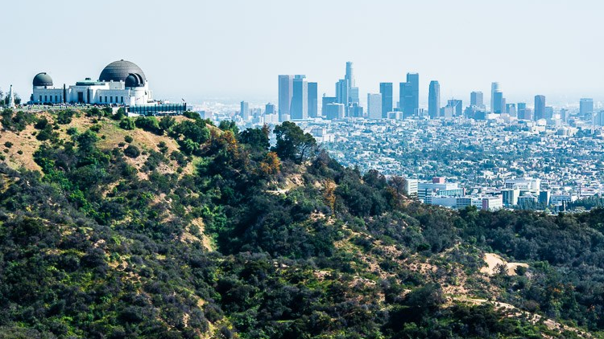
Our home is very special because of its climate.
Photo by Bethany Szczepanski
Notes:
California is a unique place in the world with many plants, animals, people that can only be found here. We have endemic ecosystems and a unique climate that is very rare on our planet.

Slide 5
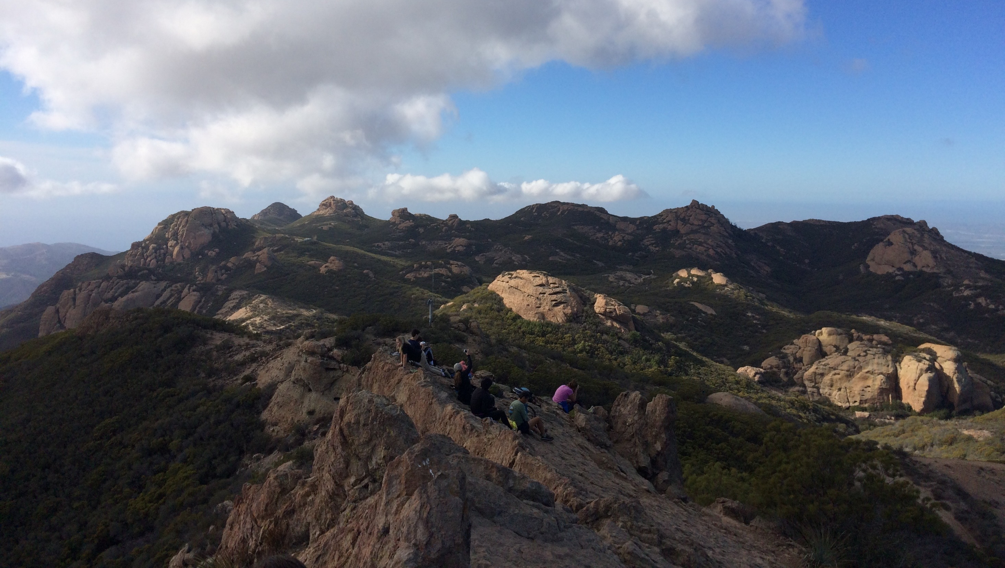
It is a Mediterranean Climate.
Photo by Bethany Szczepanski
Notes:
California is a unique place in the world with many plants, animals, people that can only be found here. We have endemic ecosystems and a unique climate that is very rare on our planet.

Slide 6
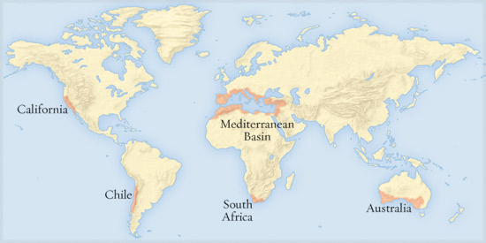
The Mediterranean Climate
Is found in 5 parts of the world
It has hot and dry summers
It has mild and wet winters
Notes:
Notes for teacher: from Ranger Bethany Szczepanski
The following features distinguish one biome from another:
Climate
The characteristics of a biome are determined by temperature and rainfall.
Example: Tropical Rain Forests have year-round rainfall with warm temperatures ideal for lush, leafy plant growth. A Boreal Forest (evergreen coniferous) has plants and trees that must endure cold, snowy weather in winter and little rain in the summer. The plant life of each of these areas is significantly different as each has adapted to survive the area’s climate conditions.
Soil
Certain soil types characterize a biome. Soils are very important because they determine what types of plants will grow within a biome. They are influenced by the parent-rock geology and the climate.
Example: The soils of a Temperate Broadleaf biome are characterized by a dark brown, slightly acid soil. This is due to the heavy tree cover of the biome and its warm, wet summers that cause a buildup of organic materials forming a loamy soil.
Vegetation
The plant life of biomes is dependent on the soil and climate of the area. Plants adapt to specific conditions by changing such characteristics as leaf shape and size.
Example: Adapting to the long, dry summer conditions, the chaparral plants of the Mediterranean biome are woody shrubs containing small, thick, waxy leaves capable of retaining water moisture.
Animals
Climate, soil, and vegetation all help determine the animal life and adaptations of the animals to a biome.
Example: Burrowing, nocturnal animals are typical of a Desert biome, having adapted to hot daytime temperatures.
Location
Some biomes have similar location patterns around the world. Similar biomes are often found at the same latitude around the world.
Example: Various Desert biomes around the world are located between 20° and 30° latitude, including Chihuahuan Desert in Mexico, Sahara Desert in North Africa, and Great Indian Desert in India. Altitude similarities exist as well. Ascending a tall mountain, the higher in altitude you climb, the cooler the temperature, the thinner the air, and the longer the winter. Several different climates exist on one mountain, so different biomes can exist as well.
Example: As one climbs in altitude, a Temperate Deciduous Forest biome (broadleaf deciduous trees) can change to a Boreal Forest biome (evergreen pine trees) and eventually become a Tundra biome (treeless and cold).
(NPS)

Slide 7
The Mediterranean Climate
Where are we?

Slide 8
The Mediterranean Climate
Where are we?

Slide 9
The Mediterranean Climate
The most common plant community in southern California is Chaparral and Coastal Sage Scrub.
Because of this climate, wildfires can occur in these plant communities.

Slide 10
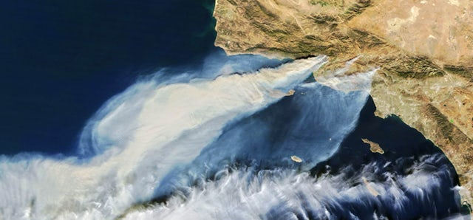
How does a fire start?
Photo by NASA

Slide 11
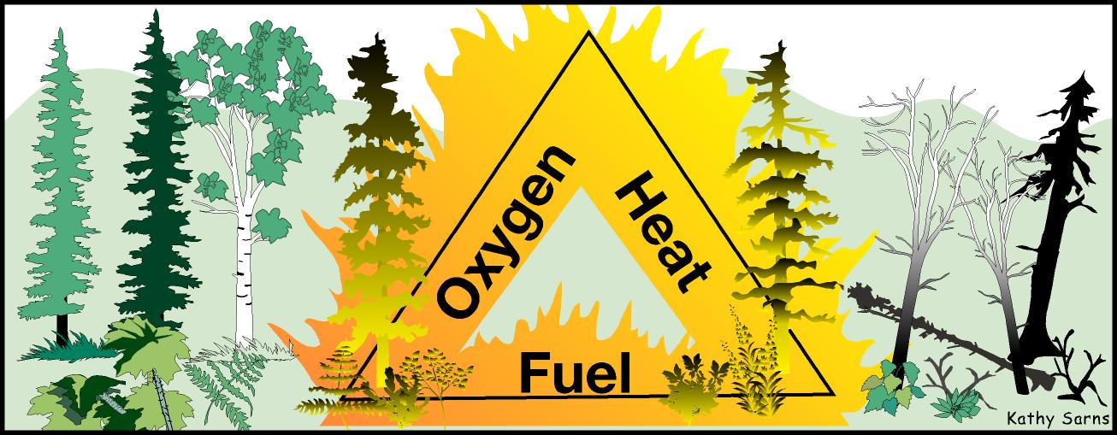
The Fire Triangle Activity
Pair up with someone sitting next to you.
On sheet of paper, draw a triangle.
Write down 3 three things you think are needed for fire to start.

Slide 12
Fire needs Oxygen, Heat, and Fuel
With your partner, discuss wherein the mountains you think fire gets:
Oxygen
Heat
Fuel
Optional Video Link: What is a Flame?

Slide 13
Fire needs Oxygen, Heat, and Fuel
If you remove ONE, the fire will stop burning.

Slide 14
Oxygen
Oxygen is everywhere in the air and there is an endless supply outside.
Notes:
Source: https://smokeybear.com/en/about-wildland-fire/fire-science/elements-of-fire
Air contains about 21 percent oxygen, and most fires require at least 16 percent oxygen content to burn. Oxygen supports the chemical processes that occur during fire. When fuel burns, it reacts with oxygen from the surrounding air, releasing heat and generating combustion products (gases, smoke, embers, etc.). This process is known as oxidation.

Slide 15
Heat
Heat comes from the movement of atoms or molecules.
The faster molecules move, the hotter they will be.
Heat can come from lightning, cigarettes, sparks,
matches, etc.
Notes:
https://smokeybear.com/en/about-wildland-fire/fire-science/elements-of-fire
A heat source is responsible for the initial ignition of fire, and is also needed to maintain the fire and enable it to spread. Heat allows fire to spread by drying out and preheating nearby fuel and warming surrounding air.

Slide 16
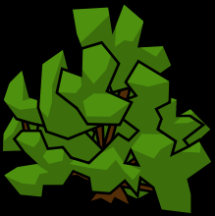
Heat
Heat emits energy and can warm up or dry things around it.
by raemi
Notes:
https://smokeybear.com/en/about-wildland-fire/fire-science/elements-of-fire
A heat source is responsible for the initial ignition of fire, and is also needed to maintain the fire and enable it to spread. Heat allows fire to spread by drying out and preheating nearby fuel and warming surrounding air.

Slide 17
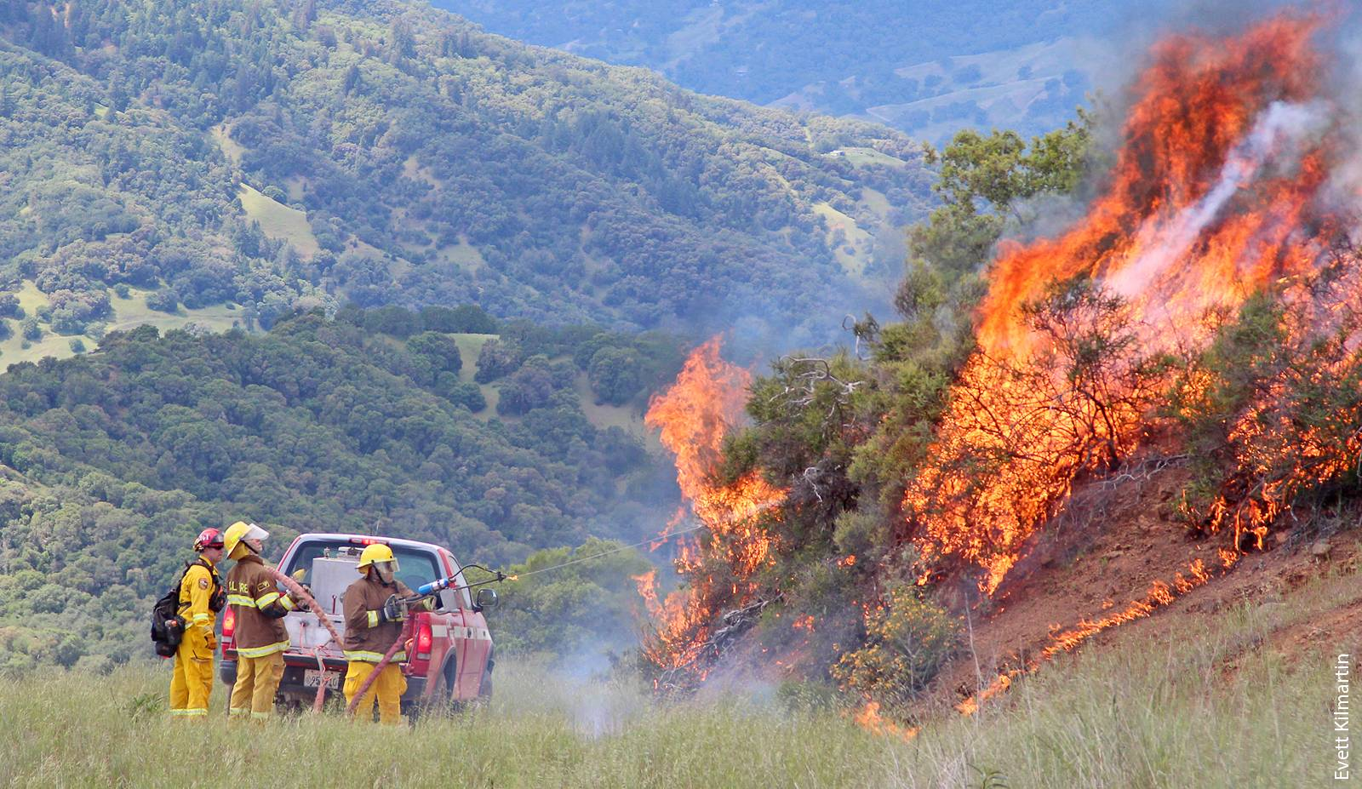
Fuel
Fuels are materials that can catch fire. Fuels include wood, leaves, grass, paper, chemicals, etc.
Fuels burn differently depending on:
How dry they are
Their shape and size
The amount of fuel
Where they are found
Notes:
https://smokeybear.com/en/about-wildland-fire/fire-science/elements-of-fire
Fuel
Fuel is any kind of combustible material. It’s characterized by its moisture content, size, shape, quantity and the arrangement in which it is spread over the landscape. The moisture content determines how easily it will burn.

Slide 18
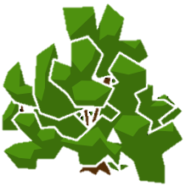
How Fuels Catch Fire
Heat emits energy.
As temperatures increase, the plants dry out.
Oxygen contributes to plant combustion.

Slide 19
Fire Behavior Activity: Draw a Model
On your paper:
Draw a Mountain

Slide 20
Fire Behavior Activity: Draw a Model
On your paper:
Draw a Mountain
Draw grass at the bottom

Slide 21
Fire Behavior Activity: Draw a Model
On your paper:
Draw a Mountain
Draw grass at the bottom
Draw bushes on the grass and mountain

Slide 22
Fire Behavior Activity: Draw a Model
On your paper:
Draw a Mountain
Draw grass at the bottom
Draw bushes on the grass and mountain
Draw a little fire at the base of the mountain
Discuss with your partner where the fire will go and why

Slide 23
Fire Behavior Triangle
Fire needs heat, fuel, and oxygen to start and continue to burn.
Wildfires will behave differently depending on:
Fuel
Weather
Topography
Topography
Weather

Slide 24
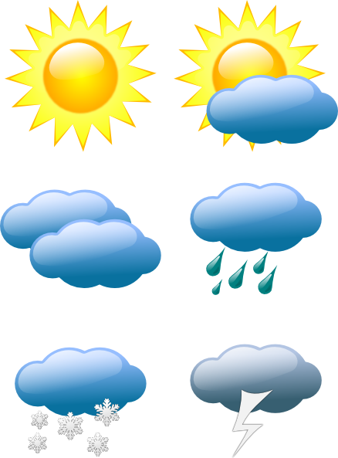
Fire Behavior Triangle: Weather
When looking at how weather influences fire behavior, we look at:
Wind
Precipitation (rain or snow)
Humidity (moisture in the air)
Temperature

Slide 25
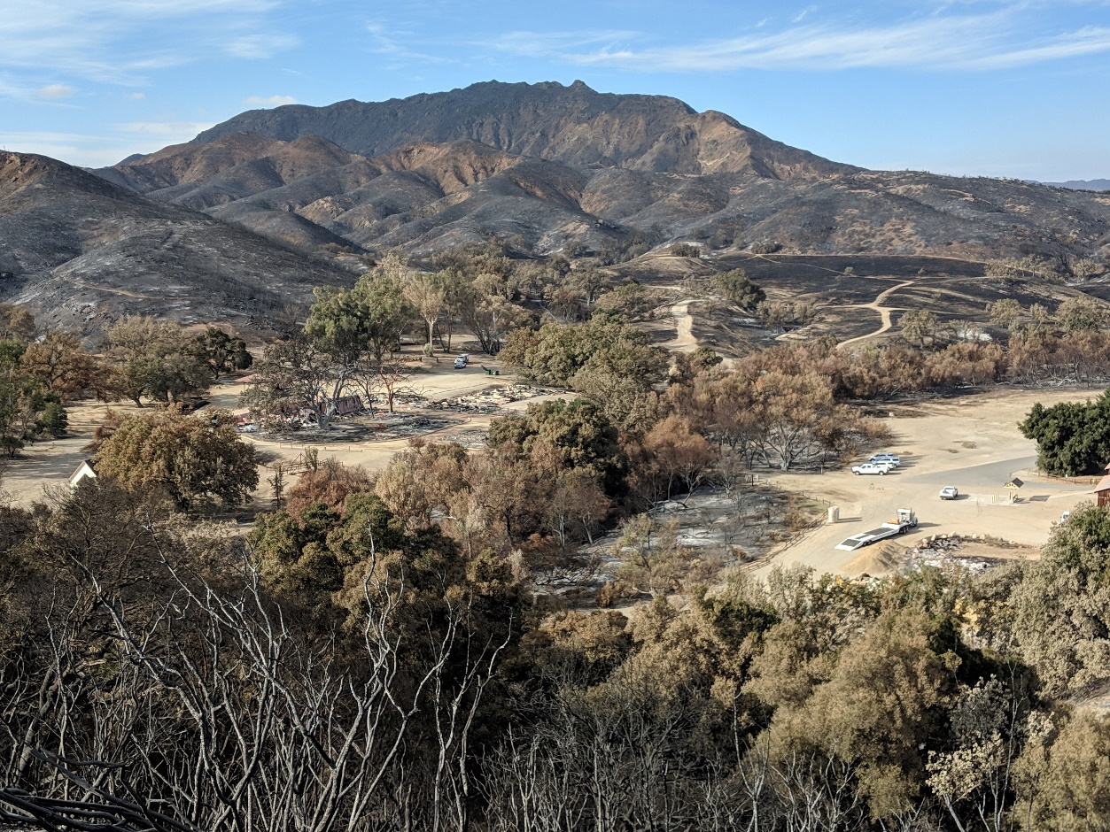
Fire Behavior Triangle: Topography
Topography is the shape of the land
Photo by Nico Ramirez

Slide 26
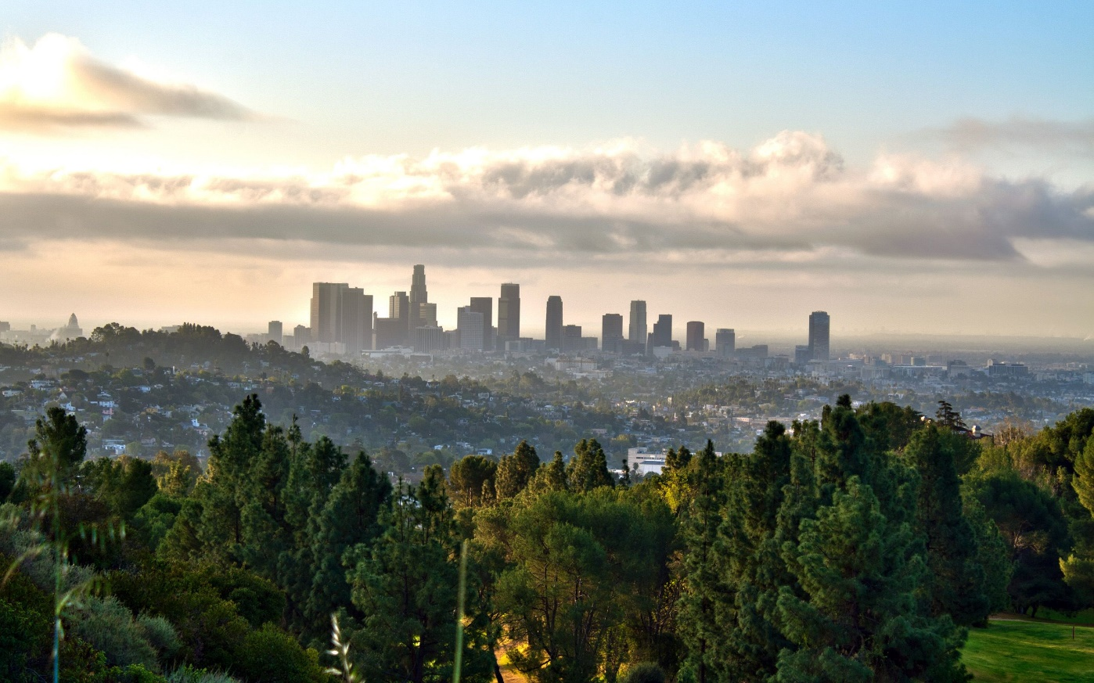
Fire Behavior Triangle: Topography
Are there hills or mountains where you live?
Are there canyons and steep cliffs?
Are there rivers or lakes?
Are there roads and buildings?

Slide 27
Fire Behavior Activity: Draw a Model
On your picture:
What will the fire do if it:
Is hot with winds blowing up the mountain?
It rains a lot?
Discuss with your partner.

Slide 28
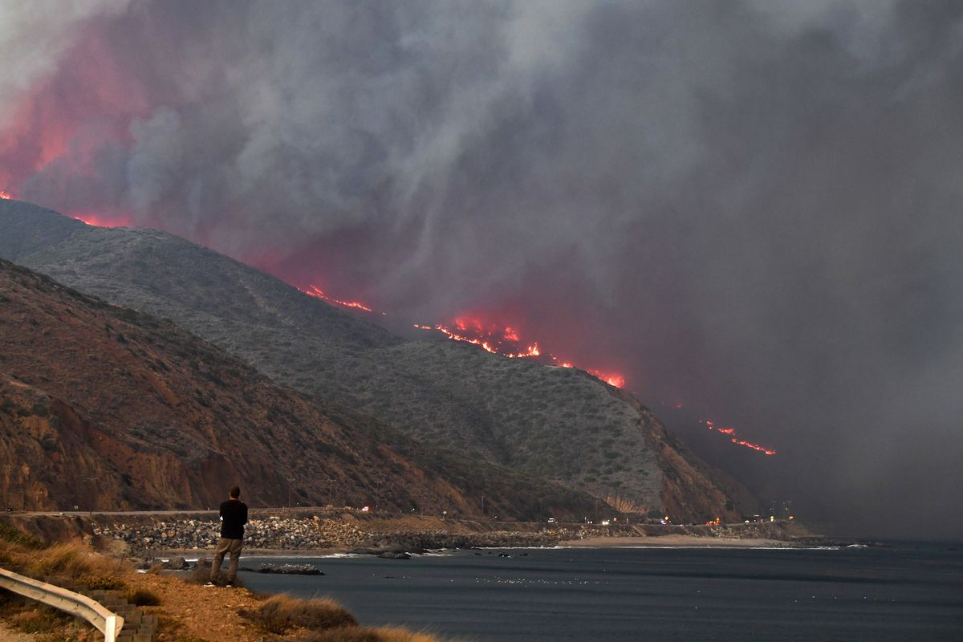
Fire in our nearby ecosystems
Fires in southern California can help chaparral plan communities maintain biodiversity and sprout new growth.
Photo by AP/Getty Images

Slide 29
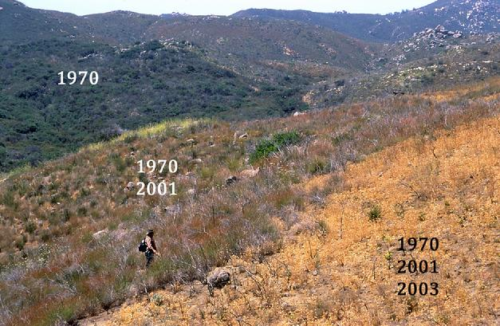
Fire in our nearby ecosystems
If fires burn too often, plants from other places can move in and native plants won’t grow back. The plant community can change.
These are invasive species, and they can take over.
Photo by California Chaparral Institute

Slide 30
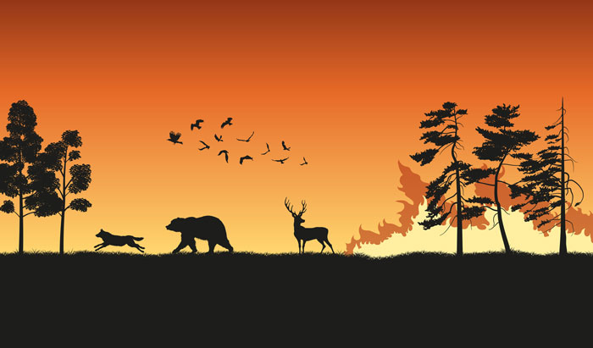
Wildlife and Fire
Wildlife have instincts that allow them to avoid danger.
Some wildlife will die.
Birds and bugs with wings will fly away.
Some animals with burrows can escape underground.
Large animals will run away.
Photo from Common Ground

Slide 31
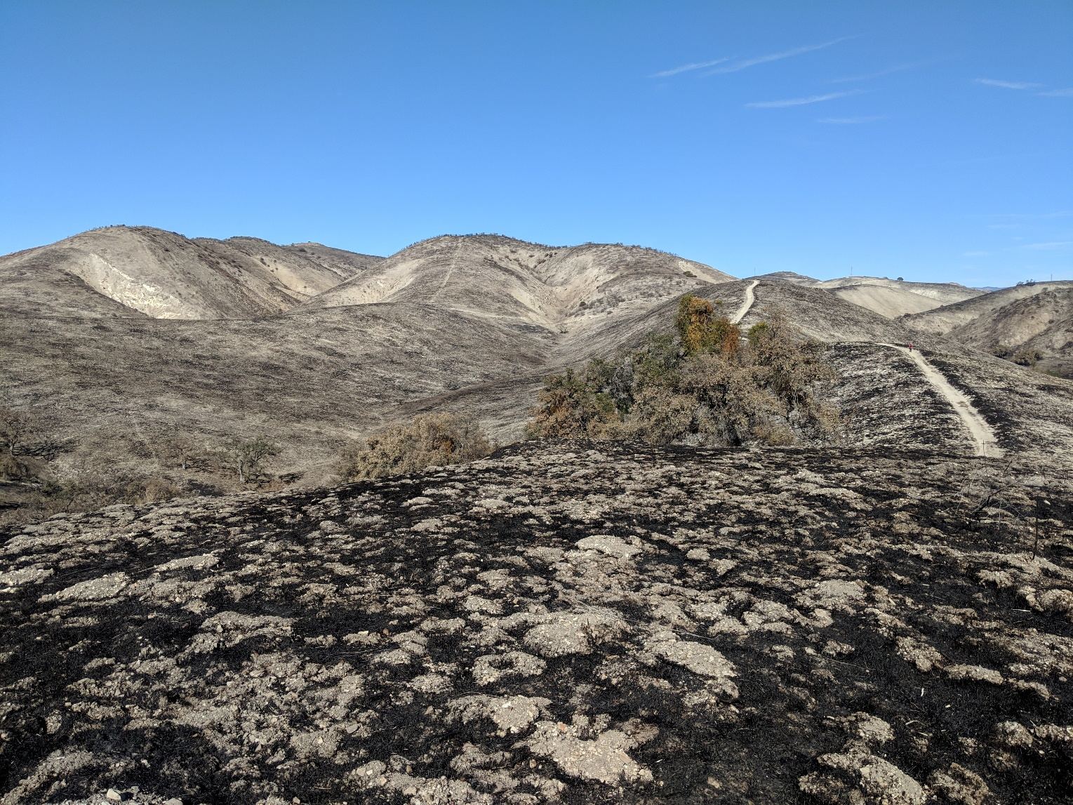
Wildlife and Fire
If a fire is too hot and everything is burned, it may take a little longer for animals to move back home.
Photo by Nico Ramirez

Slide 32
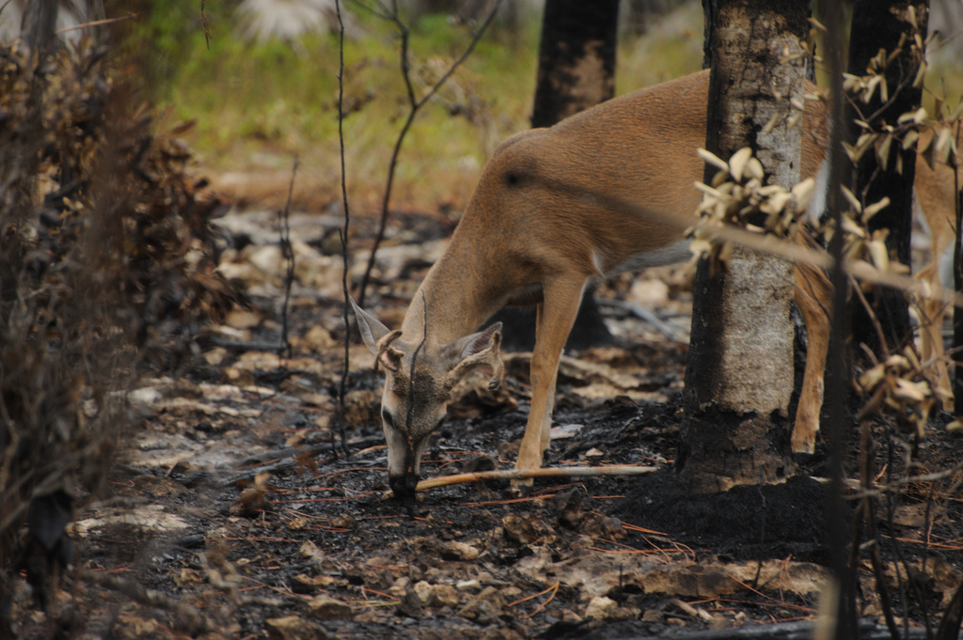
Wildlife and Fire
Insects can move into dead plants which will attract birds and other organisms.
As flowers and grasses reappear, larger mammals, such as deer move back and their predators will follow.
Many animals survive and some die.

Slide 33
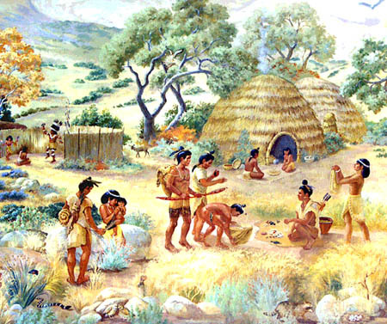
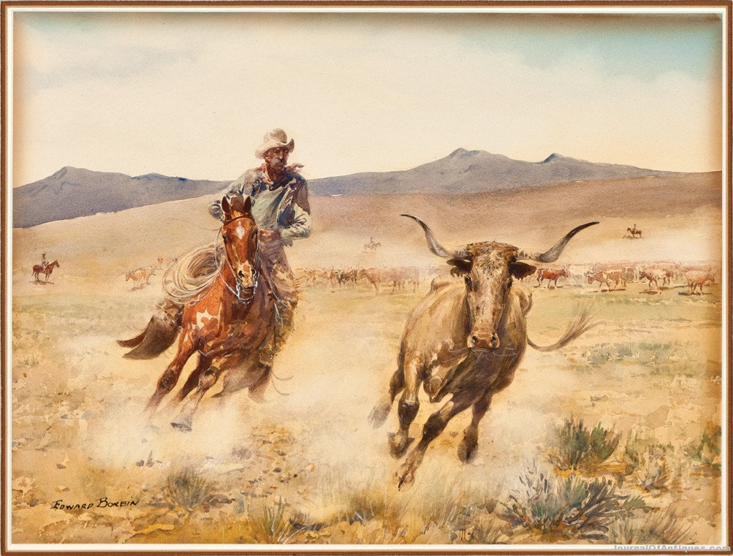
People and Fire
California has a rich cultural history. There are Native Americans, settlers, and ranchers who have used fire as a tool to their advantage.

Slide 34
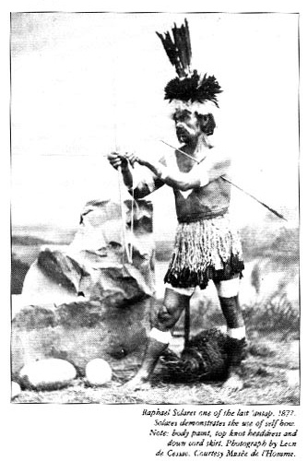
People and Fire
California Native Americans used fire to:
Protect themselves from predators
Increase favored game species
Produce food and materials
Warfare

Slide 35
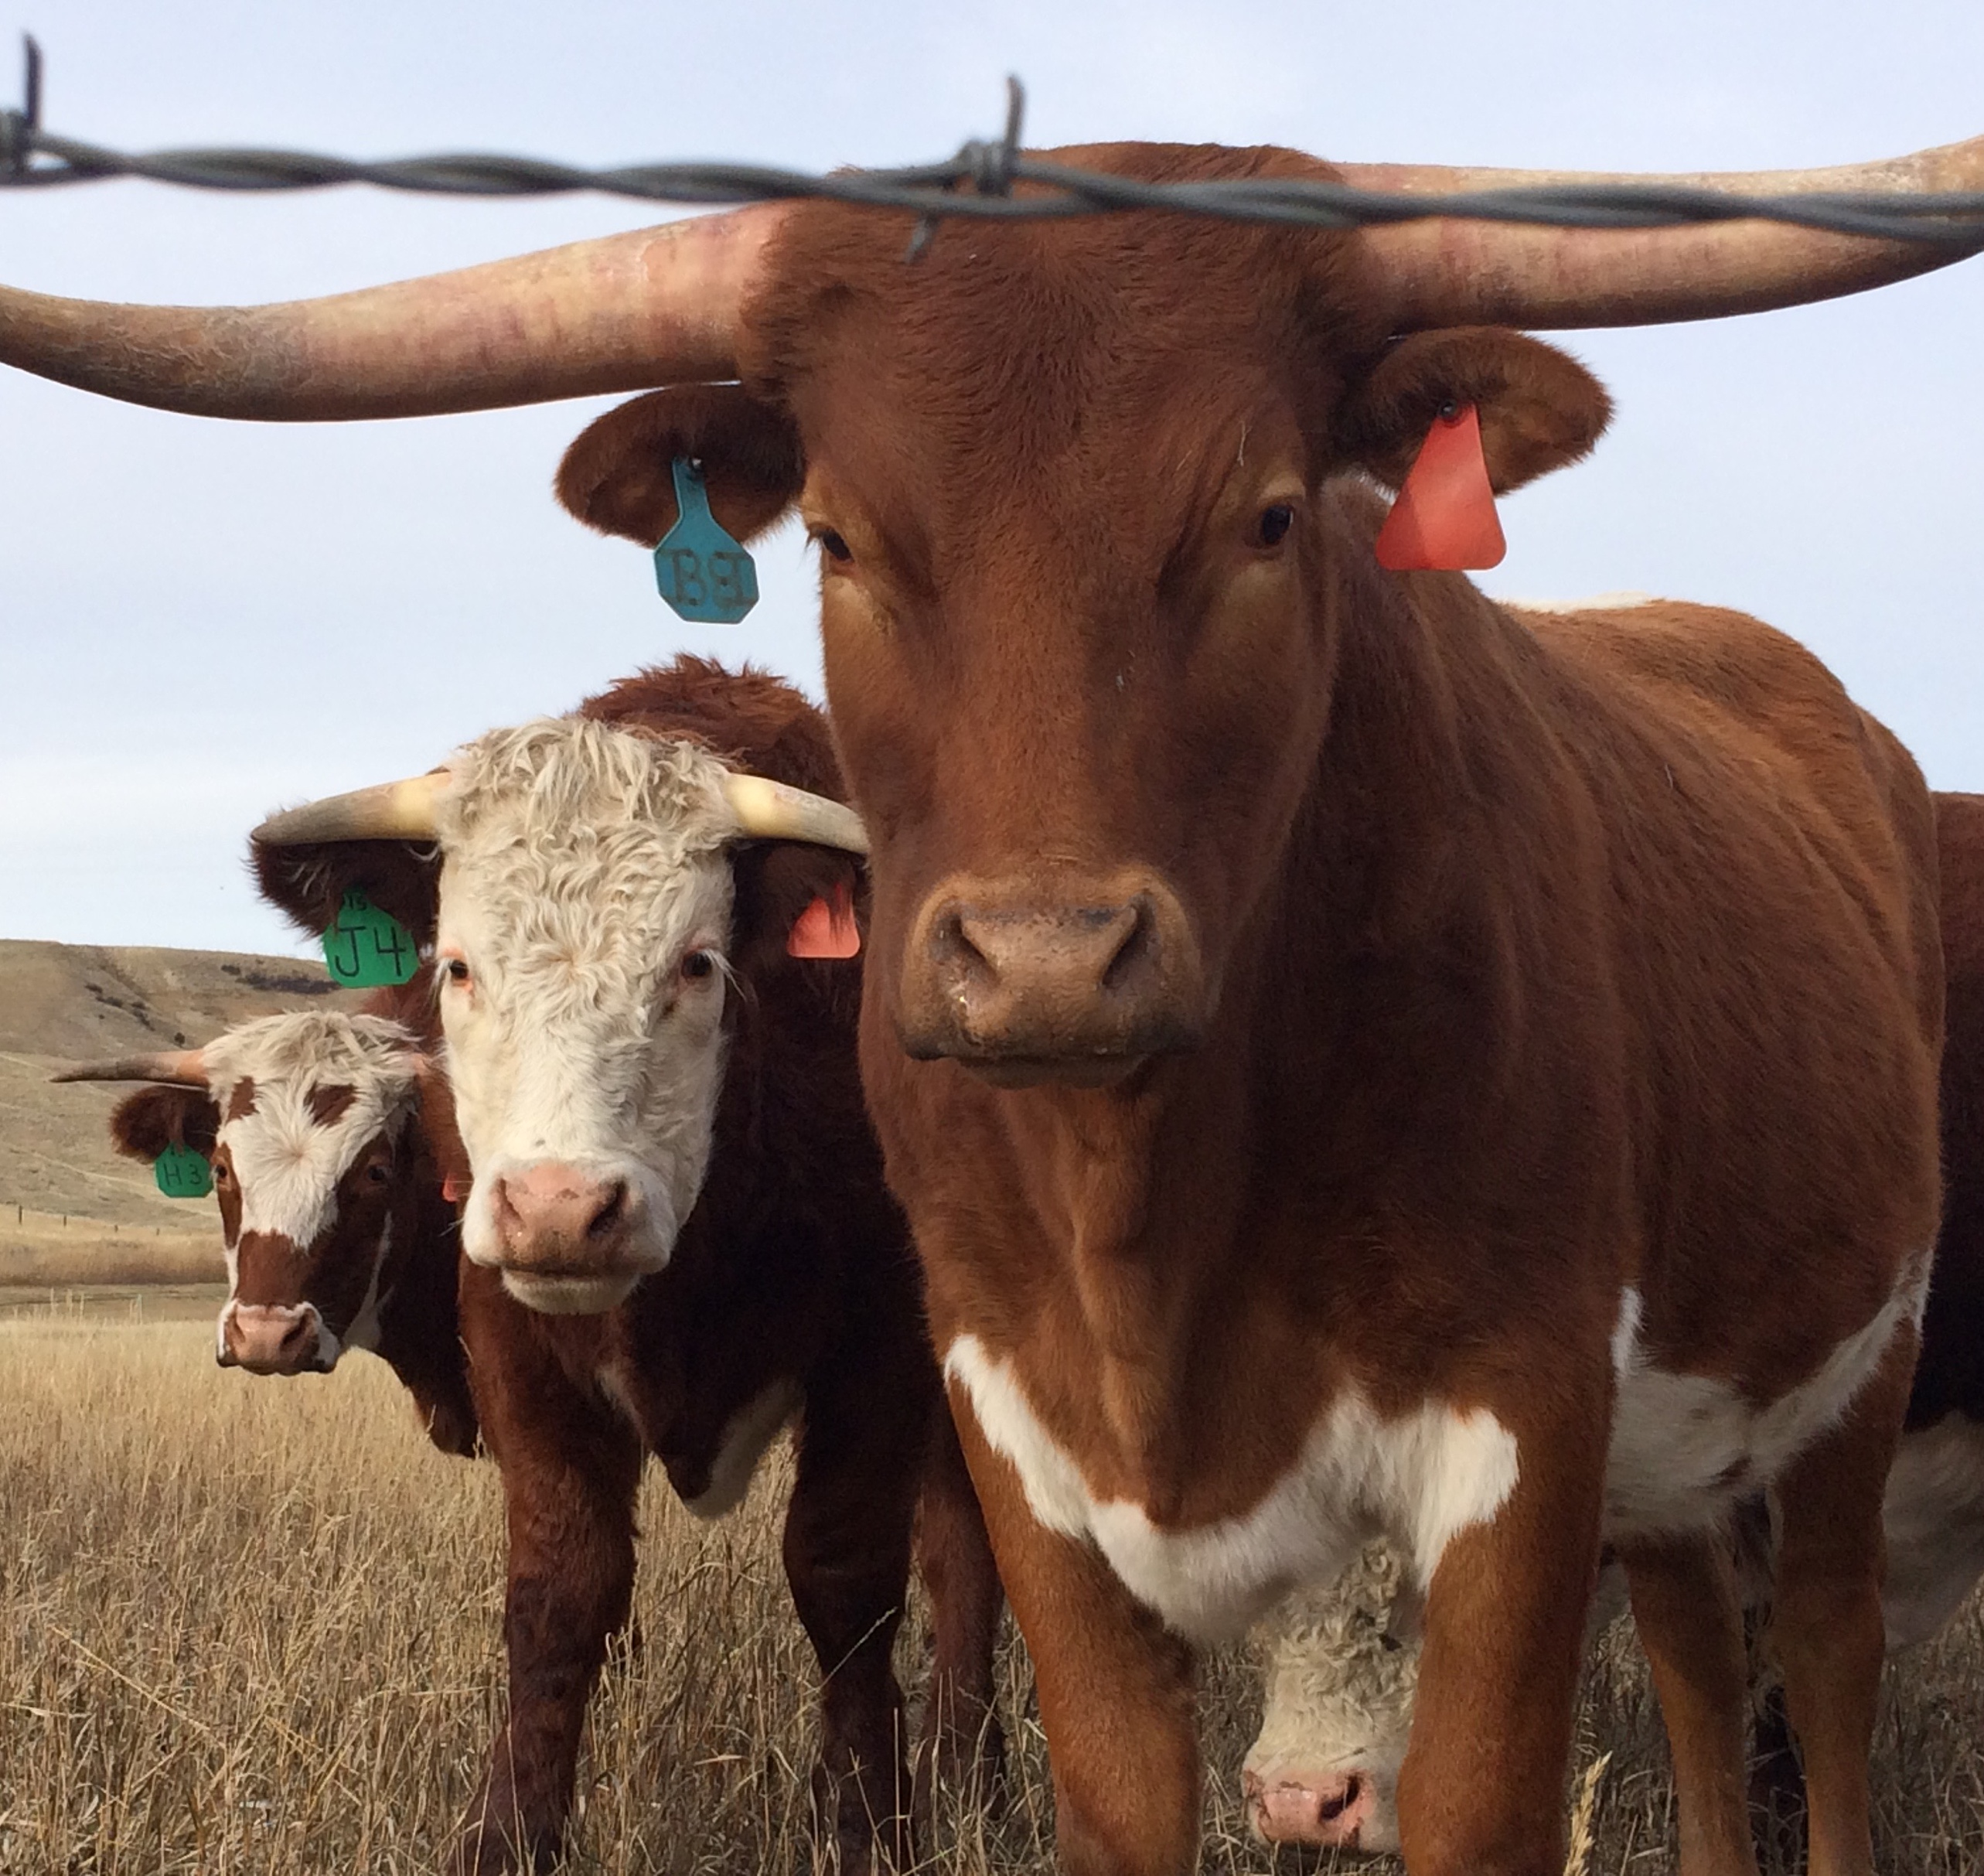
People and Fire
Ranchers burned the land so that grasses could grow.
This provided food sources for cattle.
Photo by Bethany Szczepanski

Slide 36
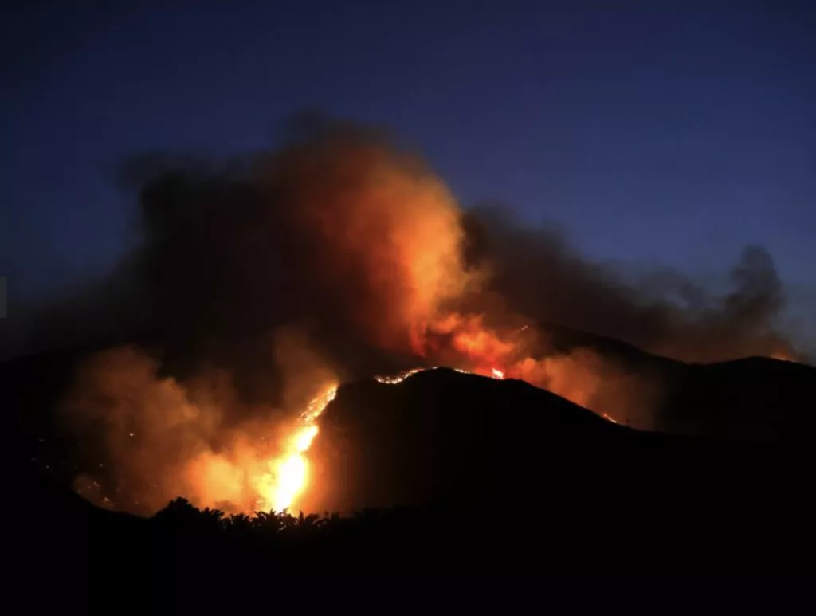
Fire in California
Fire is a natural part of the ecosystems in southern California.
Fire needs to have fuel, oxygen, and heat to ignite.
Topography, weather, and fuel can change fire behavior.
Too many fires change the ecosystems and allow invasive plants to move in.
Fire has been used by southern California Native Americans and ranchers to meet their needs.
Photo by Gary Coronado

Slide 37
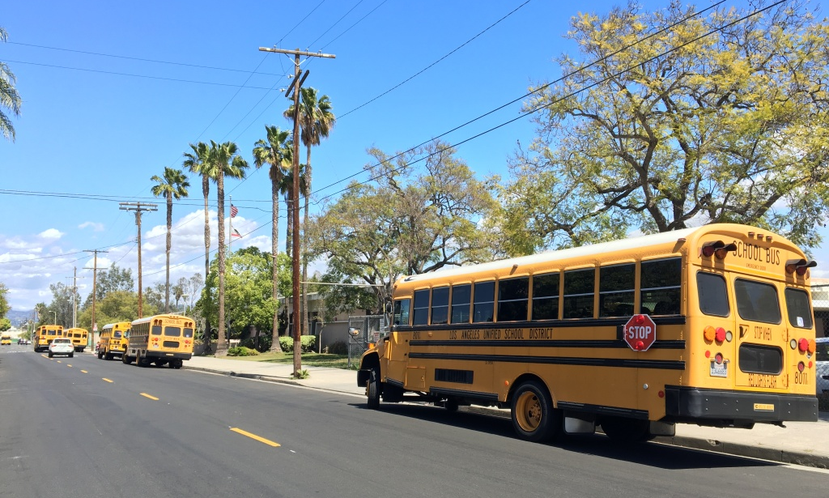
When you come on your field trip, you may see many plant communities.

Slide 38
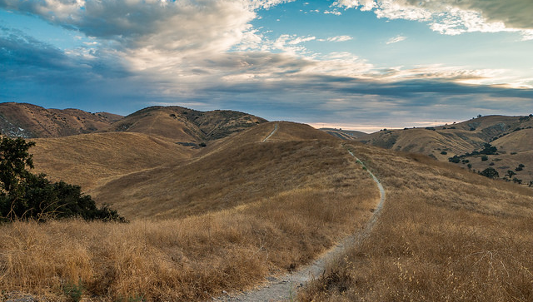
You may see Valley Grasslands
Photo by NPS
Notes:
https://www.nps.gov/samo/learn/nature/valley-grassland.htm
There are two types of grassland that occur in the Santa Monica Mountains: native perennial and non-native annual grasslands. Perennial bunch grasses are considered to be the original native grassland of California, while annual grasses were those introduced by the European and Spanish settlers for their livestock. The golden rolling hills of California are largely a result of the introduction of these annual grasses, since bunch grasses often remain green even during summer drought.
Perennial bunch grasses differ from annual grasses in that they put much of their energy during their first several years into establishing a well-developed root system that would sustain them through regular summer drought. Their roots penetrate deeply into the soil, providing nutrients and water and holding soil particles firmly in place. This decreases the erosive effects of wind and water. Unlike annual grasses, they don't produce seeds the first year, but as the years continue, produce an abundance of seed at maturity.
More than 100 years of livestock have been grazing on California's former native perennial grassland, which has been converted to non-native annual grassland. Native perennial grasslands historically covered nearly 20 percent of California, but today cover less than 0.1 percent. Today, approximately 10 million acres, or 17 percent of California, is considered valley grassland that contains both non-native annual and native perennial species.

Slide 39
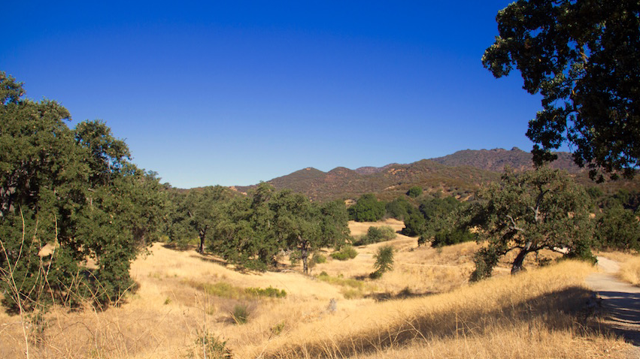
Valley Oak Savannah
Photo by NPS
Notes:
https://www.nps.gov/samo/learn/nature/valleyoaksavanna.htm
Valley oaks (Quercus lobata) reach the southernmost extension of their range in Malibu Creek State Park. Endemic to California, valley oaks were once widely distributed from the Sacramento River delta, 500 miles south to the Santa Monica Mountains. These trees, which reach truly majestic proportions, originally spread over the native grasslands in the wide valleys of central and coastal California. Valley oaks reach ages of 400-600 years and may have trunks six to seven feet in diameter. They present a graceful appearance on the landscape, widely spaced with branches that may drape to the ground.
Over the last 150 years, valley oaks have succumbed to widespread agricultural and residential development that has focused on their prime habitat - alluvial valleys. Although thousands of acres of valley oak savanna remain, they are vastly changed. The savanna or grassland understory was formerly comprised of dozens of species of native grasses and forbs, which blossomed in an array of wildflowers in the spring. Now the grassland understory is comprised mainly of non-native annual grasses, which have out-competed and crowded out the native species over the decades since they were introduced.
Where once a multi-layered composition of valley oaks of different ages existed, now only large trees remain. Many years of non-seedling growth have resulted in low replenishment of young or medium aged trees to the valley oak savanna.
Aside from valley oaks, characteristic native grasses, which dominate valley oak savanna, include purple needlegrass (Nassella pulchra), and non-native grasses such as wild oats (Avena fatua) and ripgut brome (Bromus diandrus), as well as black mustard (Brassica nigra). Wildflowers include mariposa lilies (Calochortus catalinaea) and coast goldfields (Lasthenia chrysotoma).

Slide 40
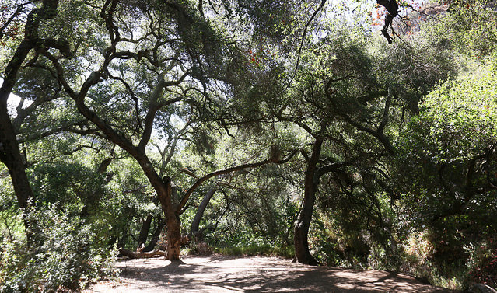
Oak Woodland
Photo by NPS
Notes:
https://www.nps.gov/samo/learn/nature/oak-woodland.htm
Oak woodland communities are found on north slopes and in shaded ravines or canyon bottoms and is characterized by coast live oak (Quercus agrifolia), hollyleaf cherry (Prunus ilicifolia), California bay laurel (Umbellularia californica), coffeeberry (Rhamnus californica), and poison oak (Toxicodendron diversilobum). Coast live oak is more tolerant to salt-laden fog than other oaks and thus can be found relatively near the ocean. This community is often found on the well-drained soils of coastal plains and protected bluffs. Groves are formed across valleys and along streams and intermittent watercourses. Live oaks, as their name suggests, are evergreen. Preferring permanent water, the deep taproots of live oaks can reach to the water table.
Well-developed oak woodlands can be found at Trippet Ranch in Topanga State Park and at Rocky Oaks.

Slide 41
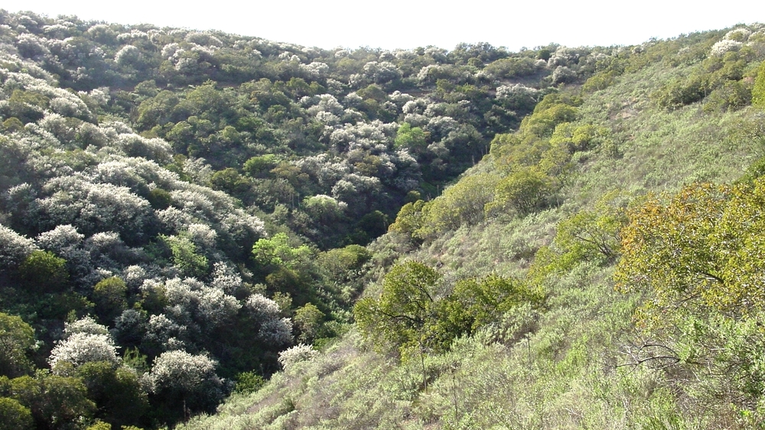
Coastal Sage Scrub
Photo by NPS
Notes:
https://www.nps.gov/samo/learn/nature/coastalsagescrub.htm
In the Santa Monica Mountains, coastal sage scrub occurs on drier sites and lower elevations than chaparral, especially on coastal south-facing slopes. Coastal sage scrub is also common in inland areas of the Simi Hills within the park boundary. Often occurring in recently eroded areas, this community plays an important role in soil stabilization. Many of its characteristic plants produce soil-holding, fiberous shallow roots. Soils underlying coastal sage scrub tend to be low in nutrients and subject to rapid erosion.
The coastal sage scrub community has been referred to "chaparral" since soft-leaved, grayish green, aromatic shrubs characterize the widely spaced vegetation. Characteristic plants include purple sage (Salvia leucophylla), California sagebrush (Artemesia californica), coast goldenbush (Haplopappus venetus), coastal buckwheat (Eriogonum cinereum), laurel sumac (Malosma laurina), and lemonadebery (Rhus integrifolia).
Many species in this community, particularly the sages, are summer or drought deciduous, dropping larger leaves during mid-summer to conserve moisture.
Good examples of coastal sage scrub can be found at the mouth of Zuma Canyon and in coastal Point Mugu State Park.

Slide 42
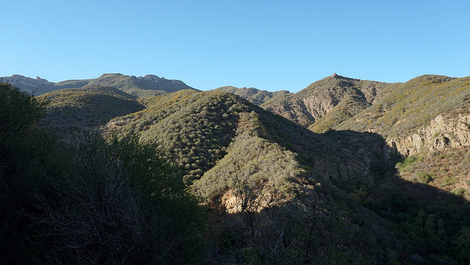
You will definitely see Chaparral!
Photo by NPS
Notes:
https://www.nps.gov/samo/learn/nature/chaparral.htm
Chaparral, the dominant vegetation community in the Santa Monica Mountains, is characterized by deep-rooted, drought and fire-adapted evergreen shrubs growing on coarse-textured soils with limited water holding capacity. Unlike other plant communities, in chaparral, a nearly impenetrable vegetative wall of stiff stems and leathery leaves is formed by the four- to 12-foot high plants. Underneath, the ground is devoid of herbaceous vegetation, except for an occasional clip of foothill needlegrass (Nassella lepida) or a cluster of wildflowers.
The drought-adapted leaves of chaparral plant species are often small, leathery, thick, fuzzy and/or waxy. Depending on the species, chaparral plants may reproduce after fire either by seeds or stump-sprouting, or both. Various subcommunities are dominated by one or more species.
Mixed chaparral is found throughout the Santa Monica Mountains on moist, north facing slopes. It contains a number of woody vines and large shrubs, including scrub oak (Quercus berberidifolia), greenbark or spiny ceanothus (Ceanothus spinosus), mountain mahogany (Cercocarpus betuloides), toyon (Heteromeles arbutifolia), hollyleaf redberry (Rhamnus ilicifolia), sugarbush (Rhus ovata) and manzanita (Arctostaphylos spp.).
Ceanothus chaparral primarily occurs on stable slopes and on ridges. On some sloped, bigpod ceanothus (Ceanothus megacarpus) makes up over 50 percent of the vegetative cover. In other areas, buckbrush ceanothus (Ceanothus cuneatus), hoary-leaved ceanothus (Ceanothus crassifolius), or greenbark ceanothus may dominate. In addition to ceanothus, the following species may also be present: chamise, black sage (Salvia mellifera), and hollyleaf redberry, among other shrubs.

Slide 43
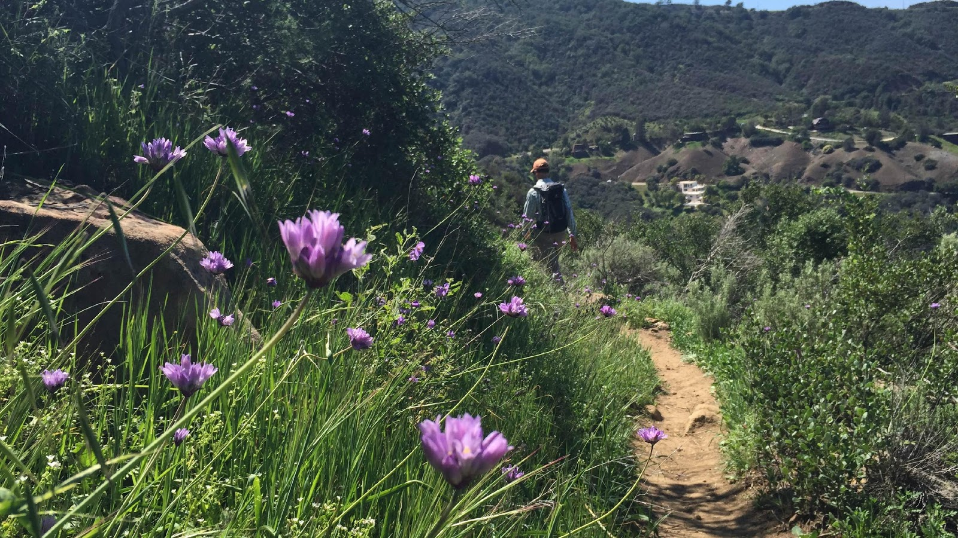
Chaparral
Grow in dry areas and can survive droughts
Mainly shrubs
Evergreen, they can use photosynthesis all year
Can grow back after fires if they do not happen too often
Photo by NPS

Slide 44
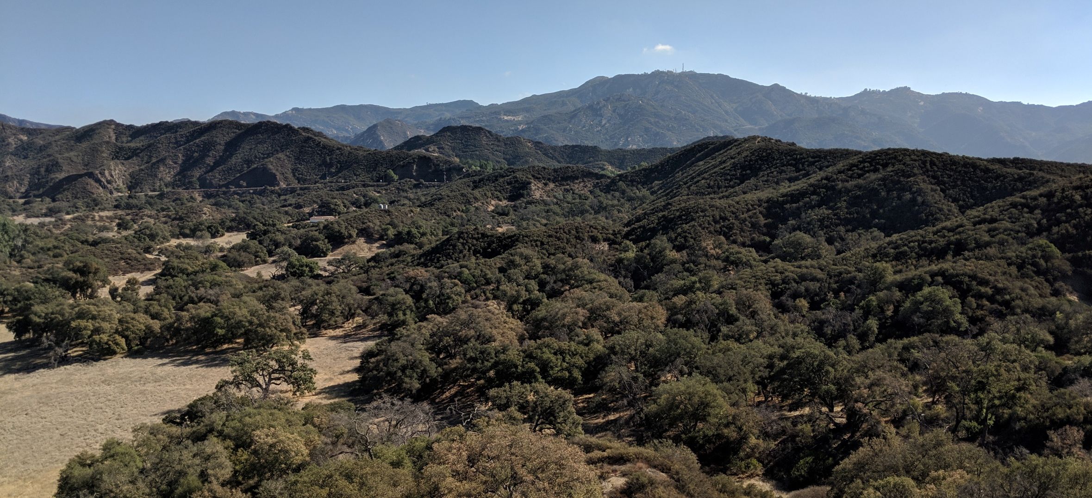
On the bus, you will see healthy plants…
Photo by Nico Ramirez

Slide 45
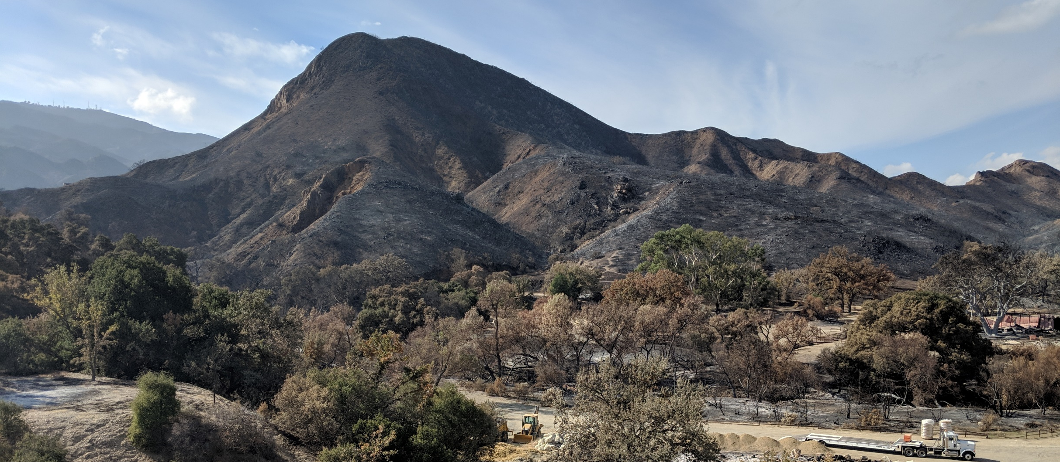
and areas that burned from wildfires
Photo by Nico Ramirez

Slide 46
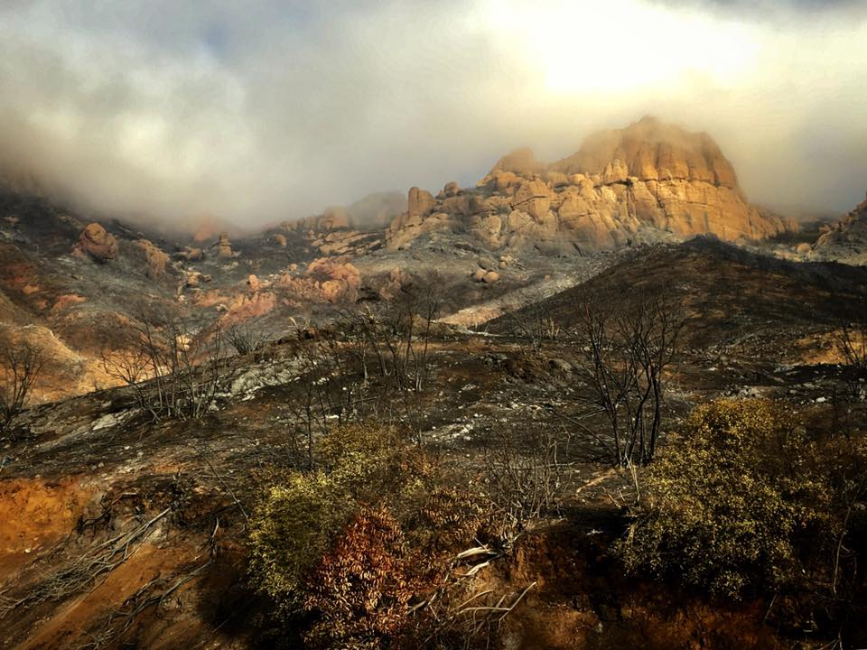
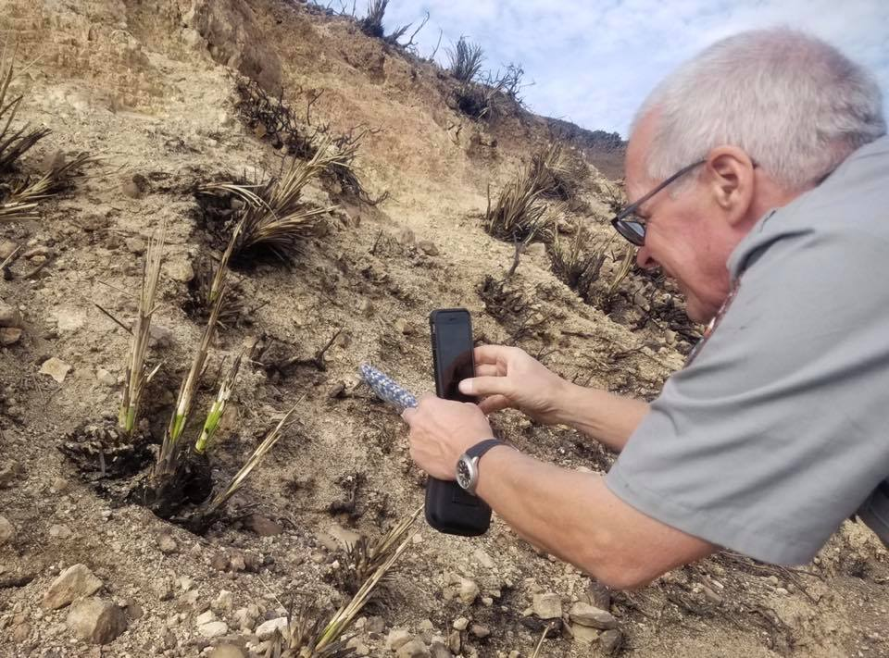
But, 2 weeks after the fire, plants started growing back! It is recovering already!

Slide 47
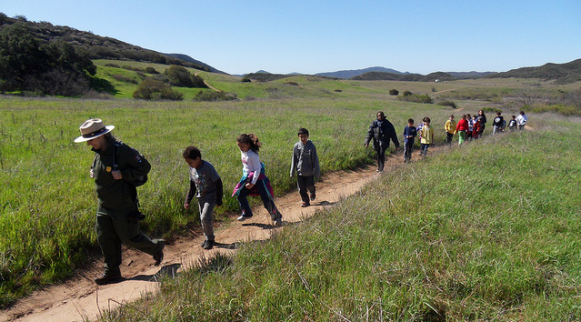
We will see you soon!

