Slide 1
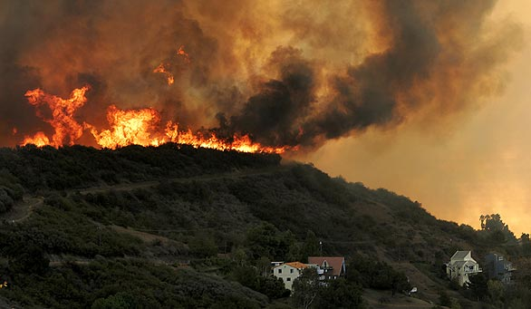
fire ecology
Santa Monica Mountains National Recreation Area
The relationship between wildfire &
the biotic & abiotic environment
“Fire, biology, and life in California are intimately connected. One cannot truly know California nature without a thorough understanding of fire” (Halsey, 2008, p. viii).
Notes:
Reflect on this quote. Have students pair share their thoughts about the quote and how they think wildfire is connected to California.

Slide 2
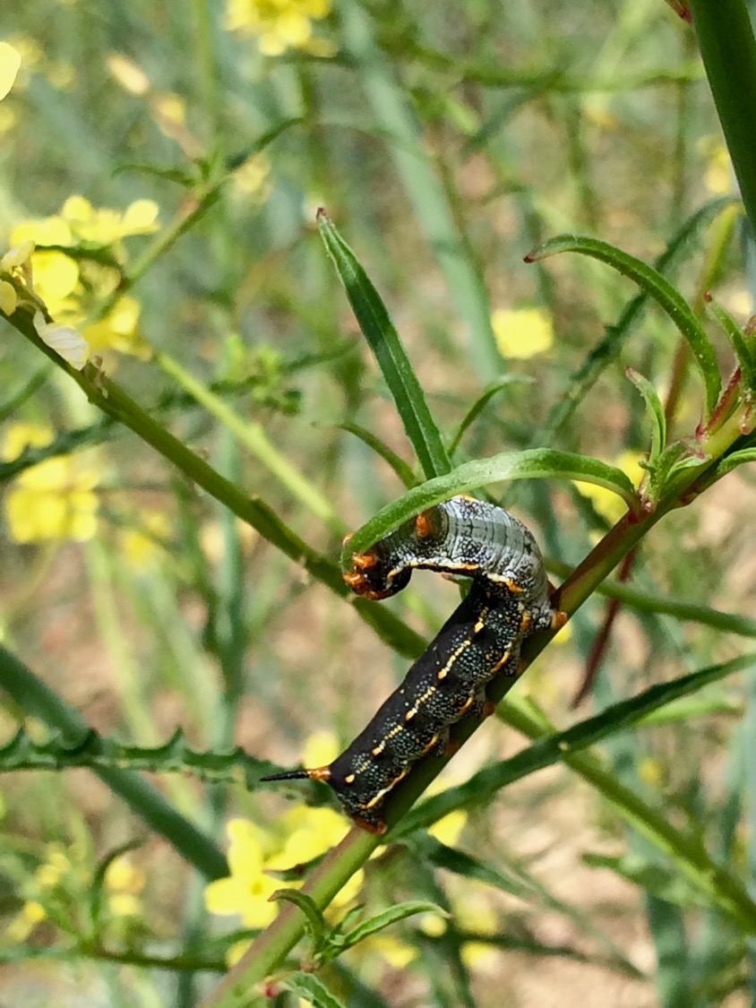
What is Ecology?
“Ecology is the study of the relationships between living organisms, including humans, and their physical environment; it seeks to understand the vital connections between plants and animals and the world around them.”
(Image: Bethany Szczepanski)
(ESA, n.d., para 1)
Notes:
“Ecology also provides information about the benefits of ecosystems and how we can use Earth's resources in ways that leave the environment healthy for future generations.” (ESA, n.d., para 1)

Slide 3
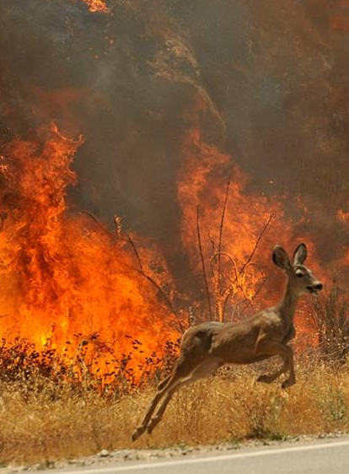
What is fire Ecology?
“Fire ecology is a branch of ecology that concentrates on the origins of wildland fire and its relationship to the living and nonliving environment. This school of thought recognizes that fire is a natural process operating as a component of an ecosystem.”
(Image: Taylor, n.d.)
(NPS, n.d.a, para 1)
Notes:
“The field of fire ecology seeks to understand when fires occurred in the past, how plants and animals in various environments respond and adapt to fire, and how fires and their effects may change in the future” (NPS, n.d.b).
“To understand an ecosystem requires looking beyond the system’s present state. Full understanding includes an investigation of the ecosystem’s origin, possible future stages of the ecosystem, and the cycles through which the ecosystem progresses. Fire, similar to floods, earthquakes, storms, etc., can be viewed as one catalyst promoting changes in an ecosystem” (NPS, n.d.a).
The field of Fire Ecology includes:
Fire History which is “…how often fires occur in a given geographical area. Trees actually record fire history. Each year a tree adds a layer of cells, increasing the width of its trunk. When a fire passes through a forest, trees may be only scorched. A layer of charcoal remains on a living tree and, in time, is enveloped by a layer of new growth. These fire scars provide a record that scientists can use to determine when in history a fire occurred” (NPS, n.d.a).
Fire Regime: “The role fire plays in an ecosystem varies with the characteristics under which the ecosystem evolved. This role is [another] concept of fire ecology--fire regime. The interactions of humidity, fuels, and ignition sources will determine the fire regime for a particular land area. A fire regime is a function of the frequency of fire occurrence, the fire intensity, and the amount of fuel consumed. Both frequency and intensity of fire vary and are interdependent.
Frequency of fire is largely determined by the ignition source(s) and the duration and character of weather that favors the spread of fire.
Intensity of fire is determined by the quantity of fuel available and the fuels' combustion rates. The interaction between frequency and intensity of fires also will be influenced by wind and topography” (NPS, n.d.a).

Slide 4
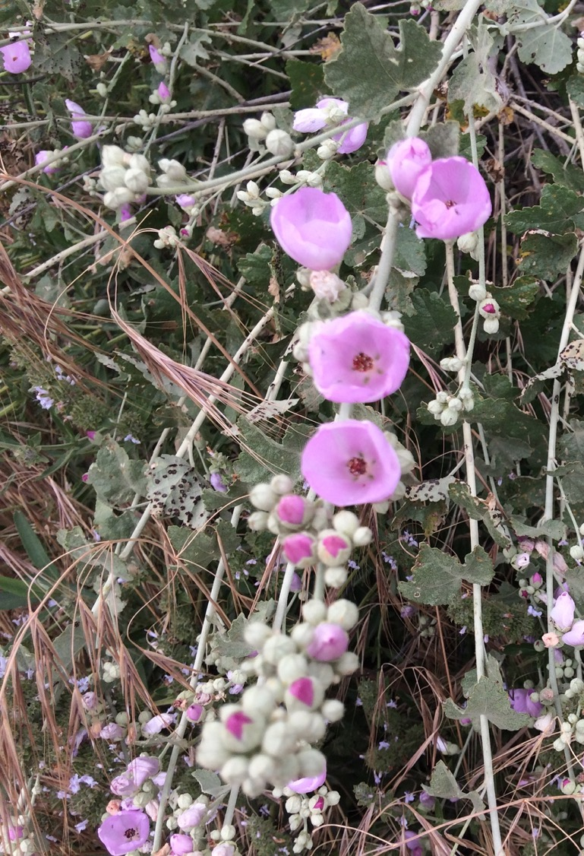
Wildfire & Flora
Fire Ecology
Chaparral Bush Mallow
(Image: Bethany Szczepanski)

Slide 5
Chaparral
“Chaparral is a diverse, shrub-dominated plant community shaped by a Mediterranean-type climate (hot, dry summers and mild, wet winters), a complex mixture of relatively young soils, and large, infrequent, high-intensity fires.” (CCI, n.d.b)
“Large expanses of dense chaparral vegetation cover coastal mesas, canyons, foothills, and mountain slopes throughout California, southward into Baja California, and extending north into the Rogue River Valley of southwest Oregon. Disjunct patches of chaparral can also be found in central and southeastern Arizona and northern Mexico.” (CCI, n.d.b)
Chaparral is California’s most extensive plant community and most characteristic wilderness. (Halsey, 2008, p. 1)
Chaparral comprises about a quarter of the state’s native plant species, of which almost half are endemics (only found in California). (Litman, 2013, p. 2)

Slide 6
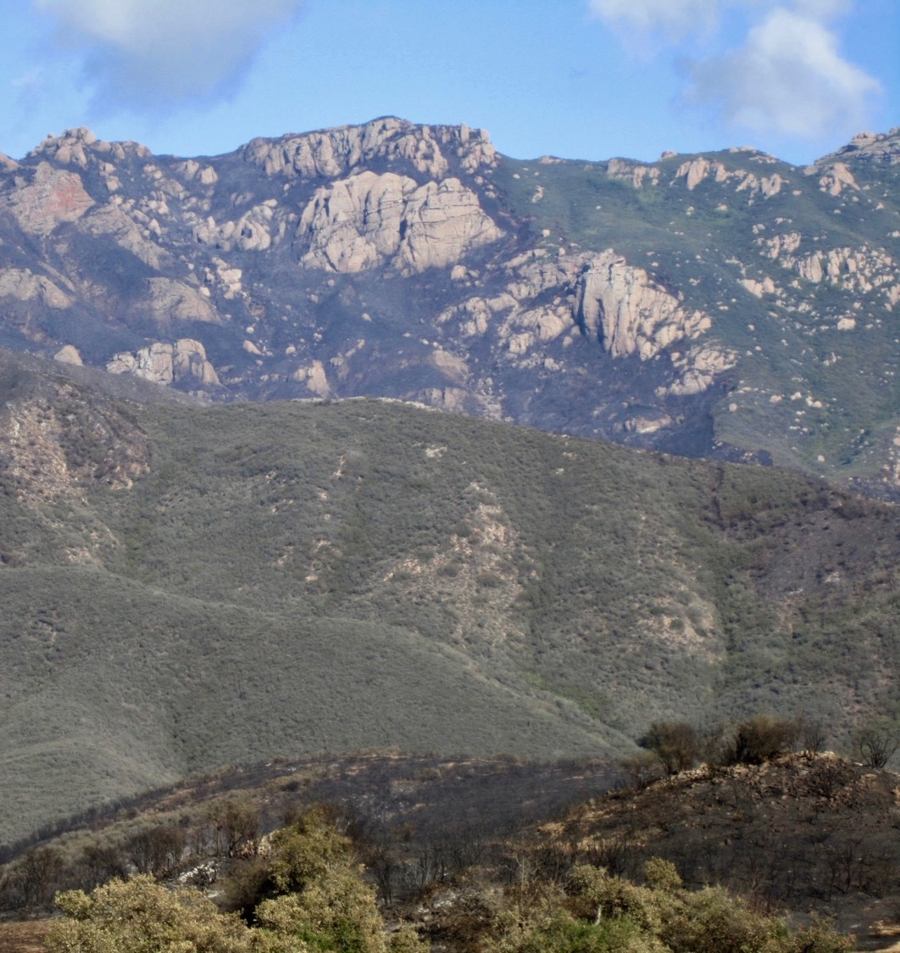
The Relationship between Chaparral & Wildfire
Fire is very important to shrublands.
Shrublands (like Chaparral) are composed of fire-prone species that are adapted to survive burning, and fire plays a major role in maintaining biodiversity.
You may hear “chaparral needs to burn,” or that “fire is good for the chaparral.”
However,
Chaparral is NOT “adapted to fire” but it is adapted to a particular fire regime.
Santa Monica Mountains 2013 Springs Fire Burn Scar
Photo: NPS
(CCI, n.d.b; Litman, 2013, p. 4)
Notes:
“Annual and perennial herbs flourish after fire in chaparral, along with seedling and resprouting shrubs. Herbs are gradually eliminated as the dense overstory of large shrubs matures
(DeBano, Neary, & Ffolliott, 1998)” (Smith, 2000, p. 13).
“The most important principle underlying chaparral fire ecology is that, as an ecosystem (and the species that live there), chaparral is not “adapted to fire,” but is rather adapted to a particular fire pattern” (CCI, n.d.b).
While chaparral is a adapted to a natural fire regime, it is not useful to think of it as a fire-dependent ecosystem. This term implies that management needs to provide fire that is lacking in an ecosystem. While a few chaparral species depend on fire to reproduce, such as the non-sprouting shrub species like bigpod ceanothus (Ceanothus megacarpus) and big-berry manzanita (Arctostaphylos glauca), most chaparral species in the Santa Monica Mountains are obligate sprouters and actually recruit in the fire-free intervals between fire. (NPS, 2018)
Photo: NPS - View looking across Sycamore Canyon showing burned and unburned vegetation. The fire ran up to Tri Peaks on Boney Ridge, but did not go over the top.

Slide 7
Chaparral Natural fire Regime
Characterized by:
A Fire Return Interval between 30-150+ years or more.
Fires occurring in the summer or fall when lightning appears.
Fires that burn with high intensity and severity
(CCI, n.d.b)
Notes:
“The natural fire pattern in chaparral is characterized by a fire return interval between 30 – 150 years* or more, occurring in the summer or fall when lightning appears, and burning at high-intensity” (CCI, n.d.b).
“The upper end of the chaparral’s fire regime (150 years or more) has been estimated by dating the oldest shrubs present, like manzanita.
The lower end (30 years) has been determined by the time needed to ensure proper post-fire recovery (restoration of the soil seed bank and energy storage by roots and burls, and sufficient plant mass to allow for high-intensity fire).
Old-growth chaparral, characterized by beautiful manzanitas with waist-sized trunks and a wild diversity of lichens and other living things, is typically 60-years-old or more. Due to increasing fire frequencies, old-growth chaparral stands are becoming extremely rare” (CCI, n.d.b).
More on Chaparral natural fire regime from Santa Monica Mountains:
“Coastal southern California shrublands are adapted to a fire regime of infrequent, intense, stand-replacing crown fires that usually occur in the fall.
These fires are often sensationalized in the press and reported to have "destroyed" thousands of acres of wildlands. However, native shrublands are resilient to infrequent fires and have numerous traits that allow them to recover quickly” (NPS, 2018).
Fire Return Interval: “The period of time between fires within a given area in a specific period of time.” (Witter, Taylor, & Davis, 2007, p. 176)
Fire Severity: A qualitative measure of the immediate effects of fire on the ecosystem. It relates to the extent of mortality and survival of plant and animal life both above ground and below ground and to loss of organic matter. (Wooten, n.d)
Fireline Intensity: “Also called Byram’s intensity, this is the rate of energy release per unit length of the fire front expressed as BTU per foot of fireline per second or as kilowatts per meter of fireline (Paysen et al., 2000). This is a physical parameter that is related to flame length. This expression is commonly used to describe the power of wildland fires, but it does not necessarily follow that the severity, defined as the vegetation mortality, will be correspondingly high (Carey and Schumann, 2003)” (Wooten, n.d.).
* This number varies based on the source of information. Santa Monica Mountains historic range: approximately 70-100 years with a current interval of 28 years (NPS, 2018)

Slide 8
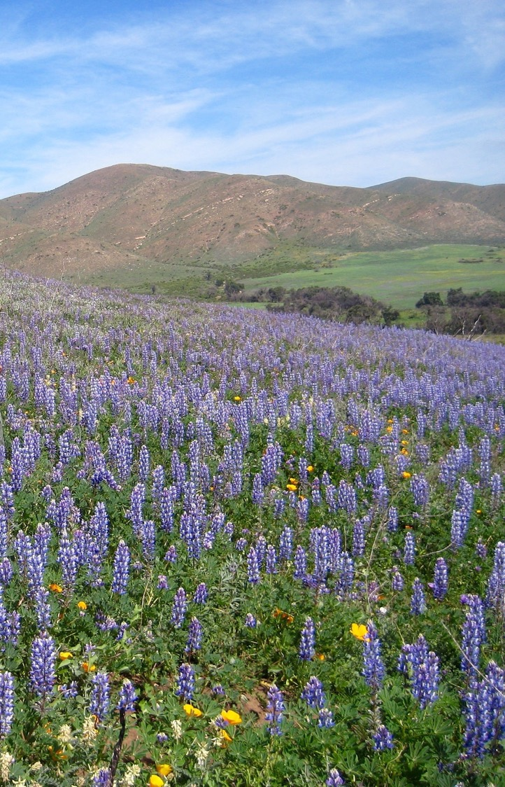
Chaparral Response to Wildfire
Three strategies Chaparral plants use to respond to fire:
Obligate Resprouters
Obligate Seeders
Facultative Seeders
Lupines & California Poppies
Photo: NPS
(CCI, n.d.b)
Notes:
“The first spring following a fire there is dramatic vegetation recovery on barren, blackened hillsides from resprouting shrubs and herbaceous perennials, germinating shrub seedlings, and an abundance of colorful native annuals. Within about 10 years at coastal sites and 20 years at inland sites, the canopy of the dominant shrubs begins to close and short lived fire-following annuals and perennials disappear and are present only in the soil seed bank” (NPS, 2018).
“Normal postfire recovery in chaparral is autosuccessional, that is, the same plant community will recover and reassemble after the fire, from in situ seedlings or resprouts. Postfire recovery depends on spring-germinating seedlings and postfire resprouts surviving the summer dry season in the first year after fire, a period of 4-6 months without rain” (NPS, 2018).
“Shrubs are classified by their method of recovery after fire which is associated with suites of morphological and physiological features related to drought tolerance” (NPS, 2018).
There are non-sprouters (obligate seeders), species which are killed and regenerate only from seed; facultative seeders, species which regenerate partly from seed and partly from a percentage of the plant population which resprouts; and obligate resprouters, which regenerate only from resprouts with no postfire seedling recruitment. (NPS, 2018)

Slide 9
Chaparral Response to Wildfire
Obligate resprouters survive burns because of their ability to sprout from their stumps.
Obligate resprouters, like Toyon (Heteromeles arbutifolia), depend on resprouting from their underground root systems or burls to survive after a fire.
Most obligate resprouting shrubs are characterized by large seeds which are either eaten by seed predators or burned in the fire.
Obligate Resprouters
Resprouting Toyon
(CCI, n.d.a; CCI, n.d.b; Halsey, 2008) Photos: (CCI, n.d.a)
Notes:
“Obligate resprouters are possibly relic species from a a time when the climate of southern California was sub-tropical and fires played a smaller evolutionary role than they do today. Consequently, these plants are found in more mesic environments [well-balanced supply of moisture] such as north-facing hillsides and canyon bottoms” (Halsey, 2008, p. 19).
“Their seeds, frequently surrounded by some fruity covering, are short-lived and likely do not survive into the fire season, either succumbing to decay or by being eaten” (Halsey, 2008, p. 19).
They are more deeply rooted and experience reduced drought stress by tapping into deep soil moisture supplies. (NPS, 2018)
“Geophytes (perennials with fleshy, underground structures like bulbs or tubers) are obligate resprouters as well, but have a unique after-fire response. The enhanced light from the lack of cover stimulates many geophytes to produce large numbers of flowers” (CCI, n.d.b).

Slide 10
Chaparral Response to Wildfire
Obligate seeders, like about half the Ceanothus and most of the Manzanita shrub species, are killed by the flames and depend on seedlings to replace their populations.
Their seeds require some fire cue (heat, or the chemicals found in charred wood or smoke) to germinate.
Most of the wildflowers that are seen in the post-fire environment are obligate seeding annuals or short-lived perennials.
This does not mean obligate seeders “need” fire, but rather are adapted to a particular fire pattern.
Obligate Seeders
Ceanothus seedling
(CCI, n.d.a; CCI, n.d.b) Photo: (CCI, n.d.a)
Notes:
“Obligate Seeder shrubs are typically found in concentrated, even-aged stands. These homogenous populations exist for two reasons. First, their seeds are small and do not have structures encouraging animal or wind distribution. Most go no further than the canopy directly below the mother plant (Keeley, 1991). Secondly, since the seeds respond to the same fire cue at the same time, all the adult plants have the same birthday” (Halsey, 2008, p. 19).
“Cupleaf ceanothus (Ceanothus greggii) and bigberry manzanita (Arctostaphylos glauca) are classic obligate seeders” (Halsey, 2008, p. 19).
Obligate Seeders are frequently found in xeric areas (little moisture) like ridge tops, flat mesas, and south-facing hillsides. (Halsey, 2008, p. 19)
“Non-sprouting species that reproduce by seed after fires are shallowly rooted and tolerate high levels of drought stress” (NPS, 2018).
“Conifers like Tecate cypress (Cupressus forbesii) are also obligate seeders, but deal with fire through serotiny, the tendency for cones to remain closed and on the tree until the heat of a fire opens them up, releasing its seeds” (CCI, n.d.a).
Photo: Photo: Ceanothus seedling (heat stimulated).

Slide 11
Chaparral Response to Wildfire
Facultative seeders do both!
Facultative seeders, like Chamise (Adenostoma fasciculatum), resprout AND germinate after a fire. About half of the Ceanothus and a few of the manzanita species are facultative seeders.
Facultative Seeders
Resprouting & Seeding Chamise
(CCI, n.d.a; CCI, n.d.b) Photo: (CCI, n.d.a)
Notes:
Facultative seeders include dominant shrubs like Chamise, Laurel Sumac, and Whitebark Ceanothus. (Halsey, 2008, p. 20)
Facultative seeders are intermediate in their tolerance to drought stress. (NPS, 2018)
Photo: Chamise resprouting and seeding (seeds are stimulated to germinate by smoke/charred wood).

Slide 12
Changing Fire Return Intervals
Effects on Flora
Notes:
“With so many people living on the landscape lighting fires, a changing climate which is creating conditions more conducive to fire ignitions and fire spread, and the presence of highly flammable, non-native weeds, the chaparral today is suffering from too much fire. This is especially true in southern California” (CCI, n.d.b).

Slide 13
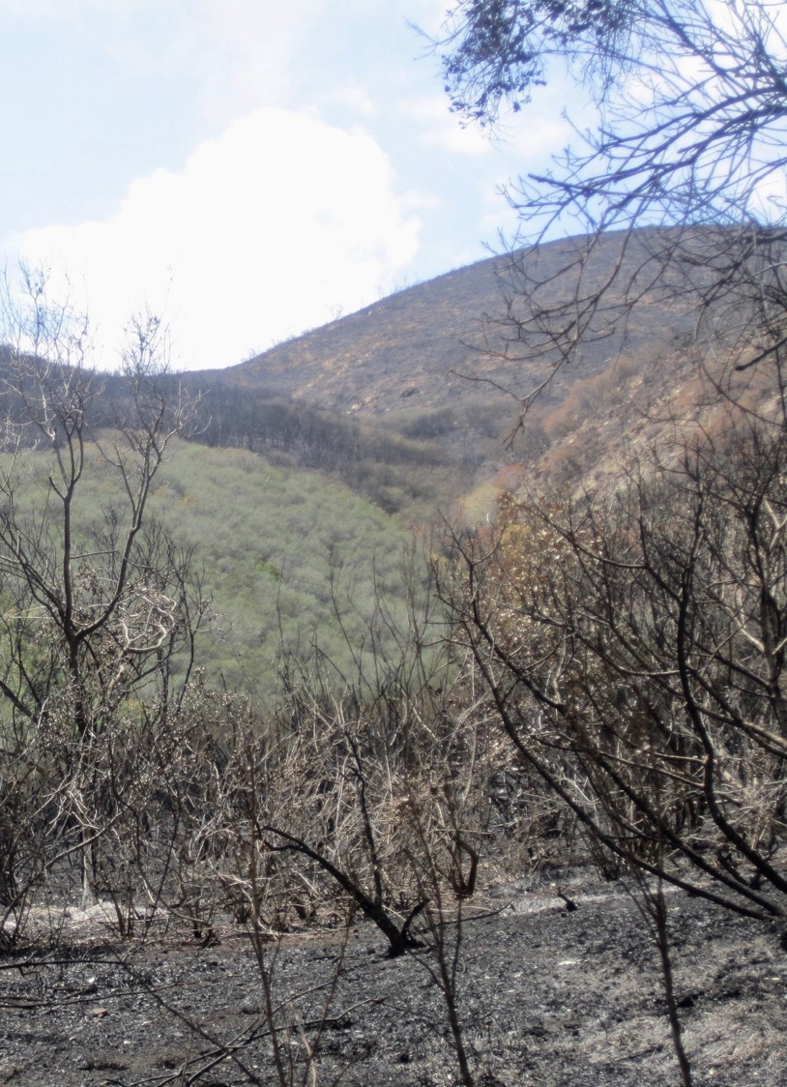
Changing fire Return Intervals
Type-conversion
Non-native grasses
Erosion
Loss of native ecosystems
Fire maintains many ecosystems, however, it can also irretrievably alter the chaparral.
What happens if the interval between fires becomes shorter and more fires burn?
2013 Springs Fire: Sycamore Canyon Chaparral
(Photo: NPS)
(Litman, 2013)
Notes:
“Change the pattern and you can cause the entire chaparral plant community to disappear, often being replaced by more flammable, non-native weeds and grasses” (CCI, n.d.b).
“…if fire frequency exceeds a species’ adaptive capabilities, postfire shrub regeneration will be reduced” (Witter, Taylor, & Davis, 2007, p. 183).
“Sensitivity to fire frequencies varies with regeneration strategies. Non-sprouters show the greatest sensitivity to short fire return intervals and may be eliminated by a single premature burn where insufficient time has passed to build up an adequate seed bank (Biswell 1989; Zedler 1995). Theoretically, non-sprouting species may also be at risk from extinction due to excessively long fire intervals that exceed the life span of both the adults and the seed bank. There is no evidence that long fire intervals are a real problem in California chaparral. One hundred and fifty year old stands of chaparral in the Sierra Nevada recovered as well as younger stands, although populations of the non-sprouter Ceanothus cuneatus were reduced (Keeley et al. 2005)” (Witter, Taylor, & Davis, 2007, p. 183).
“In the Santa Monica Mountains, no plant communities are considered to be at risk from an excessively long fire-free period because only 1.6% of the vegetation is more than 77 years old (NPS 2005). Because of the high fire frequency in this region, risk to native plant communities from fire is associated with the potential for repeated fires and short fire return intervals, which exceed the capability of native shrubs to recover after fire (Zedler 1995)” (Witter, Taylor, & Davis, 2007, p. 183).
Photo: Springs Fire NPS: View of Sycamore Canyon showing unburned chaparral and Big Pod Ceanothus on hillside.

Slide 14
Changing fire Return Intervals
Type Conversion
This is
Type Conversion
With short fire intervals, the ecosystem may not be able to recover normally and non-native plants or grasses may out compete natives therefore converting the vegetation type from a native ecosystem to a non-native ecosystem.
Historic Fire Return Interval: approximately 70-150+ years*
Current Fire Return Interval: ~ 28 years
This photo is an excellent example of Type Conversion.
How do you think changing plant communities will impact the future of these areas?
Type Conversion from native shrublands to non-native grasses in San Diego county
(Photo Richard Halsey)
(Halsey, 2008; Litman, 2013; Witter, Taylor, & Davis, 2007)
Notes:
“The current fire return interval of 28 years is far shorter than the estimated natural fire return interval of approximately 70-100 years. The ecological perturbations related to fire in the Santa Monica Mountains are not from an insufficient amount of fire required in a fire-dependent ecosystem, but from fire occurring at such a high frequency that it can exceed the ability of the ecosystem to recover normally” (NPS, 2018).
Photo: When fires occur too frequently native shrubs are not able to recover as they do after a single fire. Richard Halsey photographed this location in 2004 to show the vegetation change after three fires in San Diego county: the 1970 Laguna Fire, the 2001 Viejas Fire and the 2003 Cedar Fire. We call the process of change from a native shrubland to a non-native dominated grassland type conversion. (Litman, 2013)
“Chaparral on its way to being type-converted to weedy nonnative grassland. This site in San Diego County shows an old-growth chaparral stand last burned during the 1970 Laguna Fire. The middle/left shows an area recovering from the Viejas Fire of January 2001 composed primarily of chamise, deerweed, and several other shrub species. To the right is a portion of the Viejas Fire scar reburned in the Cedar Fire October 2003. The Cedar Fire scar is now filled with nonnative grasses. The majority of resprouting shrubs have been killed and no obligate seeding species, such as ceanothus, are present. The interval between the two fires was too short, causing the elimination of the chaparral plant community in that area” (Litman, 2013).
“These frequent fires can change the species composition of the chaparral community, facilitate the spread of nonnative invasive species, and ultimately (absent restoration efforts) cause complete loss of the chaparral ecosystem in an area” (Litman, 2013, p. 4).
"Short intervals between fires do not allow enough time for some species to replenish their seed banks, which is necessary for postfire survival. For example, most Ceanothus species, which reproduce only from the postfire seed bank, need more than 10 years between fires to reestablish their seed bank. Manzanita requires even more time, perhaps 20 years. Without an adequate period between fires these dominant chaparral species will not recover, and nonnative grasses will likely take over” (Litman, 2013, p. 5).
*This is variable based on source.

Slide 15
Changing fire Return Intervals
Non-native Grasses,
Loss of Ecosystems, & Erosion
Consequences of type converted non-native grasslands:
Non-native grasslands dry out earlier in the spring and increase the length of the fire season. They are highly combustible which increases the probability of ignition.
These grassy weeds, known as “flashy fuels” spread faster than Chaparral plants.
Loss of ecosystem services including carbon storage, erosion control, water provisioning, biodiversity, and aesthetic recreational values.
Type converted grasslands represent a loss of habitat for native Chaparral animals.
Loss of the native herbaceous flora that follows fire. These flowers act as nature’s own “band-aid” erosion control measure. These beautiful wildflowers and the Chaparral plants that follow are much better at erosion control than non-native grasses.
(Halsey, 2008, p. 26 & 93; USGS, 2014)

Slide 16
Wildfire & Fauna
Fire Ecology
Photo: (Taylor, n.d)

Slide 17
Responses of fauna to Wildfire
“Despite the perception by the general public that wildland fire is devastating to all animals, fires generally kill and injure a relatively small proportion of animal populations.”
Animals with limited mobility living above ground are the most vulnerable to injury & death from fire.
“Predators and scavengers are often attracted to burns because their food is more abundant or more exposed than on unburned sites.”
Burning increases seed visibility and availability for small mammals but also increases their visibility to predators.
(Smith, 2000, p. 17 & 22)
Notes:
Despite the perception by the general public that wildland fire is devastating to all animals, fires affect various functional groups differently. Animals can flee, take refuge, or be killed and depend on recolonization after the fire from unburned patches within or from outside the fire. In most groups, only a relatively small proportion of the population is killed or injured. e.g. 2 of 11 mountain lions died in conjunction with the Woolsey fire in 2018 but species such as wood rats may have a 100% mortality rate during a fire due to behavior and maladaptation to the current fire regime and frequent fires. (Witter, personal communication, 2/20/19)
“Many vertebrate species flee or seek refuge, but some vertebrates and many insects are attracted to burning areas. Other behavioral responses to fire include rescuing young from burrows, approaching flames and smoke to forage, and entering recent burns to feed on charcoal and ash (Komarek, 1969)” (Smith, 2000, p. 17).
”Ambient temperatures over 145 ° F are lethal to small mammals (Howard and others 1959), and it is reasonable to assume the threshold does not differ greatly for large mammals or birds. Most fires thus have the potential to injure or kill fauna, and large, intense fires are certainly dangerous to animals caught in their path (Bendell, 1974; Singer and Schullery, 1989)” (Smith, 2000, p. 17).
“Season of burn is often an important variable in fauna mortality. Burning during nesting season appears to be most detrimental to bird and small mammal populations (Erwin and Stasiak, 1979)” (Smith, 2000, p. 18).
"Many animals are actually attracted to fire, smoke, and recently burned areas. Some of the most interesting research regarding immigration in response to fire is in the field of insect ecology. The beetles of the subgenus Melanophila (“dark loving”), for instance, use infrared radiation sensors to find burning trees, where they mate and lay eggs (Hart, 1998). Most birds and mammals that immigrate in response to fire are attracted by food resources” (Smith, 2000, p. 21).
“Many insects living in a fire stricken area are destroyed in the blaze. Many survive because they live below the surface. As plants regenerate, insects return and help in reestablishing the chaparral plant community by pollination and also by aiding in the decomposition of dead wood” (Michael Klein as cited in Halsey, 2008, p. 41-42).
"At least 40 species of arthropods are attracted to fires (Evans 1971), alerted by stimuli including heat, smoke, and increased levels of carbon dioxide. Many use burned trees for breeding. When the larvae hatch, they feed on the burned trees” (Smith, 2000, p. 30).

Slide 18
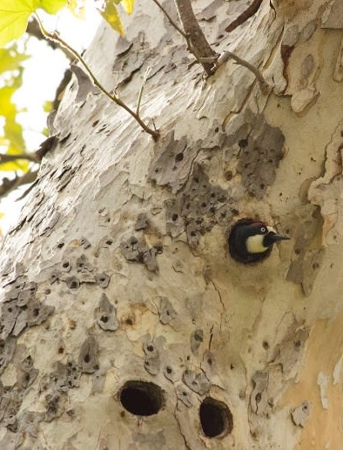
Responses of fauna to Wildfire
Birds
Fire caused death of birds depends on the season and severity of wildfires.
Mortality of adult songbirds is minor, but mortality of nestlings and fledglings does occur.
Woodpeckers are attracted to burn areas to feed on insects in charred wood.
Woodpecker
(Photo: NPS)
(Smith, 2000, p. 18 & 22)
Notes:
“Many birds leave burning areas to avoid injury. Some return to take advantage of the altered habitat, but others abandon burned areas because the habitat does not provide the structure or foods that they require to survive and reproduce. While some raptors are attracted to fire, others move out of an area immediately after fire” (Smith, 2000, p. 20).
“Bird populations often decline after shrubland fires, but declines may be offset by populations that rebound if fire spread is patchy, leaving some areas unburned, and if species usually associated with grassland communities invade the burn” (Smith, 2000, p. 39).
“Research in California shrublands indicates that fire does not reduce species diversity but does alter species composition. During the year following a stand-replacing fire in coastal sage scrub, southern California, the species richness of birds in the burned area gradually increased. By the end of the first year, species richness on the burn was 70 to 90 percent similar to that on an adjacent unburned area (Moriarty, et al., 1985). The species most abundant in the burn were those typically associated with open areas, whereas the species most abundant in unburned areas typically avoid open areas” (Smith, 2000, p. 40).
“In the Southwest, raptor and scavenger species that are attracted to fire or use recent burns for hunting include northern harrier, American kestrel, red-tailed hawk, red-shouldered hawk, Cooper’s hawk, and turkey and black vultures (Dodd, 1988)” (Smith, 2000, p. 21-22).
“Woodpeckers were attracted to a stand-replacement burn in coastal sage scrub, probably to feed on insects in the fire-killed cover (Moriarty, Farris, Noda, & Stanton, 1985)” (Smith, 2000, p. 22).

Slide 19
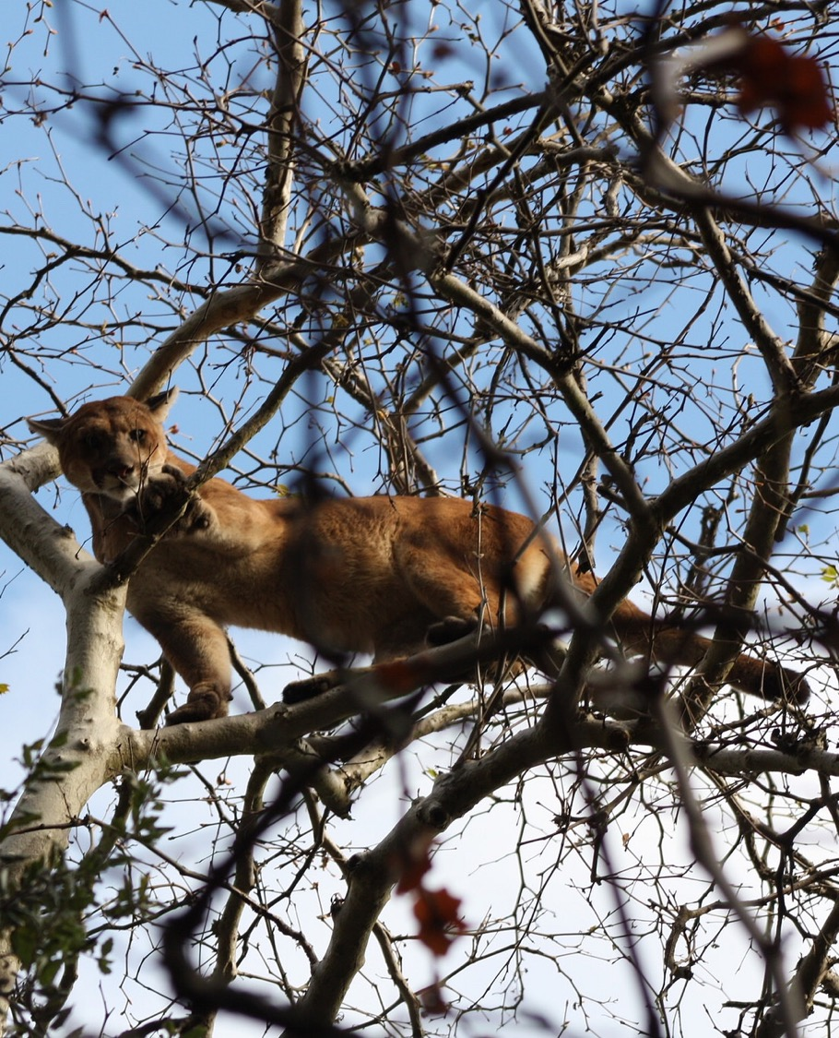
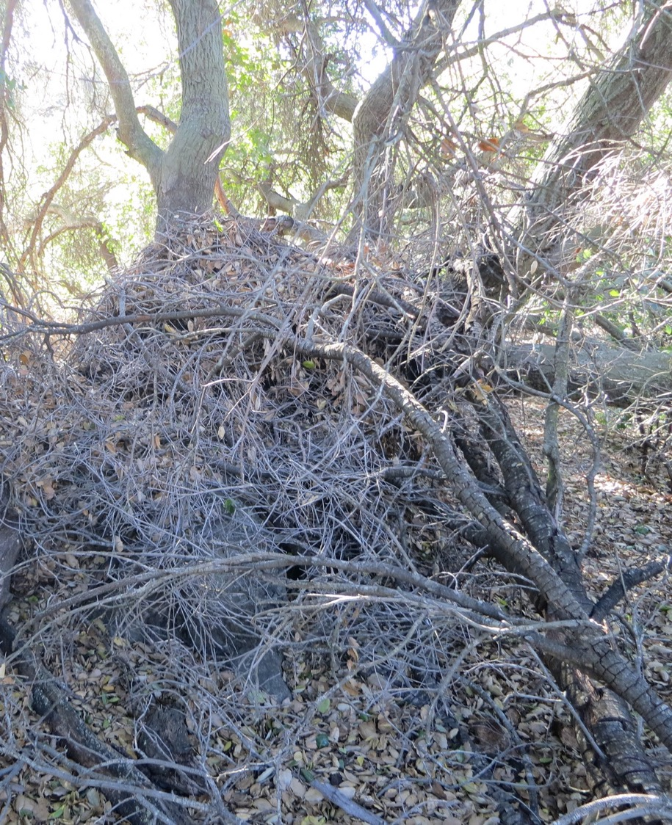
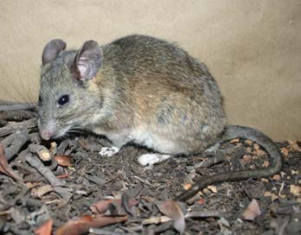
Responses of fauna to Wildfire
Mammals
The ability of mammals to survive fire depends on their mobility and the type of fire.
Small mammals will seek refuge underground or in a sheltered place.
Large mammals need to find a safe location either in an unburned patch or outside of the burned area.
Woodrat & Nest
Santa Monica Mountains - Mountain Lion in Tree
(Lion & Nest Photos: NPS; Woodrat Photo: Scott Tremor (CCI, 2009, p. 5)
(Smith, 2000, p. 18)
Notes:
“Most small mammals avoid fire by using underground tunnels, pathways under moist forest litter, stump and root holes, and spaces under rock, talus, and large dead wood (Ford, Menzel, Mcgill, Laerm, & Mccay, 1999). Not all survive. Adequate ventilation inside burrows is essential for animal survival (Bendell, 1974)” (Smith, 2000, p. 18).
“Small rodents that construct surface-level nests, such as brush rabbits, harvest mice, and woodrats (dusky-footed, desert, and white-throated), are more vulnerable to fire-caused mortality than deeper-nesting species, especially because their nests are constructed of dry, flammable materials (Kaufman, Kaufman, & Finck, 1988; Quinn, 1979; Simons, 1991). Woodrats are particularly susceptible to fire mortality because of their reluctance to leave their houses even when a fire is actively burning (Simons, 1991)” (Smith, 2000, p. 18).
Because large and small mammals, such as moose, deer, and rodents depend on vegetation for forage, bedding, cover, and thermal protection, they abandon burned areas if fire removes many of the habitat features they need. Thus stand-replacing fires and understory burns that are severe enough to top-kill shrubs and young trees seem more likely to trigger high rates of emigration than patchy or low-severity fires. (Smith, 2000, p. 21)
“Many studies describe movement by large mammals to recently burned areas because of food quantity or quality” (Smith, 2000, p. 23).
“In California chaparral, mountain lions are attracted to the edges of recent burns where deer tend to congregate (Quinn, 1990)” (Smith, 2000, p. 22-23).
“Population responses of small mammals to fire are related to fire uniformity. Most reports of woodrat responses to fire indicate that they usually suffer relatively high mortality because their nests are above ground (Simons 1991). However, populations of woodrats were “unexpectedly high” in burned areas observed by Schwilk and Keeley (1998). These burns left patches of “lightly burned” vegetation in California chaparral and coastal sage scrub, which may have provided refugia for woodrat populations” (Smith, 2000, p. 28).
“Ungulate species often benefit from increased food and nutrition on recent burns. Because ungulates are sensitive to alterations in vegetation structure, however, their net response to fire depends on its severity and uniformity” (Smith, 2000, p. 28).

Slide 20
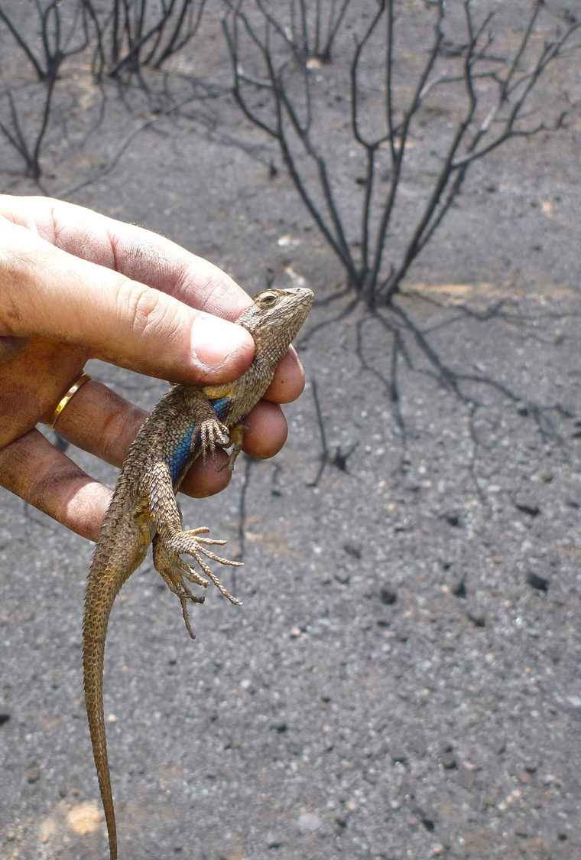
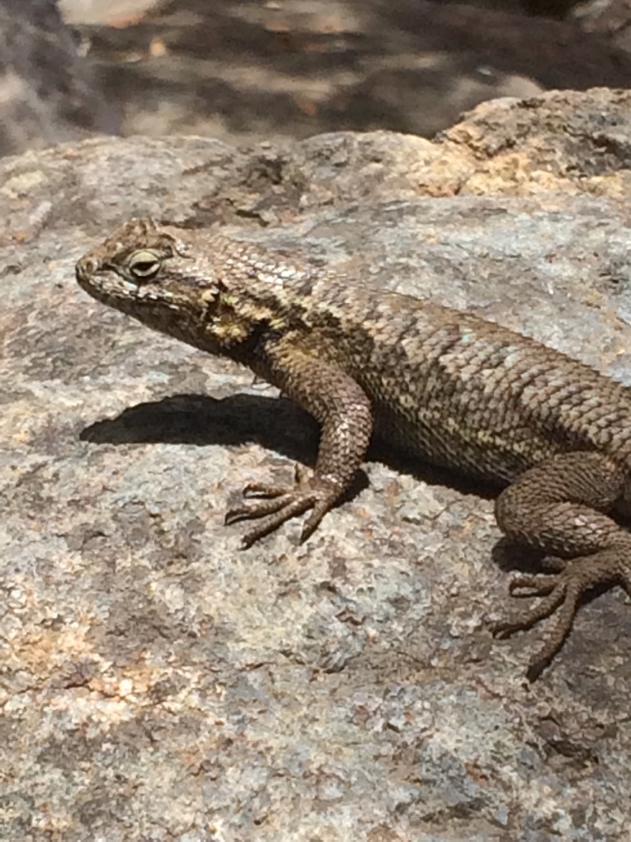
Responses of fauna to Wildfire
Reptiles
Western fence lizards take refuge during a fire then invade the burned site after the fire for food and sun.
In chaparral, reptiles are more abundant in recently burned areas than mature areas with dense cover.
Western Fence Lizard after the Springs Fire
Western Fence Lizard
(Photo 1: Bethany Szczepanski; Photo 2: NPS)
(Smith, 2000, p. 18 & 29)
Notes:
“According to a review by Russell and others (1999), there are few reports of fire-caused injury to herpetofauna, even though many of these animals, particularly amphibians, have limited mobility” (Smith, 2000, p. 20).
“Western fence lizards in chaparral take refuge under surface objects at the time of fire; after the fire, they invade the burned site from unburned patches (Lillywhite & North, 1974)” (Smith, 2000, p. 23).
“In chaparral, reptiles were more abundant in recently burned areas than in areas with mature, dense cover. Individual populations responded to the developing structure of the vegetation (Simovich 1979). Species that preferred open sites increased slightly during the first 3 years after fire. During the same time, species that used or could tolerate dense vegetation decreased but were not eliminated. As the chaparral becomes a dense, mature layer, reptile abundance is likely to decrease” (Smith, 2000, p. 29).

Slide 21
Wildfire & Humans
Fire Ecology

Slide 22
Wildfire and Humans
What is the relationship between humans and wildfire?
Human Causation of Wildfires
Effects of Wildfires on Humans
Human Restoration & Recovery Efforts after Fire

Slide 23
Human Causation of Wildfires
Wildfire and Humans

Slide 24
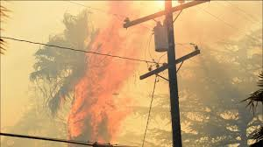
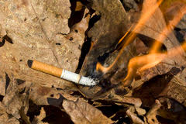
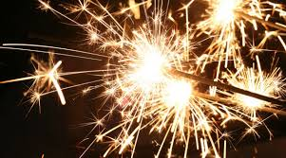
Ignitions
Wildfire and Humans
Fires recorded by NPS 1982-2011, by cause of ignition*
NPS specific causes
# of fires
Total acres burned
Other/Unknown
Arson
Power Lines
Rx Burning
Warming Fire
Smoking
Lightning
Land Clearing
Fireworks
Playing with Matches
Cooking Fires
Burning Vehicles
Trash Burning
Burning Building
Aircraft
Exhaust-Power Saw
Burning Dump
Exhaust-Other
Brushpile Burning
98
15
20
24
1
6
6
13
4
8
10
20
2
4
2
7
4
1
1
150,273.0
103,706.6
20,472.0
7,822.7
4,707.0
809.6
602.5
328.0
281.1
149.6
69.8
55.2
54.3
51.4
31.1
14.0
0.6
0.2
0.1
98% of all fire ignitions are of human origin
Cal Fire - One Less Spark
Grand Total
246
289,429.0
*Includes a few older historic fires from LA County Fire reports and other sources.
(Taylor, n.d.)
Notes:
Currently, ninety-eight percent of all fire starts are of human origin, with arson and arcing power lines responsible for the vast majority of the total area burned (NPS, 2005).
Click the Cal Fire link in the slide for a 30 second video.
“In recent decades, fire frequency has increased dramatically due to the large and growing human population in chaparral landscapes, which results in more ignitions. These frequent fires can change the species composition of the chaparral community, facilitate the spread of nonnative invasive species, and ultimately (absent restoration efforts) cause complete loss of the chaparral ecosystem in an area” (Litman, 2013, p. 4).
40% of fire records have no definitively attributed cause. Most of these occur along roadsides, and many of the rest occur near human development (several of these were suspected to be power lines or arson).
Arson and power lines burn the most acres because both causes tend to be correlated with extreme fire weather (Santa Ana winds). Most of the other causes could occur during Santa Ana winds. If they did, then a single fire would move them far up the list.
Many other areas of southern CA have seen big fires started by some of the lesser causes on this list. Burning vehicles are common. Land clearing fires tend to occur in the spring and early summer when folks are doing their defensible space clearance. Campfires do not escape from developed campgrounds operated by CA State Parks. The cooking fires generally occur in densely vegetated places where homeless people are furtively camping out. (Taylor, n.d.)
Don’t spark a wildfire – Some helpful tips!
Mechanical equipment should not be used outdoors on Red Flag Days (i.e., weed eaters, lawn mowers)- they can create sparks and start a fire in nearby grasses
Cover chimney outlet with non-flammable wire mesh
Trim trees 10 feet away from chimney
Tow chains that drag on roadways can create sparks that ignite grasses along the roadside
Park vehicles on dirt, cement or asphalt not on dry grass or brush next to roads, hot mufflers and undercarriages can cause brush to ignite and start a wildfire
Be Alert
Watch for Arson -report suspicious behavior in wildland areas especially on Red Flag days
Report illegal camp fires
Be prepared to evacuate and have a plan. (NPS, 2016)

Slide 25
Effects of Wildfires on Humans
Wildfire and Humans

Slide 26
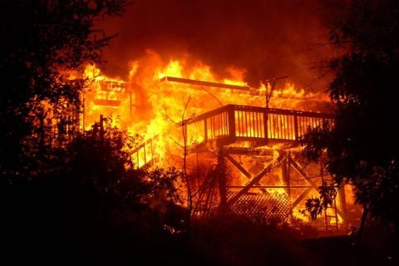
Effects of Wildfires on Humans
How are humans impacted by wildfires?
Wildfires can cause:
Structure Loss
Life Loss
Erosion
Debris Flows
(Photo: Taylor, n.d.)
Sugihara, et al., 2006; USGS, 2017)
Notes:
Erosion
“Fire renders the landscape more sensitive to erosional forces, and large storms can result in substantial quantities of rock and soil being stripped off the hillslopes and delivered to the stream channels” (Sugihara, van Wagtendonk, Shaffer, Fites-Kaufman, & Thode, 2006, p. 85).
Surface erosion generally increases following a fire, but the amount of accelerated erosion depends on the complex combination of site conditions, fire characteristics, and rainfall patterns. Burning increases surface erosion by removing the protective barriers of vegetation and litter, thereby increasing the erosional effectiveness of rain splash, wind scour, and overland flow. Fire also alters soil properties (structure, porosity, and water repellency) that enhance hillslope erosional processes (Wells et al., 1979; DeBano, 1981)” (Sugihara, van Wagtendonk, Shaffer, Fites-Kaufman, & Thode, 2006, p. 85).
Debris Flows
“Post-fire landslide hazards include fast-moving, highly destructive debris flows that can occur in the years immediately after wildfires in response to high intensity rainfall events, and flows that are generated over longer time periods that are accompanied by root decay and loss of soil strength. Post-fire debris flows are particularly hazardous because they can occur with little warning, can exert great impulsive loads on objects in their paths, can strip vegetation, block drainage ways, damage structures, and endanger human life” (USGS, 2017).
“Post-fire debris flows are most common in the 2 years after a fire; they are usually triggered by heavy rainfall. Flooding and increased runoff may continue for several years, but it is unusual for post-fire debris flows to be produced beyond the second rainy season. Some of the largest debris-flow events have been triggered by the first intense rainstorm of the storm season. It takes much less rainfall to trigger debris flows from burned basins than from unburned areas.
In southern California, as little as 7 millimeters (0.3 inches) of rainfall in 30 minutes has triggered debris flows, and any storm that has intensities greater than about 10 millimeters/hour (0.4 inches/hour) is at risk of producing debris flows.
While multiple factors can affect debris-flow occurrence, post-fire debris flows generally are triggered by one of two processes: surface erosion caused by rainfall runoff, and landsliding caused by infiltration of rainfall into the ground.
Surface erosion runoff processes are by far the most prevalent contributor to debris flows. This is because fires commonly reduce the rate at which water can seep into the soil, which increases runoff and erosion.
Landsliding processes are much less common causes of fire-related debris flow, but prolonged heavy rains may increase soil moisture even after a wildfire. The wetted soil then may fail, producing infiltration-triggered landslides. Wildfires can also result in the destabilization of pre-existing deep-seated landslides over long time periods” (USGS, 2017).

Slide 27
Human Restoration efforts after Wildfires
Wildfire and Humans

Slide 28
Restoration after Wildfire
There is no simple answer.
Chaparral is good at recovering on its own.
However, since humans arrived, we have made many changes to the environment.
Therefore, there are circumstances when managers need to step in and help protect human life, property, and our native ecosystems from further degradation after a fire.
After a fire, should we let nature restore itself as it has done many times before or should we step in to help?
(Halsey, 2008, p. 90)

Slide 29
Restoration after Wildfire
Burned Area Emergency Response (BAER) teams are a collection of scientists, foresters, and representatives from various government agencies responsible for identifying hazards and recommending mitigation they feel is needed to protect communities and resources from post-fire impacts.
Teams will identify:
where flooding or debris flows are likely to occur and how to reduce the impacts by clearing culverts or channels and having storm patrols.
where burned trees may be hazardous and need to be cut down.
areas where exposed cultural resource sites need to be protected from looting when they are exposed after a fire.
Springs Fire BAER Plan
(Halsey, 2008, p. 88)
Notes:
Click the link in the slide to see the BAER plan for the Santa Monica Mountains Springs Fire in 2013.

Slide 30
Human Recovery: Learning from Wildfires
Wildfire and Humans

Slide 31
Learning from fires
Southern California has a climate and vegetation that lead to extreme, uncontrollable fire behavior. Fire prevention and management strategies have had very little effect on reducing fires.
Fire has been present for millions of years and will continue to be here in the future. Thus, like other natural hazards, we must learn to live with wildfire.
Wildfires are the most relevant in the Wildland Urban Interface (WUI). These are the locations where homes make direct contact with the natural environment.
In these places, it is important for citizens to take responsibility for wildland fire protection by creating an environment that will maximize the chance of survival for their homes while creating a safe space for firefighters to work.
It is also important for policy makers and urban planners to create safe and sustainable communities, so fire can continue to play its role within the natural landscapes that are so important for us and our future generations.
(Halsey, 2008, p. xvii & 103-109)

Slide 32
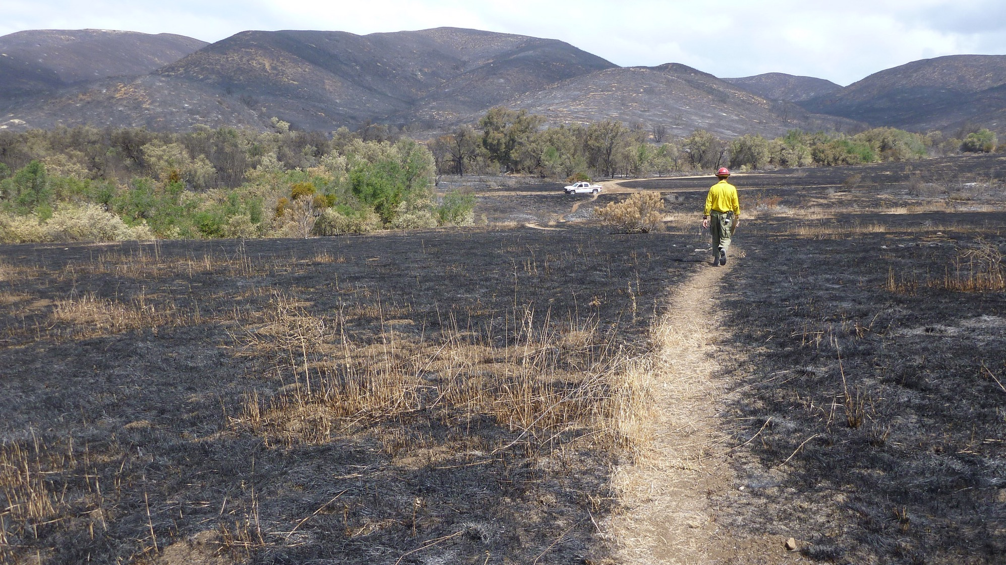
Questions for Thought
“…If you live in a city that provides you with all the things you need or an out-lying neighborhood with a wealth of amenities like good schools, nice parks, and nearby shopping facilities, why should you care about natural space, chaparral, or wildfires?”
–Richard Halsey (Halsey, 2008, p. 128)
(Photo: NPS)
Notes:
Thank you for learning about Fire Ecology: The relationship between wildfire & the biotic & abiotic environment. To continue your journey into Santa Monica Mountains National Recreation Area: Fire Ecology continue on to the Wildland Urban Interface: Learning to Live with Wildfires unit.

Slide 33
References
Bendell, J. F. (1974). Effects of fire on birds and mammals. Fire and Ecosystems,73-138. doi:10.1016/b978-0-12-424255-5.50009-2
Biswell, H. H. (1989). Prescribed burning in California wildlands vegetation management. Berkeley: University of California Press.
California Chaparral Institute (CCI). (n.d.a). Fire and nature. Retrieved April 07, 2018, from http://www.californiachaparral.org/fire/firenature.html
California Chaparral Institute (CCI). (n.d.b). What’s the chaparral’s relationship to fire? [Informational Handout]. www.californiachaparral.org. Retrieved from personal communication from Richard Halsey
Carey, H. & Schumann, M. (2003). Modifying wildfire behavior – The effectiveness of fuel treatments: The status of our knowledge. National Community Forestry Center, Southwest Region. Working Paper April 2003.
DeBano, L.F., (1981). Water repellent soils: a state-of-the-art. USDA Forest Service, Pacific Southwest Forest and Range Experiment Station, General Technical Report PSW-46.
DeBano, L. F., Neary, D. G., & Ffolliott, P. F. (1998). Fire's effects on ecosystems. New York, NY: John Wiley and Sons.
Dodd, N. L. (1988). Fire management and southwestern raptors. In: Glinski, R. L.; Pendleton, Beth Giron; Moss, Mary Beth; [and others], eds. Proceedings of the southwest raptor symposium and workshop; 1986 May 21-24; Tucson, AZ. NWF Scientific and Technology Series No. 11. Washington, DC: National Wildlife Federation: 341-347.
Ecological Society of America (ESA). (n.d.). What does ecology have to do with me. Retrieved February 13, 2018, from https://www.esa.org/esa/education-and-diversity/what-does-ecology-have-to-do-with-me/
Erwin, W. J., & Stasiak, R. H. (1979). Vertebrate mortality during the burning of a reestablished prairie in Nebraska. American Midland Naturalist,101(1), 247. doi:10.2307/2424922
Ford, W. M., Menzel, M., Mcgill, D. W., Laerm, J., & Mccay, T. S. (1999). Effects of a community restoration fire on small mammals and herpetofauna in the southern Appalachians. Forest Ecology and Management,114(2-3), 233-243. doi:10.1016/s0378-1127(98)00354-5
Halsey, R. W. (2008). Fire, chaparral, and survival in southern California. San Diego, CA: Sunbelt Publications.
Hart, S. (1998). Beetle mania: An attraction to fire. BioScience,48(1), 3-5. doi:10.2307/1313221
Kaufman, G. A., Kaufman, D. W., & Finck, E. J. (1988). Influence of fire and topography on habitat selection by peromyscus maniculatus and reithrodontomys megalotis in ungrazed tallgrass prairie. Journal of Mammalogy,69(2), 342-352. doi:10.2307/1381384
Keeley, J.E., Pfaff, A.H., & Safford, H.D. (2005). Fire suppression impacts on postfire recovery of Sierra Nevada chaparral shrublands. International Journal of Wildland Fire, 14 (pp. 255-265).
Komarek, E. V., Sr. (1969). Fire and animal behavior. In: Proceedings, 9th annual Tall Timbers Fire Ecology conference; 1969 April 10-11; Tallahassee, FL. Tallahassee, FL: Tall Timbers Research Station: 161-207.
Lillywhite, H. B., & North, F. (1974). Perching behavior of sceloporus occidentalis in recently burned chaparral. Copeia,1974(1), 256. doi:10.2307/1443035
Litman, L. (Ed.). (2013). California’s native landscape. Forestland Steward, Summer 2013. Retrieved March 21, 2018, from http://calfire.ca.gov/foreststeward/pdf/news-summer2013.pdf
Morearty, D. J., Farris, R. E., Noda, D. K., & Stanton, P. A. (1985). Effects of fire on a coastal sage scrub bird community. The Southwestern Naturalist,30(3), 452. doi:10.2307/3671284
National Park Service (NPS). (2005). Environmental impact statement fire management plan. United State Department of the Interior, National Park Service. Santa Monica Mountains National Recreation Area, Thousand Oaks, CA.
National Park Service (NPS). (2016). Create defensible space. Retrieved May 4, 2018, from https://www.nps.gov/samo/learn/management/create-defensible-space.htm
National Park Service (NPS). (2018). Fire ecology. Retrieved April 22, 2018, from https://www.nps.gov/samo/learn/management/fireecology.htm
National Park Service (NPS). (n.d.a). Learning about Fire Ecology Basics. Retrieved January 29, 2018, from https://www.nps.gov/articles/learning-about-fire-ecology-basics.htm)
National Park Service (NPS). (n.d.b). Wildland fire: Science ecology research. Retrieved April 21, 2018, from https://www.nps.gov/fire/wildland-fire/what-we-do/science-ecology-and-research.cfm
Paysen, T., Ansley, R.J., Brown, J., Gottfried, G., Haase, S., Harrington, M., …Wilson, R. (2000). Fire in western shrubland, woodland, and grassland ecosystems. Chapter 6. USDA Forest Service Gen. Tech. Rep. RMRS-GTR-42-vol. 2.
Quinn, R. D. (1979). Effects of fire on small mammals in the chaparral. Cal-Neva Wildlife Transactions.
Quinn, R. D. (1990). Habitat preferences and distribution of mammals in California chaparral. Res. Pap. PSW-202. Berkeley, CA: U.S. Department of Agriculture, Forest Service, Pacific Southwest Research Station.
Schwilk, D. W., & Keeley, J. E. (1998). Rodent populations after a large wildfire in California chaparral and coastal sage scrub. Southwestern Naturalist,43(4), 480-483.
Simons, L. H. (1991). Rodent dynamics in relation to fire in the Sonoran Desert. Journal of Mammalogy,72(3), 518-524. doi:10.2307/1382135
Singer, F. J., & Schullery, P. (1989). Yellowstone wildlife: Populations in process. Western Wildlands,15(2), 18-22.
Smith, J. K. (2000). Wildland fire in ecosystems: Effects of fire on fauna (Vol. 1, Gen Tech Rep RMRS-GTR-42). Fort Collins: U.S. Dept. of Agriculture, Forest Service, Rocky Mountain Research Station.
Sugihara, N. G., van Wagtendonk, J. W., Shaffer, K. E., Fites-Kaufman, J., Thode, A. (Eds.). (2006). Fire in california's ecosystems. Retrieved from https://ebookcentral.proquest.com
Taylor, R. S. (n.d.). Fire regime, fire history, and fire behavior in the Santa Monica Mountains [PowerPoint slides].
United States Geological Survey (USGS). (2014). Living with fire [film]. Retrieved April 24, 2018 from https://www.youtube.com/watch?v=aJ9mE0TzrX0
United States Geological Survey (USGS). (2017). Post-fire debris flow. Retrieved April 28, 2018, from https://ca.water.usgs.gov/flooding/wildfires-debris-flow.html
Wells, C.G., Campbell, R.E., DeBano, L.F., Lewis, C.E., Fredricksen, R.L., Franklin, E.C., …Dunn, P.H. (1979). Effects of fire on soil: a state of knowledge review. USDA Forest Service, General Technical Report WO-7.
Witter, M., Taylor, R., Davis, S. (2007). Vegetation response to wildfire and history in the Santa Monica mountains, California. In Flora and ecology of the Santa Monica Mountains: Proceedings of the 32nd annual Southern California Botanists symposium, ed. D.A. Knapp, (pp. 173-194). Southern California Botanists Special Publication No. 4, Fullerton, CA.
Wooten, G. (n.d.). Fire and fuels management: Definitions, ambiguous terminology and references. Retrieved April 13, 2018, from https://www.nps.gov/olym/learn/management/upload/fire-wildfire-definitions-2.pdf
Zedler, P.H. (1995). Fire frequency in southern California shrublands: Biological effects and management options. In Brushfires in California: Ecology and resource management, eds. J.E. Keeley and T. Scott, 101-112. International Association of Wildland Fire, Fairfield, WA.

