Slide 1
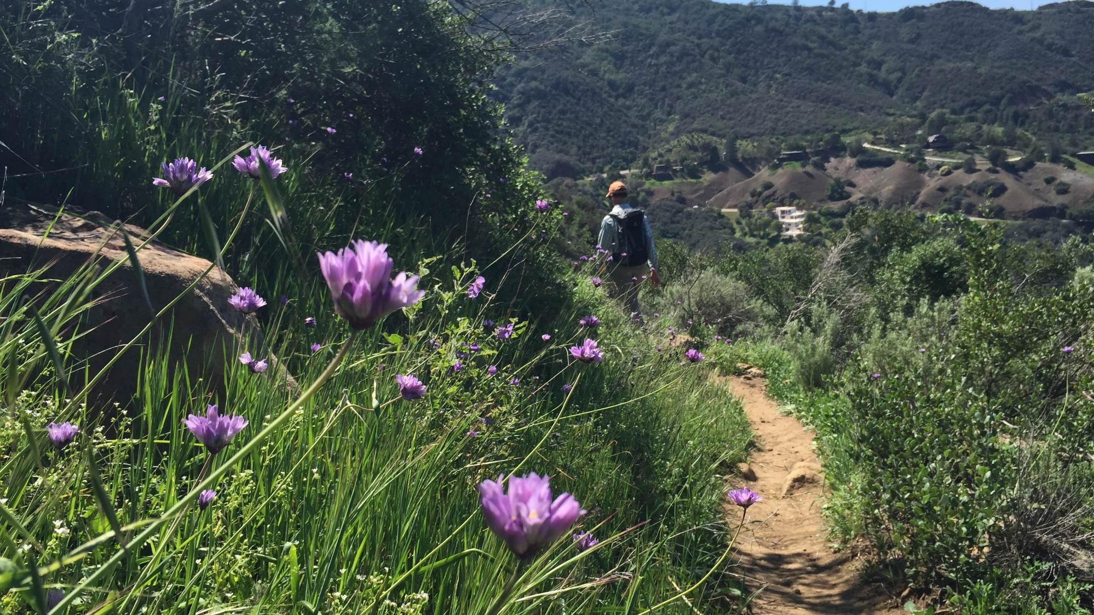
Chaparral
Santa Monica Mountains National Recreation Area
Plant Communities
“Being able to walk along a trail and recognize native plants and animals as friends who have existed here for millions of years is one of the most rewarding experiences in life.”
–Richard Halsey
(Photo: NPS)
(Halsey, 2008, p. x)
Notes:
Activity: Pair share: Think about this quote. What does it mean to you? Do you think that you belong in nature? Are you a part of nature? How do you feel when you are hiking through nature? How would you feel if you had a better understanding of the plants and animals around you?
For most Southern Californians, chaparral is the closest place to make contact with nature. “By recognizing and being able to identify native species and their surrounding environment, we begin to see their habitat as worthy of attention and stewardship. Wild space becomes our space as well” (Halsey, 2008, p. 133).
Image from National Park Service, Flicker https://www.flickr.com/photos/santamonicamtns/26373496003/in/album-72157667627081800/

Slide 2
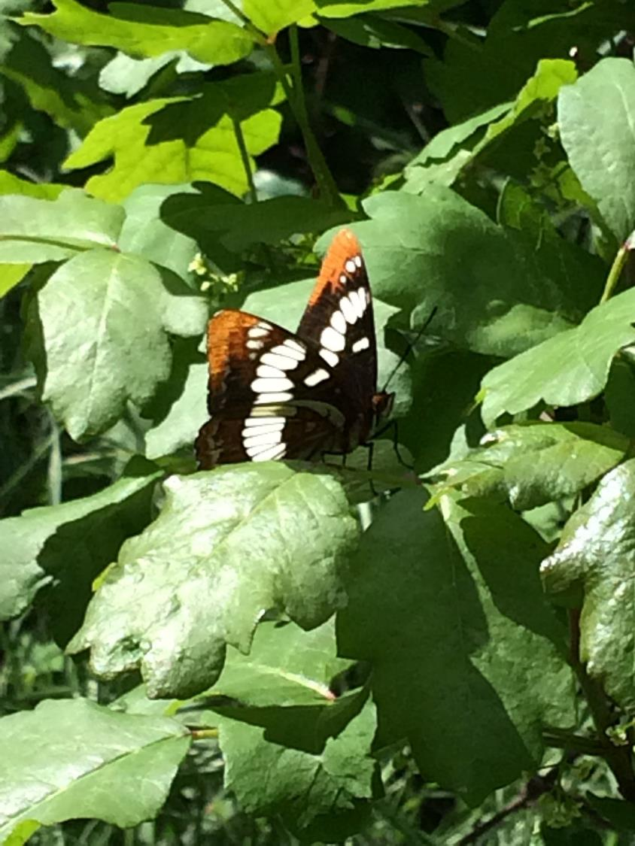
What is a plant community?
“Plant communities are groups of plants sharing a common environment that interact with each other, animal populations, and the physical environment.”
(Photo: Bethany Szczepanski)
(Zimmerman, et al., 2012)
Notes:
“An ecological community is an assemblage of plants, animals, and other organisms living together at the same place and time. Species aren’t isolated entities but interact with each other in intricate ways. Co-occurring plants compete with each other for light, water, nutrients, and space. Animals interact with plants by pollinating their flowers, dispersing their seeds, and grazing on their tissues” (Spira, 2011, p. 19).
“Communities provide the context within which species interact with each other and their physical environment. The structure and composition of natural communities varies, largely due to changes in the physical environment. Regional landscapes often have a mosaic of communities present, reflecting differences in moisture availability, soil type, topography, and other factors. Because adjoining communities often grade into one another, it can be difficult to tell where one community ends and another begins” (Spira, 2011, p. 19).
“Plants play a dominant role in community classification because they’re highly visible and form the base of the food chain” (Spira, 2011, p. 19).

Slide 3
Many plant communities can be experienced very near you within Santa Monica Mountains National Recreation Area
(Image: NPS)
Notes:
In 1978, because these mountains and adjacent seashore exhibit the components of a Mediterranean Biome, Congress established Santa Monica Mountains National Recreation Area – a unit of the National Park System – to protect the resources of this unique ecosystem.

Slide 4
There are many plant communities in Southern California & the Santa Monica Mountains
Coastal Strand
Coastal Salt Marsh
Freshwater Marsh
Coastal Sage Scrub
Riparian Woodland
Valley Grassland
Southern Oak Woodland
Chaparral
What kind of community is in this picture?
Trancas Creek
(Photo: NPS)
Notes:
For more about these communities visit:
https://www.nps.gov/samo/learn/nature/coastalsagescrub.htm
https://www.nps.gov/samo/learn/nature/coastalsaltmarsh.htm
https://www.nps.gov/samo/learn/nature/coastal-strand.htm
https://www.nps.gov/samo/learn/nature/oak-woodland.htm
https://www.nps.gov/samo/learn/nature/riparian-woodland.htm
https://www.nps.gov/samo/learn/nature/valley-grassland.htm
https://www.nps.gov/samo/learn/nature/valleyoaksavanna.htm
Image by National Park Service, Flicker: https://www.flickr.com/photos/santamonicamtns/26944871336/in/album-72157667627081800/

Slide 5
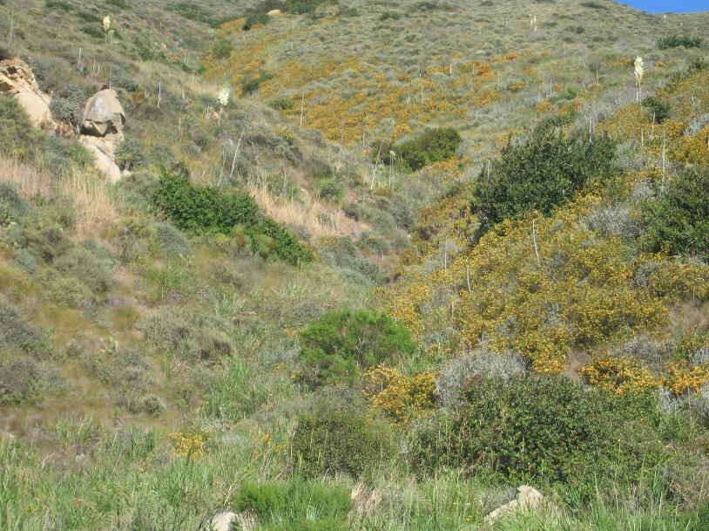
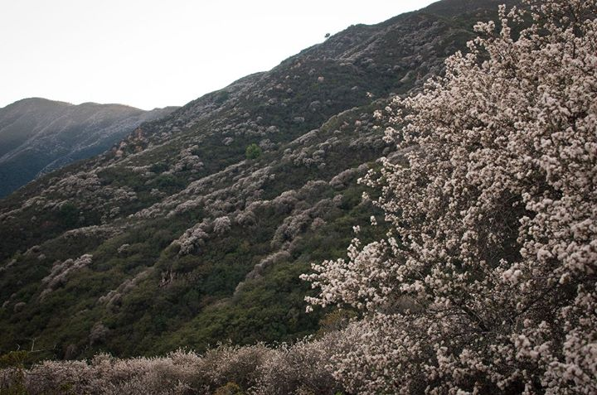
Santa Monica Mountains Plant Communities
75% of the vegetation in the Santa Monica Mountains is Coastal Sage Scrub & Chaparral.
Coastal Sage Scrub
Chaparral
(Photos: Robert Taylor)
Notes:
Vegetation
There are a variety of different plant communities in the Santa Monica Mountains, however, seventy-five percent of the vegetation in the Santa Monica Mountains is chaparral and coastal sage scrub shrublands.
“Coastal scrub is sometimes called “soft chaparral” because the dominant plants have softer leaves and are not as woody as “hard
chaparral.” Coastal scrub is generally shorter and less dense than chaparral, and found on drier slopes at lower elevations. Fog can alleviate some of this harsh climate by lowering the temperature and increasing the relative humidity. Many species have hairy leaves and aromatic oils, which help retain water. Some are drought-deciduous; they drop their leaves during summer to reduce moisture loss. Others accomplish this by producing smaller leaves in the summer. Coastal scrub soils tend to be erosive and poor in nutrients. The scrub vegetation species are instrumental in holding the soil with their fibrous shallow roots” (Litman, 2013, p. 3).
Continue on to discuss Chaparral.

Slide 6
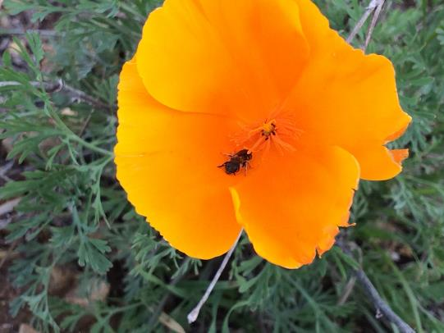
Chaparral
The most common plant community in California is:
“…chaparral is pure California. It exists in every single county… It’s a frequent home to the California quail (State Bird), is occasionally decorated by the California poppy (State Flower), and was the preferred habitat to the now extinct California grizzly bear
(State Animal)…” – Richard Halsey
(Halsey, 2008, p. ix)
California Poppy
(Photo: Bethany Szczepanski)
Notes:
“Chaparral is a plant community which derives its name from the Spanish word chaparro, which means 'little oak' and refers to a thicket of scrub oaks” (Calflora, n.d.).

Slide 7
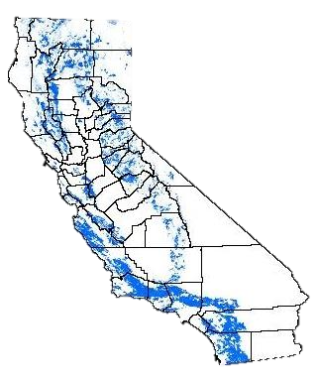
Where is Chaparral ?
Is there Chaparral where you live?
Chaparral is found in every single county in California over a broad range of elevations, from sea level to about 6000 feet.
Map from Keeley, J.E. and F.W. Davis. 2007. Chaparral. In M.G. Barbour (ed), Terrestrial vegetation of California. University of California Press, Los Angeles. Addendum: there's a small patch of chaparral in the southwest corner of Imperial County missing from the map. (CCI, n.d.c)
Chaparral Pictures: http://www.californiachaparral.org/chaparralfacts/awheresthechaparral.html
(CCI, n.d.c)
Notes:
Chaparral exists in every single county (Sacramento County has the least, San Diego County has the most) in California. It also sneaks into Oregon, wanders south of the border into Baja, and splashes upon isolated mountain tops in Arizona. (Halsey, 2008, p. ix)
“Chaparral is found throughout California from the Oregon border to Baja California, especially in the Transverse and Peninsular ranges in central and southern California and the foothills of the Sierra Nevada (see map ). Altogether, shrublands cover a respectable 8.5 percent of the state” (Litman, 2013, p. 2).
Click on the link to show pictures of different types of chaparral.

Slide 8
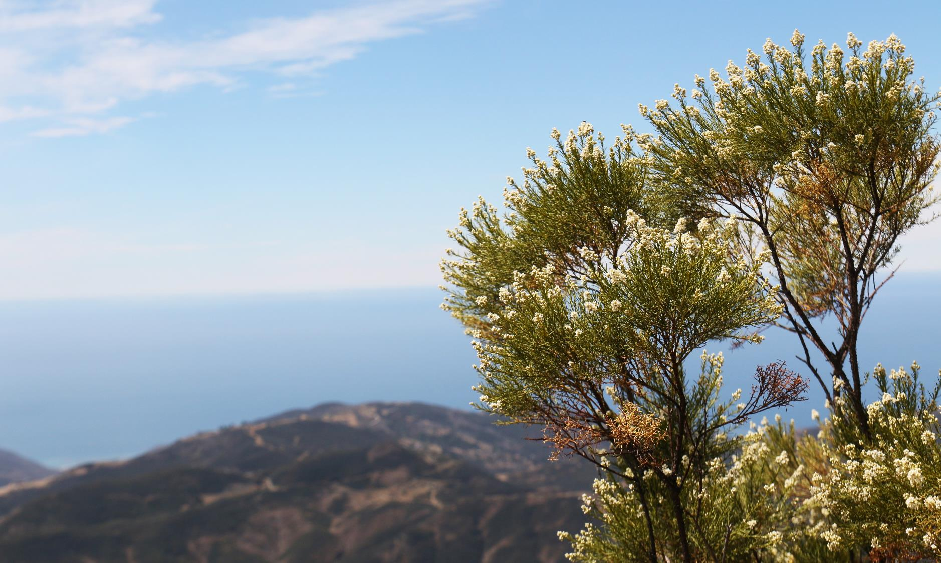
What is Chaparral?
“…Chaparral is a semi-arid, shrub dominated association of sclerophyllous woody plants shaped by summer drought, mild, wet winters, and naturally recurring fires every 30-150 years plus.”
(Halsey, 2008, p. 3)
(Photo: NPS)
Notes:
Chaparral is a part of a Shrubland Ecosystem.
For more about shrubland ecosystems visit: http://www.californiachaparral.org/shrublandecosystems.html
“Sclerophyllous is a term coined by German botanist, Andreas F.W. Schimper in 1898. Referring to Mediterranean climatic regions in his classic 844 page Plant Geography Upon a Physiological Basis he said, ‘The mild temperate districts with winter-rain and prolonged summer-drought are the home of evergreen xerophilous (dry-loving) woody plants, which, owing to the stiffness of their thick, leathery leaves, may be termed sclerophyllous woody plants’” (Halsey, 2008, p. 3).
“Meaning ‘hard-leaved’ in Greek, sclerophyllous leaves are advantageous in a semi-arid climate because they reduce evaporation through a variety of traits including waxy coatings, thicker cell layers, and recessed ‘stomata,’ the pores in the leaves permitting evaporation and the exchange of oxygen and carbon dioxide” (Halsey, 2008, p. 3).
Image: Sandstone Peak in Santa Monica Mountains from https://www.flickr.com/photos/santamonicamtns/19704547291/in/album-72157656432404981/

Slide 9
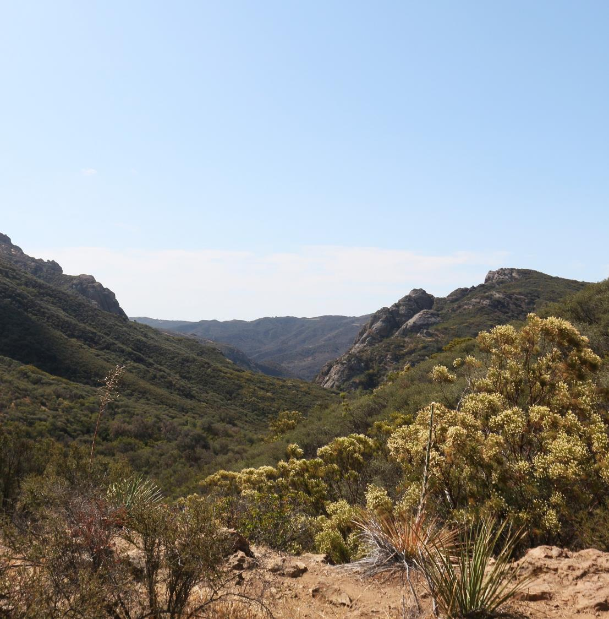
Chaparral Characteristics
Chaparral is dominated by woody evergreen shrubs.
Plants tolerate drought with either deep roots or physiological drought tolerance and thick leathery leaves.
Being evergreen, they can photosynthesize throughout the year.
(Photo: NPS)
(Litman, 2013, p. 3)
Notes:
“Chaparral communities occur in many forms, with dozens of different combinations of dominant plants and associations. These varied communities also have a lot in common. The dominant plants are woody with multiple stems, and there are few to no trees. Chaparral plants are highly influenced by our Mediterranean climate of mild wet winters and long hot dry summers. Their growing season occurs in the wetter winter months and they go dormant in the summer” (Litman, 2013, p. 2).
Image: Santa Monica Mountains from https://www.flickr.com/photos/santamonicamtns/19670119235/in/album-72157656432404981/

Slide 10
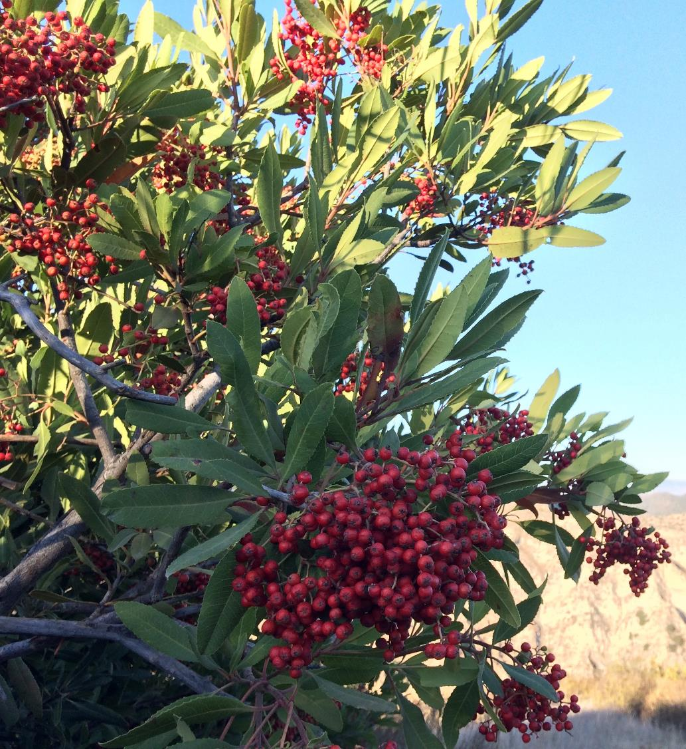
Chaparral Characteristics
Chaparral shrubs are tough, able to survive long periods of drought and recover from fire as long as the flames do not occur too often.
Toyon
(Photo: Bethany Szczepanski)
(CCI, 2009, p. 1)
Notes:
“Most chaparral plants regenerate after fire either by resprouting or germinating from the seed bank” (Litman, 2013, p. 2).
“The natural fire return interval for chaparral is 30 to 150 years or more*. Today, there are more fires than the chaparral ecosystem can tolerate” (CCI, n.d.b).
Fires more than once every 20 years, can lead to the loss of fire-sensitive species and increase the dominance of non-native weedlands (a process called type-conversion). (Witter, personal communication 2/20/19).
For more about chaparral and fire visit: http://www.californiachaparral.org/fire/firenature.html
*This is variable depending on the source.

Slide 11
Chaparral Plant Adaptations
Chaparral plants have evolved to live in a hot dry environment.
“The leaves of chaparral species are adapted to the long annual drought. They can be small, leathery, thick, fuzzy, and/or waxy—all adaptations to resist water loss.”
To cut down evaporation, plants have fewer stomata (pores in the leaves for gas exchange).
Some plants can even orient their leaves which reduces their exposure to sunlight.
Microclimate is also significant – plants that grow on hotter, drier south-facing slopes tend to have smaller leaves than plants on cooler, wetter north-facing slopes.
(Calflora, n.d.; Litman, 2013, p. 6)
Notes:
“Although plants in shrubland communities may look superficially similar, they are actually quite different physiologically. Chaparral dwellers–both plants and animals—are survivors, highly adapted to the Mediterranean climate and periodic fires” (Litman, 2013, p. 2).

Slide 12
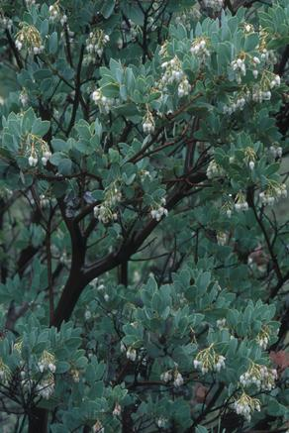
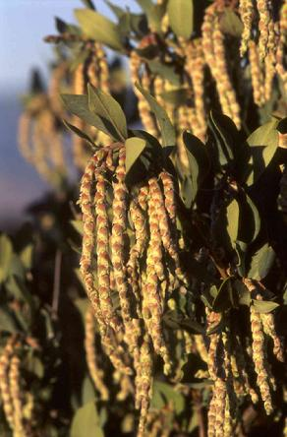
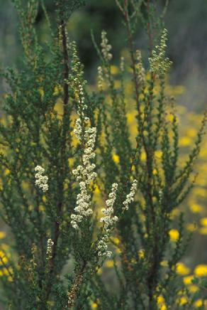
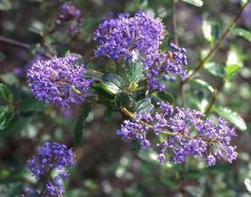
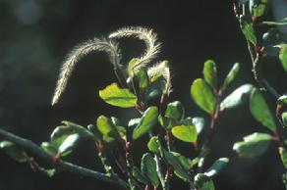
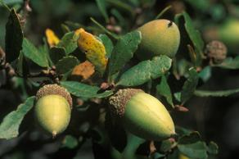
Plants of the Chaparral
Common Chaparral Shrubs:
Big-berry manzanita (Arctostaphylos glauca)
Ceanothus (Ceanothus tomentosus) - there are many other species
Scrub oak (Quercus berberidifolia)
Chamise (Adenostoma fasciculatum) - the most common shrub in the chaparral
Silk-tassel bush (Garrya flavescens) - another common species is Garrya veatchii
Mountain-mahogany (Cerocarpus betuloides)
Scrub Oak
Mountain-Mahogany
Ceanothus
Chamise
Silk-tassel Bush
Big-berry Manzanita
(Photos from CCI, n.d.a)
Notes:
For more about the plants and animals of the chaparral go to http://www.californiachaparral.org/chaparralfacts/clantsanimals.html

Slide 13
Old Growth Chaparral
Old Growth Chaparral is over a century in age and can form a canopy more than 20 feet high and manzanitas with stems the size of a person’s waist!
This was the habitat that the now extinct California grizzly bear preferred. They would make tunnels through the dense chaparral. As they walked along, they would place their paws in the same spots generation after generation.
An old-growth legacy manzanita (Arctostaphylos glauca) and an Engelmann oak that have lasted for more than a century. (Photo: Richard Halsey)
(CCI, 2009)

Slide 14
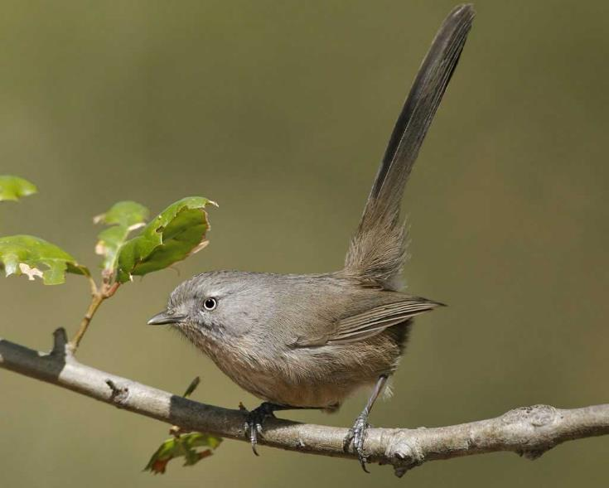
Animals of the Chaparral
Birds
The most common bird found in the Chaparral is the Wrentit. This is a small gray songbird endemic to the chaparral ecosystem.
As you walk through the chaparral, listen for its call that sounds like the bouncing of a ping-pong ball.
Wrentit Call
(CCI, 2009)
(Photo: Brian E. Small/Vireo)
Notes:
The animals that live in the chaparral are a tough lot, they have to live with limited rainfall, long and hot summers, and very little standing water. (Litman, 2013, p. 7)
To hear the call of the Wrentit click the link in slide.
To learn more about the Wrentit: http://www.audubon.org/field-guide/bird/wrentit
For more about the plants and animals of the chaparral go to http://www.californiachaparral.org/chaparralfacts/clantsanimals.html
Credits:
Photo: Brian E. Small from http://www.audubon.org/field-guide/bird/wrentit
Wrentit call: Lang Elliott, Bob McGuire, Kevin Colver, Martyn Stewart and others.

Slide 15
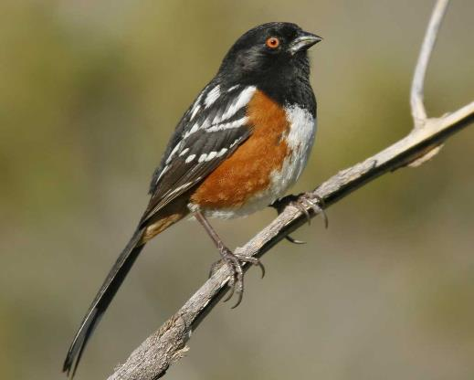
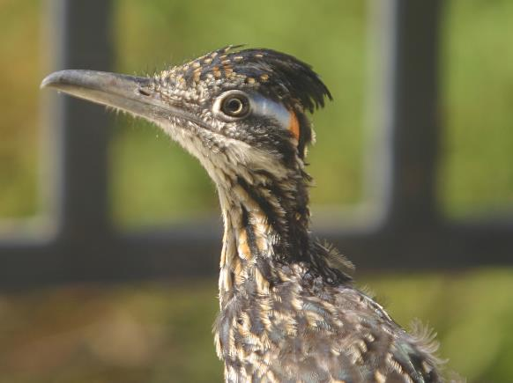
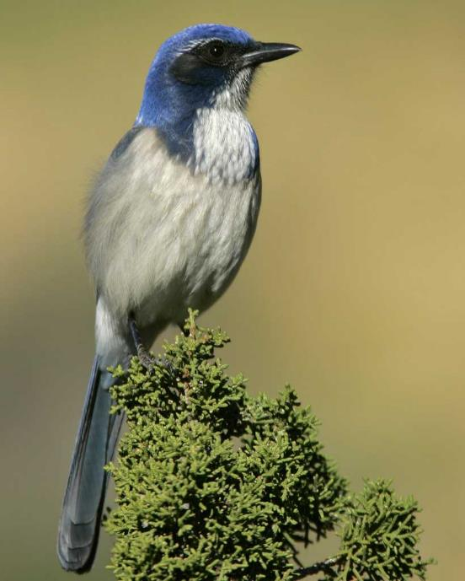
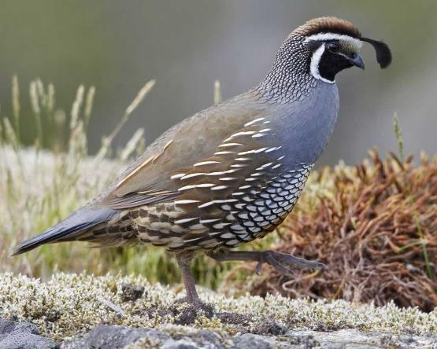
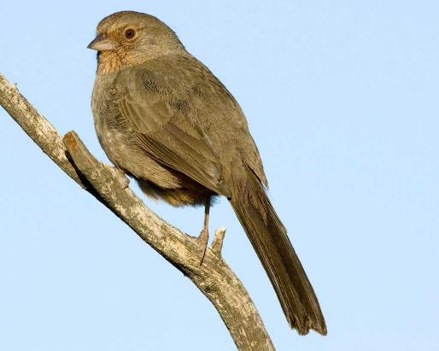
Birds of the Chaparral
Greater Roadrunner
Spotted Towhee
Spotted Towhee Song
Roadrunner Call
California Quail
California Towhee
California Scrub Jay
(Photos: Audubon; Roadrunner: NPS)
California Quail Calls & Song
California Towhee Song
Scrub Jay Call
Notes:
To hear the bird calls, click on the links in slide.
For more about the plants and animals of the chaparral go to http://www.californiachaparral.org/chaparralfacts/clantsanimals.html
For more about birds in the Santa Monica Mountains: https://www.nps.gov/samo/learn/nature/birds.htm
For more about the Greater Roadrunner: http://www.audubon.org/field-guide/bird/greater-roadrunner
For more about the California Scrub Jay: http://www.audubon.org/field-guide/bird/california-scrub-jay
For more about the Spotted Towhee: https://www.audubon.org/field-guide/bird/spotted-towhee
For more about the California Towhee: https://www.audubon.org/field-guide/bird/california-towhee
For more about the California Quail: https://www.audubon.org/field-guide/bird/california-quail
Credits:
California Scrub Jay photo: Photo: Gil Eckrich from http://www.audubon.org/field-guide/bird/california-scrub-jay
Spotted Towhee photo: Glenn Bartley from https://www.audubon.org/field-guide/bird/spotted-towhee
Spotted Towhee audio: Lang Elliott, Bob McGuire, Kevin Colver, Martyn Stewart and others.
California Towhee photo: Rick & Nora Bowers from https://www.audubon.org/field-guide/bird/california-towhee
California Towhee audio: Lang Elliott, Bob McGuire, Kevin Colver, Martyn Stewart and others.
California Quail photo: Photo: Rick Derevan from https://www.audubon.org/field-guide/bird/california-quail
California Quail audio: Lang Elliott, Bob McGuire, Kevin Colver, Martyn Stewart and others.
Greater Roadrunner photo: https://www.flickr.com/photos/santamonicamtns/albums/72157655587150740 (visit this site to see more photos of birds in Santa Monica Mountains)

Slide 16
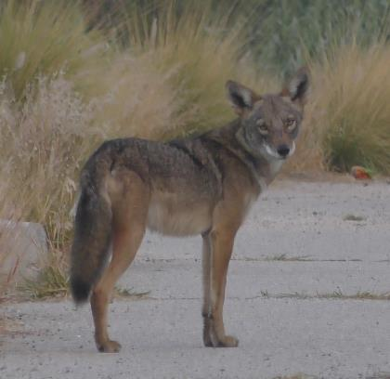
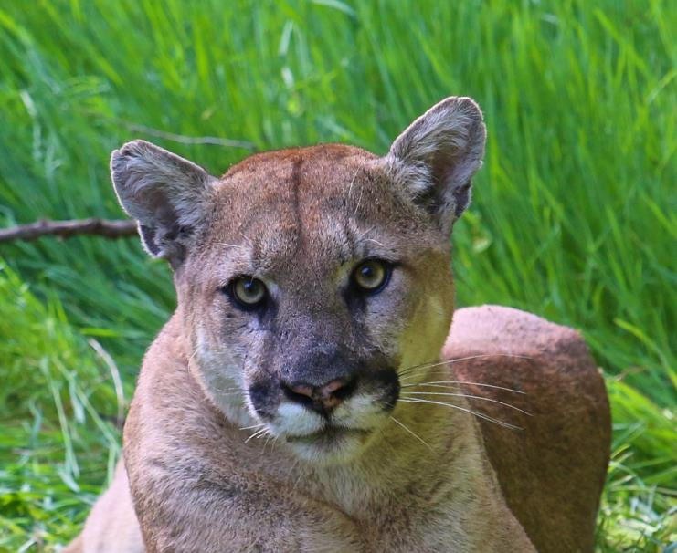
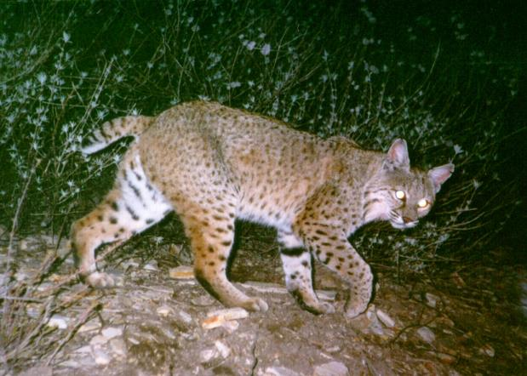
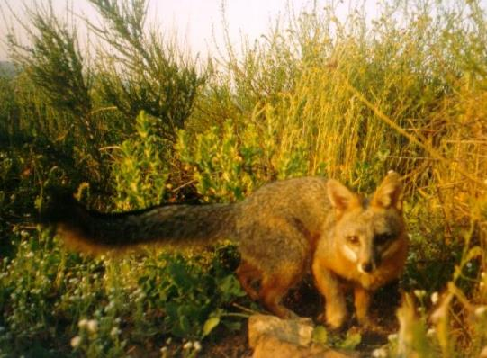
Animals of the Chaparral
Mammals
The largest predators are mountain lions, bobcats, coyotes, and gray foxes
Mountain Lion Cub
Coyote
Bobcat
Mountain Lion
Gray Fox
(Photos: NPS)
Notes:
Chaparral is rich in species diversity.
“Despite the harsh climate, shrublands are very rich in biodiversity. The animals that live there have similar survival strategies to desert dwellers. Many are nocturnal or stay in the shade by day to avoid the heat. Some avoid the hottest season by becoming dormant. And some have physiological adaptations, e.g., mice and lizards can reduce water loss by secreting a semi-solid urine.
Shrubland diversity also includes a very rich invertebrate fauna, including 150–200 species of butterflies, a rich diversity of native bees, 21 species of scorpions, and a large number of spiders.” (Litman, 2013, p. 7).
For more photos of coyotes: https://www.flickr.com/photos/santamonicamtns/albums/72157655472520590/with/28307516245/
For more photos of mountain lions: https://www.flickr.com/photos/santamonicamtns/albums/72157655467005169/with/20381107641/
For more photos of deer: https://www.flickr.com/photos/santamonicamtns/albums/72157656363513856/with/9096405471/
For more photos of bobcats: https://www.flickr.com/photos/santamonicamtns/albums/72157655885459301/with/9098579648/

Slide 17
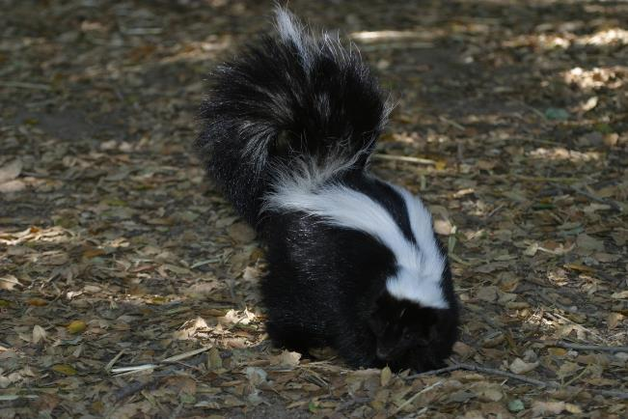
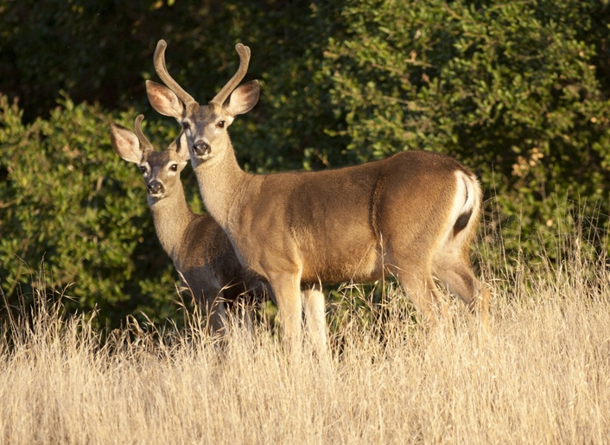
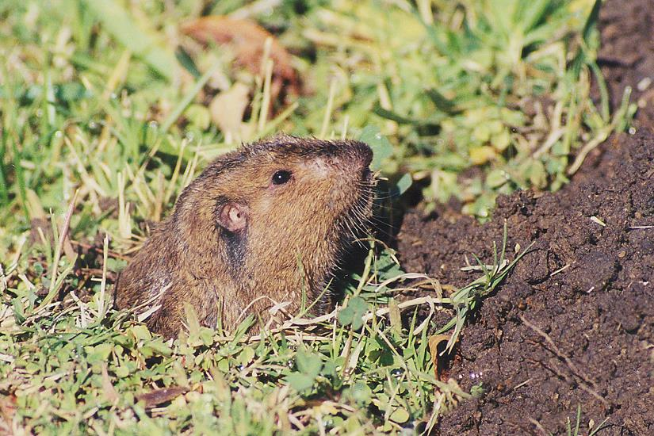
Animals of the Chaparral
Mammals
Skunk
Woodrat
Mule Deer
Gopher
(Deer Photo: Brendan Oneal; Woodrat Photo: Scott Tremor (CCI, 2009, p. 5); Other: NPS)
Notes:
“Over 45 mammal species can be found in the Santa Monica Mountains, and they range in size from shrews, which weigh less than one ounce, to mountain lions weighing up to 150lbs. However most of these are smaller mammals such as squirrels, gophers, mice, rats, rabbits, and insectivores such as shrews and moles. Although some of these small mammal species are considered pests by some people, they are actually an important part of the natural ecosystem. They eat insects, till soil, and disperse seeds. They are also a food source for many other inhabitants of the Santa Monica Mountains including mammalian carnivores, reptiles, and raptors (birds of prey).
Mammals, like other animals, generally occupy a defined area of habitat, termed a home range, where they will acquire food, find shelter, and locate mates. Territorial animals such as some carnivores will defend their home range, or at least part of it, and attempt to exclude other members of the same species and sex.” (NPS, n.d.e)
For more wildlife photos from Santa Monica Mountains: https://www.flickr.com/photos/santamonicamtns/albums/72157633969872173/with/9096372497/

Slide 18
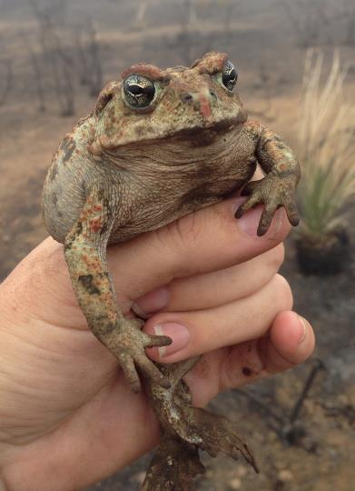
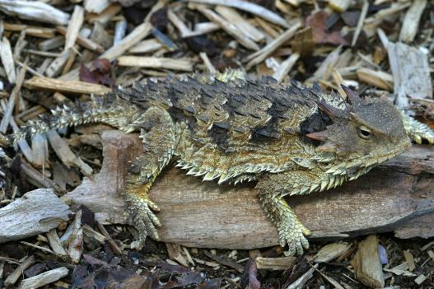
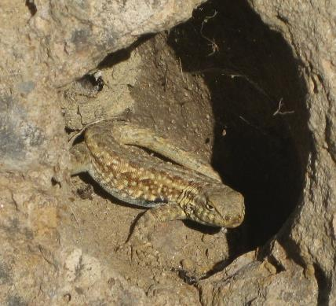
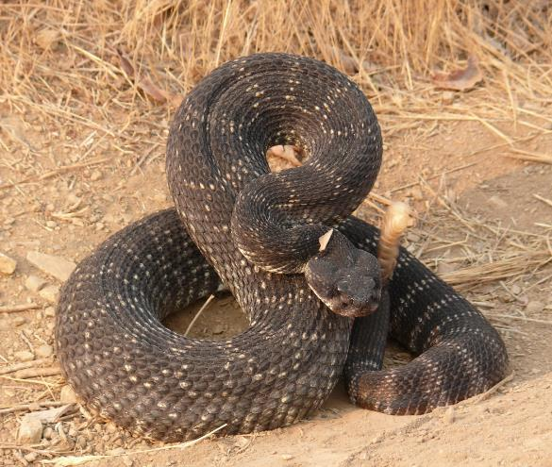
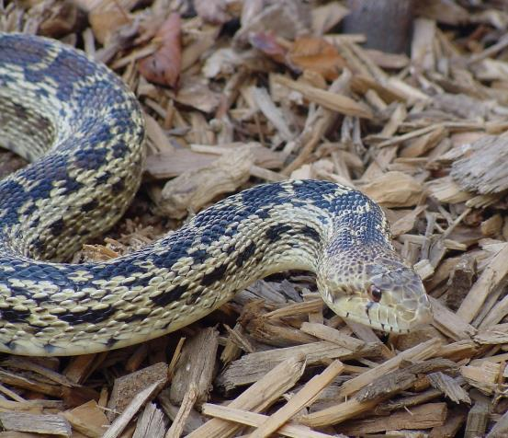
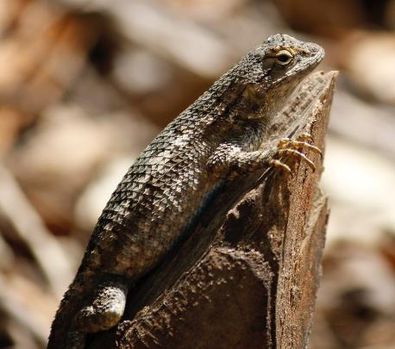
Animals of the Chaparral
Reptiles & Amphibians
Coast Horned Lizard
Western Toad
Side-Blotched Lizard
Gopher Snake
Pacific Rattlesnake
Western Fence Lizard
(Photos: NPS)
Notes:
“Reptiles encompass a range of animals that include turtles, lizards, and snakes. Twenty-five species of reptiles inhabit the Santa Monica Mountains. They inhabit a variety of habitats, including chaparral, coastal sage scrub, grasslands, oak woodlands, and riparian areas.
Reptiles are referred to as "cold-blooded" (or ectothermic) animals because they cannot maintain their body heat. Instead, they rely on gathering and losing heat from the environment. On nice, warm days in the Santa Monica Mountains, a variety of reptiles, including Western fence lizards, side-blotched lizards, and Coastal whiptails, can be seen sunning on rocks or in the middle of dirt trails. An advantage of being "cold-blooded" is that it allows reptiles to survive on much less food than "warm-blooded" animals such as mammals and birds that need to burn much of their food for warmth.
Most reptiles are oviparous (egg-laying), although some are also capable of giving live birth. The southern Pacific rattlesnake is the only reptile in the Santa Monica Mountains that gives birth to live young.” (NPS, n.d.e)
“Amphibians encompass a range of animals that include newts, salamanders, frogs and toads. Ten species of amphibians reside in the Santa Monica Mountains. They inhabit a variety of habitats, including grasslands, chaparral, and riparian areas.
Amphibians spend a portion of their life cycle in both aquatic and terrestrial ecosystems. In the Santa Monica Mountains, juvenile amphibians live the first part of their lives in the water before metamorphosing into adults. Adult amphibians spend most of their lives on land and return to the water to breed and reproduce.
Since most amphibians have a two-stage life cycle (in water and on land) and have the ability to absorb water and oxygen from their environment through their skin, amphibians are more sensitive to changes in their environment. Because of this, amphibians are recognized worldwide as an indicator of ecosystem health.
Unfortunately, amphibians are suffering dramatic declines due to habitat destruction and modification, over-exploitation, pollution, introduced species, climate change, increased ultraviolet-B radiation (UVB) and disease.” (NPS, n.d.a)
Note about the Western Toad picture: This photo is from a trained scientist. Please do not pick up Frogs or any Amphibians because they breath through their skin and picking them up incorrectly without proper training may harm them.
More photos of Santa Monica Mountains Lizards: https://www.flickr.com/photos/santamonicamtns/albums/72157655592782599/with/11938619505/
More photos of Santa Monica Mountains Frogs: https://www.flickr.com/photos/santamonicamtns/albums/72157655592440298
More photos of Santa Monica Mountains Snakes: https://www.flickr.com/photos/santamonicamtns/albums/72157655980683192

Slide 19
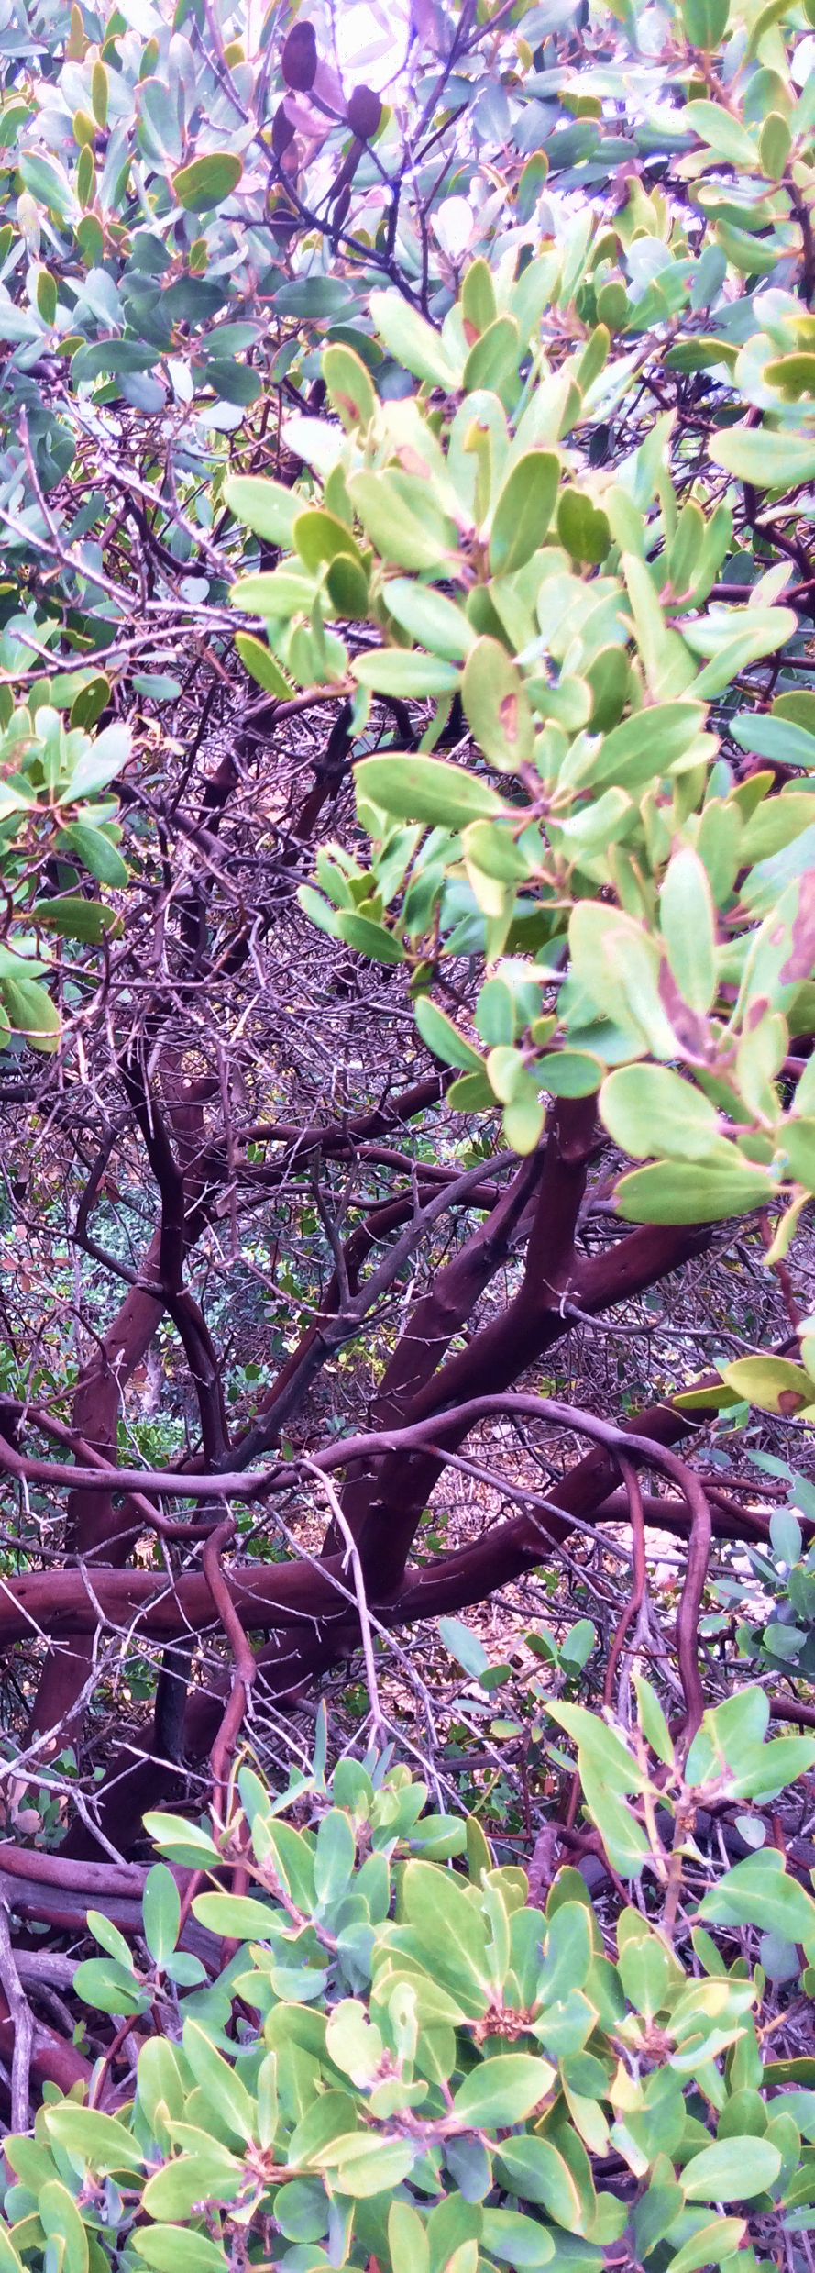
Why is Chaparral Important?
Biodiversity! Chaparral plants make up 25% of the state’s native plant species, of which almost half are endemics (only found in CA)
Water provision: Shrubs capture water to help replenish underground stores
Erosion control: Roots hold the soil to help prevent erosion
Carbon storage: helps regulate the warmth of the atmosphere & releases oxygen
Recreation: Provides a beautiful and peaceful place to experience California naturally
Manzanita
Valuing Chaparral Video
(Photo: Bethany Szczepanski)
(Litman, 2013)
Notes:
Click the link to view a 6 minute video about the value of chaparral in southern Cailifornia.
“Chaparral provides critical watershed necessary to maintain our quality of life. Without the shrubs, rain would slam into the ground with greater energy, causing increased levels of erosion and flooding, which would have a negative impact on water quality, drainage infrastructure, and waterways. Grass covered slopes do not provide the same benefits as deep rooted shrubbery… (Halsey, 2008, p. xx).

Slide 20
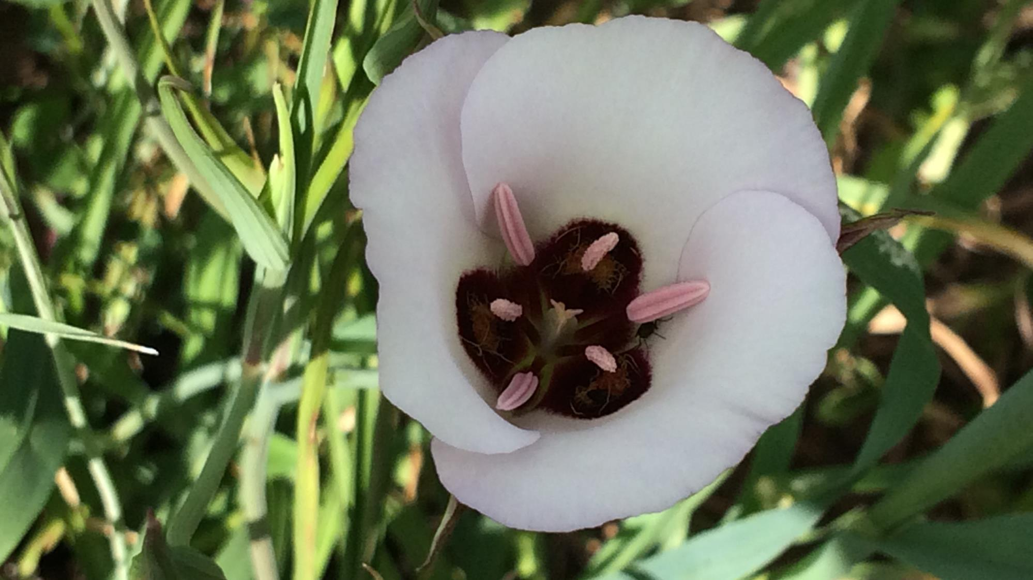
Why is Chaparral Important?
“Besides providing a wide variety of ecosystem services (watershed protection, biodiversity, [wildlife] habitat, aesthetics, etc.), chaparral defines California like no other plant community.”
–Richard Halsey
Catalina Mariposa Lily
(Halsey, 2011; Photo: Bethany Szczepanski)

Slide 21
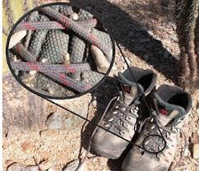
Threats to Chaparral
“Due to a combination of threats, shrublands are some of the most endangered and least protected plant communities in California” (Litman, 2013, p. 3).
Threats:
Habitat Loss due to development
Invasive species
Fragmentation
Degradation of the ecosystem
Increased fire frequency
Invasive plant species can be spread by carrying seeds in your shoes or clothing. Check yourself, your equipment, and your pets before taking a hike.
(Litman, 2013; Photo: NPS)
Notes:
“It’s one of the iconic landscapes of California, yet chaparral lacks respect. Dismissed as “brush” or “weedy,” these important native shrublands are under siege by some very serious threats: development, fire, nonnative plant invaders, and a changing climate” (Litman, 2013, p. 2).
Habitat loss and fragmentation in the Santa Monica Mountains:
“The Santa Monica Mountains are nearly isolated from the other natural areas in Southern California by the surrounding urban and agricultural lands. In addition, ongoing development throughout the mountains is subdividing the remaining landscape. Continued habitat loss and fragmentation threatens the long-term existence of many native species and is one of the greatest threats facing biodiversity protection. Larger mammals, such as mountain lions, bobcats, and badgers, are particularly at risk and may be vulnerable to extinction by chance demographic, environmental, and genetic events in fragmented areas. Conservation biologists recognize that protecting large core habitat areas is the most effective way to counter fragmentation effects. Further, maintaining or re-establishing connections between large areas would help prevent isolation of wildlife populations” (NPS, n.d.b).
Non-native and Invasive Species :
“ Another suite of successful plants did not evolve as part of the native chaparral community. Most of the common grasses in California are nonnative invasives. Their lifecycles
are different from those of native plants and their impacts on the chaparral community can be devastating. Nonnative grasses dry out before summer, creating a fuel source that increases the risk and frequency of wildfire. Grasses are often successful early colonizers after fire but their root systems are not as effective as native species at stabilizing the soil, so there is greater potential for erosion and mudslides when the rains come. A healthy chaparral ecosystem is resilient and will recover from wildfire. The presence of nonnative plants makes recovery more difficult” (Litman, 2013, p. 6).
Non-native and Invasive Species in the Santa Monica Mountains:
“Non-Native Species pose a risk to the fragile Mediterranean habitats of the Santa Monica Mountains National Recreation Area.
Plants and animals that originated outside of California have made their way into the Santa Monica Mountains. These species are, in many ways, destroying the native species populations unique to this ecosystem. These “non-native” or “invasive” species out compete the locals for resources such as food, water or space, and demonstrate superior competitive abilities in areas influenced by human activity.”
Plants
“Non-native plants comprise over 25% of the Santa Monica Mountains flora. Urbanization, increase in recreational activities and fire, amongst others, are factors that facilitate the introduction and spread of non-native species in the Santa Monica Mountains National Recreation Area.”
“You can help the park reduce the number of non-native plants introduced to park lands by checking your pets, recreational equipment and boots for stray seeds and fruits that are caught on fabric. Even visiting between areas within the park can spread unwanted invasive seeds!”
Animals
“Non-native animals can also be devastating to parklands. These animals can degrade natural habitats, prey on native species and off-set ecosystem balance. They can spread disease, non-native plant seeds and eat key predators or producers.” (NPS, n.d.d)

Slide 22
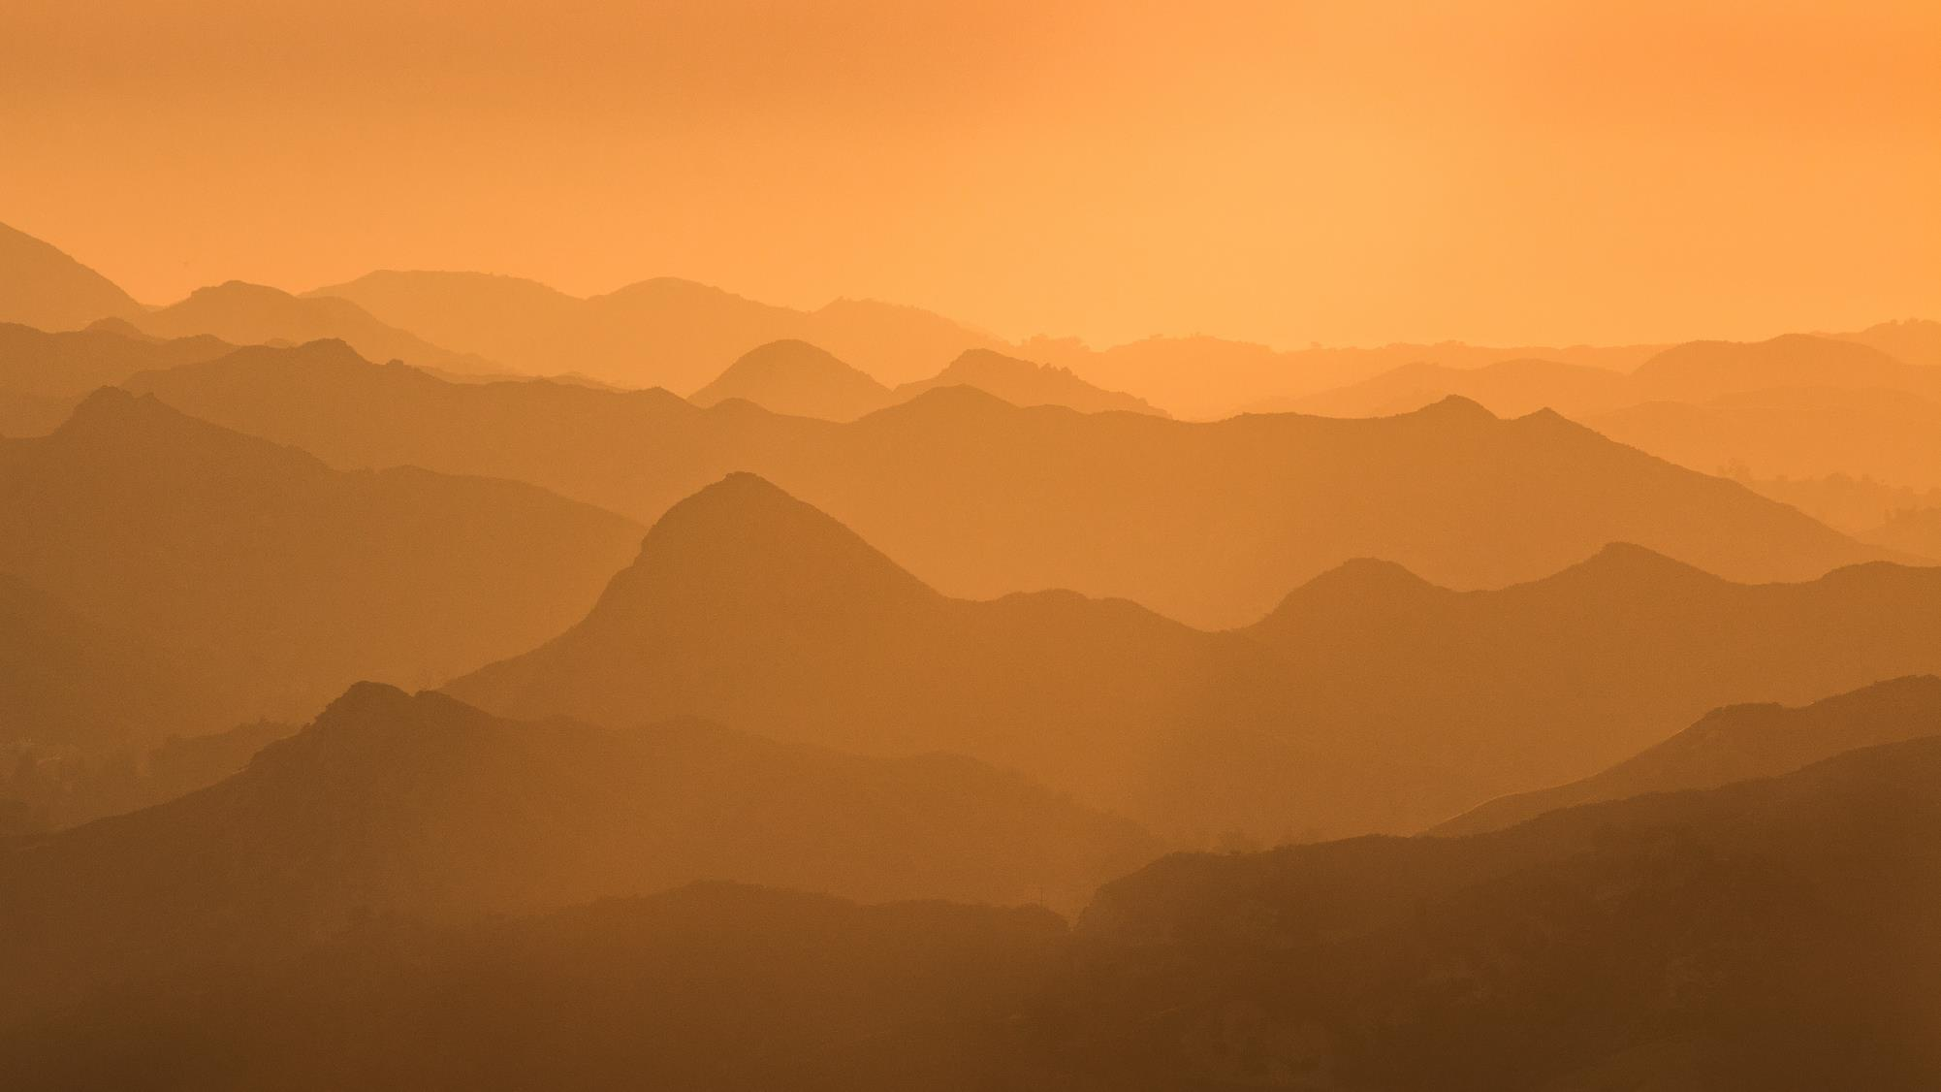
Questions for Thought
How much wilderness, open space, and natural heritage do you want remaining 100 years from now?
Do wild places like chaparral have value?
Can open spaces & wilderness make a positive contribution to your family’s quality of life?
What can you do to help the chaparral?
(Image: NPS)
Notes:
Image from: https://www.flickr.com/photos/santamonicamtns/37487091226/in/album-72157686371601046/

Slide 23
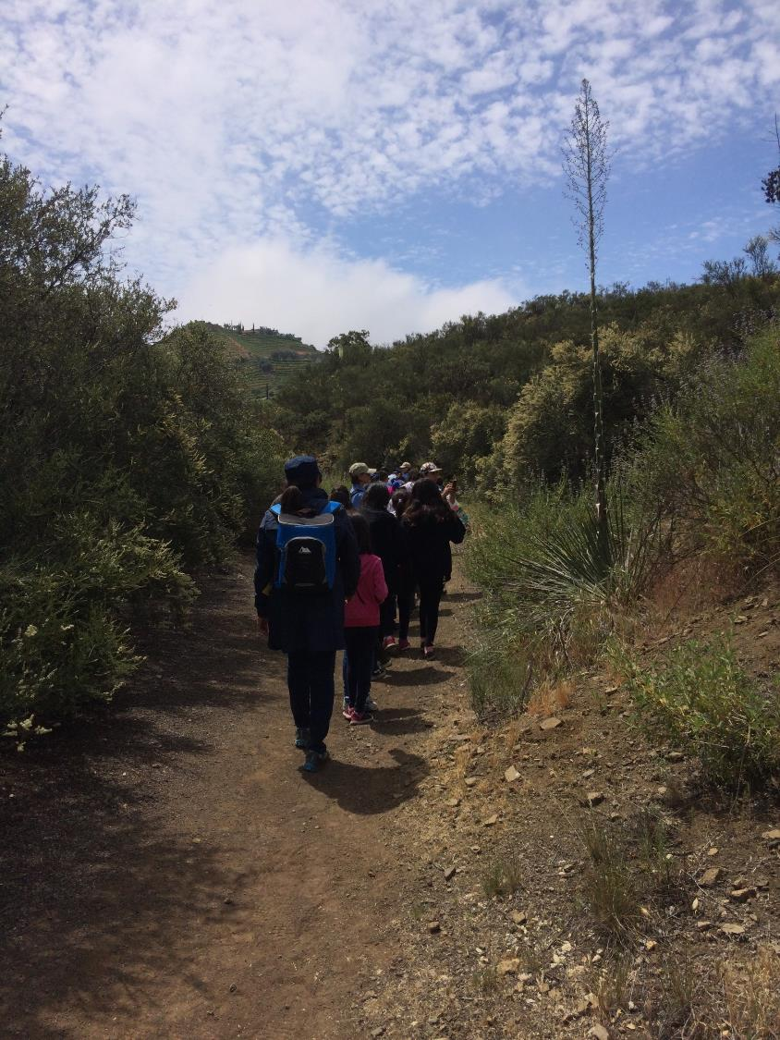
Closing Thoughts
“By recognizing and being able to identify native species and their surrounding environment, we begin to see their habitat as worthy of attention and stewardship. Wild space becomes our space as well.”
Students hike through the Chaparral on a Santa Monica Mountains Field Trip
(Photo: Bethany Szczepanski)
(Halsey, 2008, p. 133)
Notes:
Thank you for learning about Chaparral Plant Communities. To continue your journey into Santa Monica Mountains National Recreation Area: Fire Ecology continue on to the Wildfires: Natural History unit.

Slide 24
References
Calflora. (n.d.). Plant communities. Retrieved May 15, 2018, from http://www.calflora.net/botanicalnames/plantcommunities.htmlCalifornia
Chaparral Institute (CCI). (n.d.a). Plants and animals of the chaparral. Retrieved March 22, 2018, from http://www.californiachaparral.org/chaparralfacts/cplantsanimals.html
California Chaparral Institute (CCI). (n.d.b). Fire and nature. Retrieved April 07, 2018, from http://www.californiachaparral.org/fire/firenature.html
California Chaparral Institute (CCI). (n.d.c). Where to find chaparral. Retrieved April 04, 2018, from http://www.californiachaparral.org/chaparralfacts/awheresthechaparral.html
California Chaparral Institute (CCI). (2009). The chaparral habitat: For young chaparralians. The Chaparralian,6(3). Retrieved from http://www.californiachaparral.com/images/CHAP_32_Learning_Chaparral_Habitat.pdf
Halsey, R. W. (2008). Fire, chaparral, and survival in southern California. San Diego, CA: Sunbelt Publications.
Halsey, R. W. (2011). Chaparral as a natural resource: Changing the conversation about chaparral and fire. In California Native Plant Society 2009 Conservation Conference Procedings Strategies and Solutions (pp. 82-86). Sacramento, CA: California Native Plant Society.
Litman, L. (Ed.). (2013). California’s native landscape. Forestland Steward, Summer 2013. Retrieved March 21, 2018, from http://calfire.ca.gov/foreststeward/pdf/news-summer2013.pdf
National Park Service (NPS). (n.d.a). Amphibians. Retrieved April 07, 2018, from https://www.nps.gov/samo/learn/nature/amphibians.htm
National Park Service (NPS). (n.d.b). Habitat Loss and Fragmentation. Retrieved April 07, 2018, from https://www.nps.gov/samo/learn/nature/habitatloss.htm
National Park Service (NPS). (n.d.c). Mammals. Retrieved April 07, 2018, from https://www.nps.gov/samo/learn/nature/mammals.htm
National Park Service (NPS). (n.d.d). Non-native Species. Retrieved April 07, 2018, from https://www.nps.gov/samo/learn/nature/nonnativespecies.htm
National Park Service (NPS). (n.d.e). Reptiles. Retrieved April 07, 2018, from https://www.nps.gov/samo/learn/nature/reptiles.htm
Spira, T. (2011). Wildflowers and plant communities of the southern Appalachian Mountains and Piedmont: A naturalist's guide to the Carolinas, Virginia, Tennessee, and Georgia (1st ed., Southern gateways guide). Chapel Hill [N.C.]: University of North Carolina Press.
Taylor, R. S. (n.d.). Fire regime, fire history, and fire behavior in the Santa Monica Mountains [PowerPoint slides].
Zimmerman, E., Davis, T., Podniesinski, G., Furedi, M., McPherson, J., Seymour, S., . . . Fike, J. (Eds.). (2012). Terrestrial & Palustrine Plant Communities of Pennsylvania, 2nd Ed. Pennsylvania Natural Heritage Program, Pennsylvania Department of Conservation and Natural Resources, Harrisburg, Pennsylvania. Retrieved April 04, 2018, from http://www.naturalheritage.state.pa.us/Communities.aspx

